Slide 1
Regular Meeting Report
Nguyen Duy Linh
ndlinh301@mail.ulsan.ac.kr
Mar. 20, 2024

Slide 2
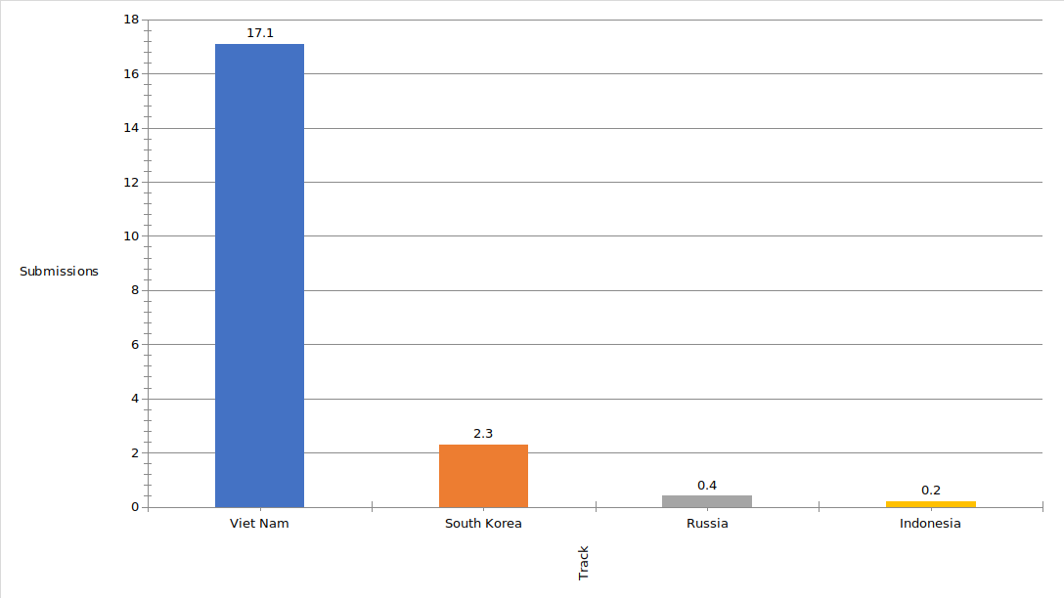
Last Week
CITA 2024 conference paper:
Review process: almost finished
Deadline: Mar. 21st
Note: Additional review via email

Slide 3
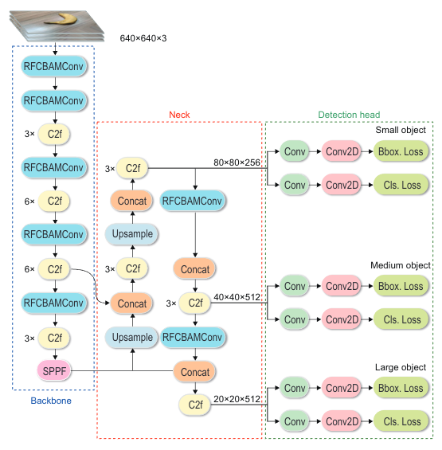
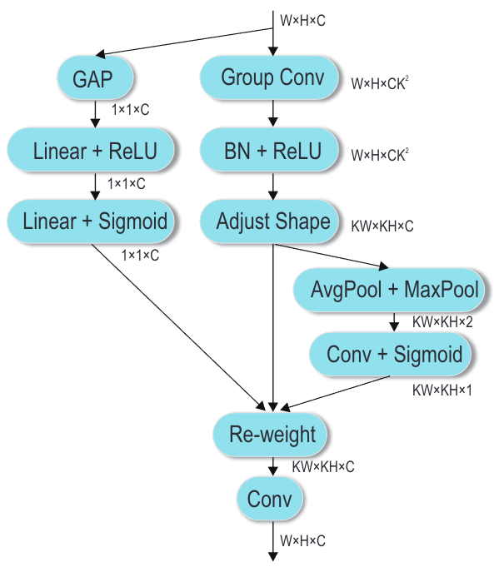
Last Week
ISIE 2024 conference paper:
Writing the manuscript (Cont.)
Abstract section (Finished)
Introduction section (Finished)
Related work section (Finished)
Proposed method section (Going on)

Slide 4
Last Week
ISIE 2024 conference paper:
Collect the dataset for Pothhole and Manhole cover dataset
Training the fine-tune YOLOv8 on this dataset
Dataset source: Computer Vision Based Pothole Detection under Challenging Conditions, Sensors 2022

Slide 5
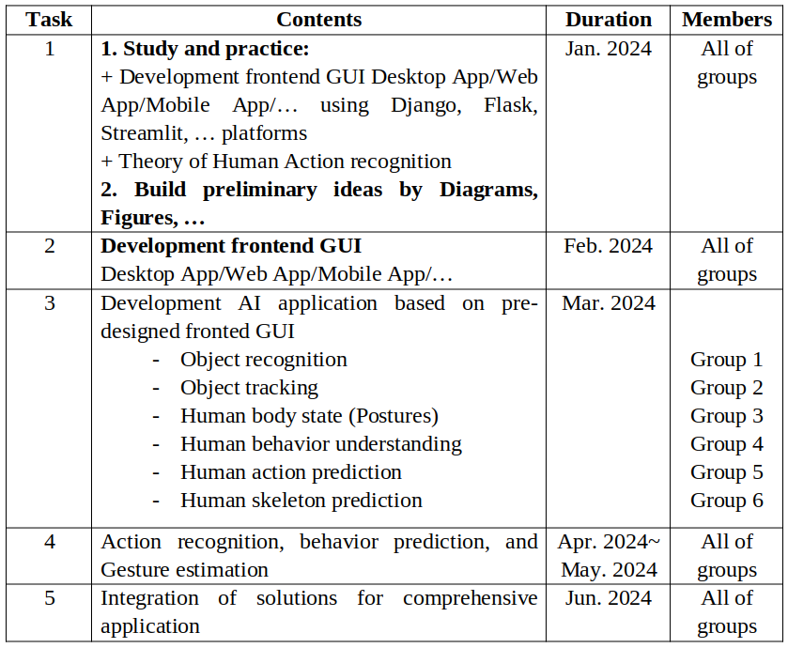
Last Week
Project work
Completed the report
Checked the details of each member
Details: 01 no report, 11 reports via email
Fix the errors with multi-cameras
Looking for several free web server and deploying the application on them -> But, it isn’t successful

Slide 6
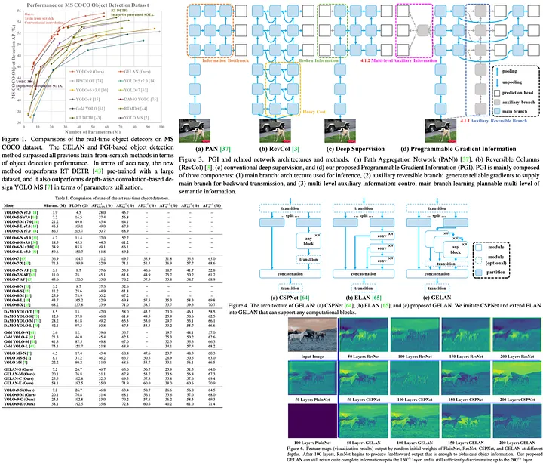
Last Week
Seminar
YOLOv9: Learning What You Want to Learn Using Programmable Gradient Information
New techniques:
A novel concept named Programmable Gradient Information (PGI)
A new lightweight network architecture called Generalized Efficient Layer Aggregation Network (GELAN)

Slide 7
This Week
Project work
Report to professor
Fix the code for connecting multi-cameras and deploy the AI application on the free server
ISIE 2024
Finish writing the manuscript
Double-check with Thuy, Andri’s help
Submit to system (TT09 track)
IWIS 2024
Finish training with fine-tune YOLOv8
Try to train and evaluate with YOLOv9
Make the tables, figures, ablation studies

Slide 8
Thank you for your attention!

