Slide 1
Regular Meeting
Youlkyeong Lee
yklee00815@gmail.com
Feb 27 , 2024

Slide 2
Activities
Last Week
IW-FCV2024
Title: Efficient Vehicle Status Network with Adaptive Adversarial Learning
This Week
Journal
TII_1: Data-Driven Vehicle Status Classification for Urban Traffic Monitoring
E. Ablation Studies
Study for Adaptive Weighted Losses (Complete)
Study for Combination of Modules (Complete)
Study for Global Feature Extraction Module (Complete)
Runtime Analysis (Complete)
F. Qualitative Results (until this week)
Set of result images
Graph for Specificity-Precision, Sensitivity-Precision, Specificity-F1, Sensitivity-F1 Distribution
G. Discussion (Complete)

Slide 3
Thank you for your attention!

Slide 4
Overall Process

Slide 5
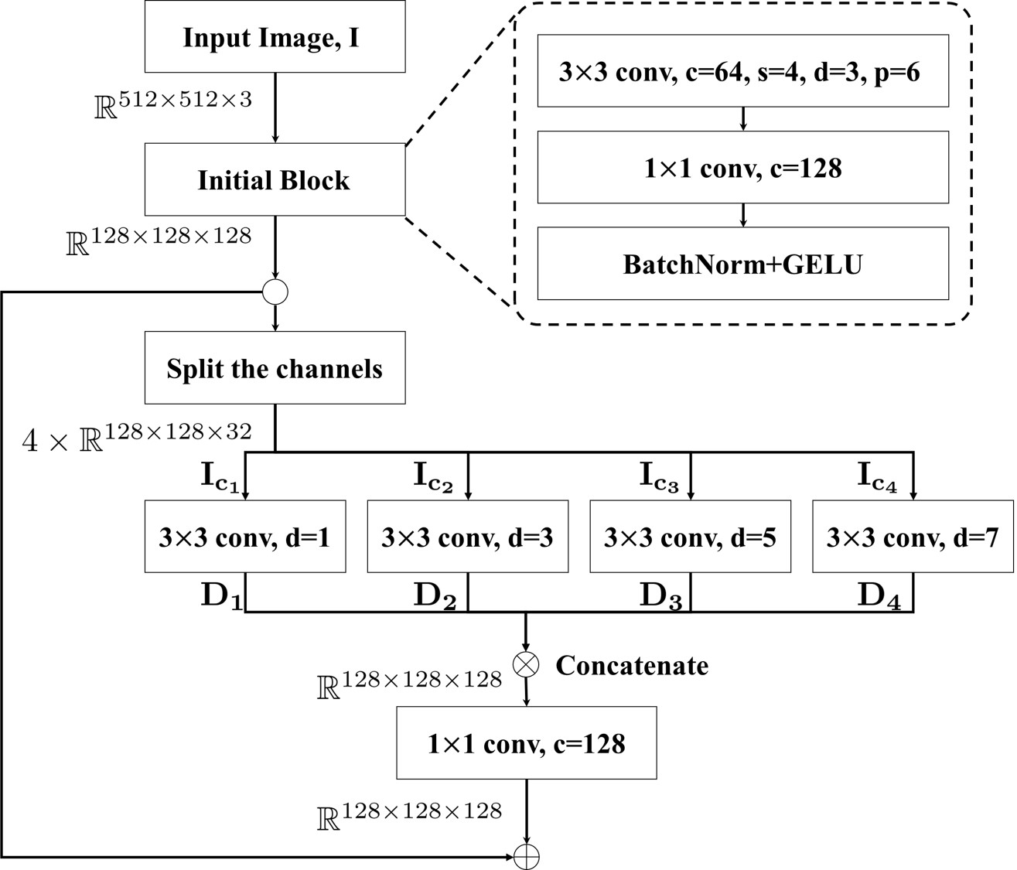
Wide Area Feature Extraction Module

Slide 6
Dynamic Local Feature Extraction + Global Feature Extraction

Slide 7
Dynamic Local Feature Extraction Module

Slide 8
Global Feature Extraction Module

Slide 9
Dataset
UAVDT
Unmanned Aerial Vehicle Benchmark Object Detection and Tracking
" The Unmanned Aerial Vehicle Benchmark: Object Detection and Tracking", European Conference on Computer Vision (ECCV), 2018.
Number of Images: 40,376
Train: 35,000
Val: 5,376
UOU Drone based Vehicle Status Dataset
Class: Stop, Safe, Lane change
Number of Images: 14,906

Slide 10
Patch based Feature Extraction
Applied Self-Attention for global pattern extraction

Slide 11
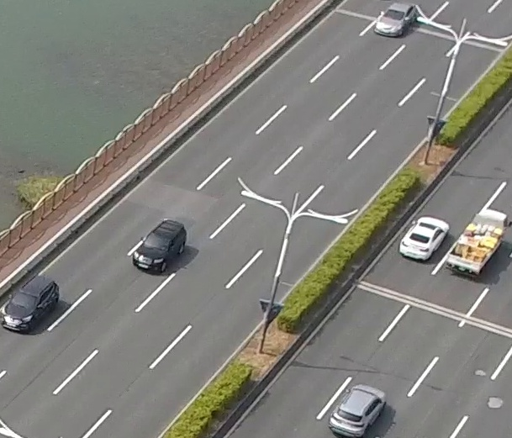
Deformable Residual Module
Target vehicle
Wide Area Feature Extraction Module
Patch based Feature Extraction Module
Input: Cropped image
Vehicle State: Normal

Slide 12
ACIIDS2023

Slide 13
ACIIDS2023

Slide 14
ACIIDS
Soft label assignment
Soft label
N=4
Hard label
distribution
K=4

Slide 15
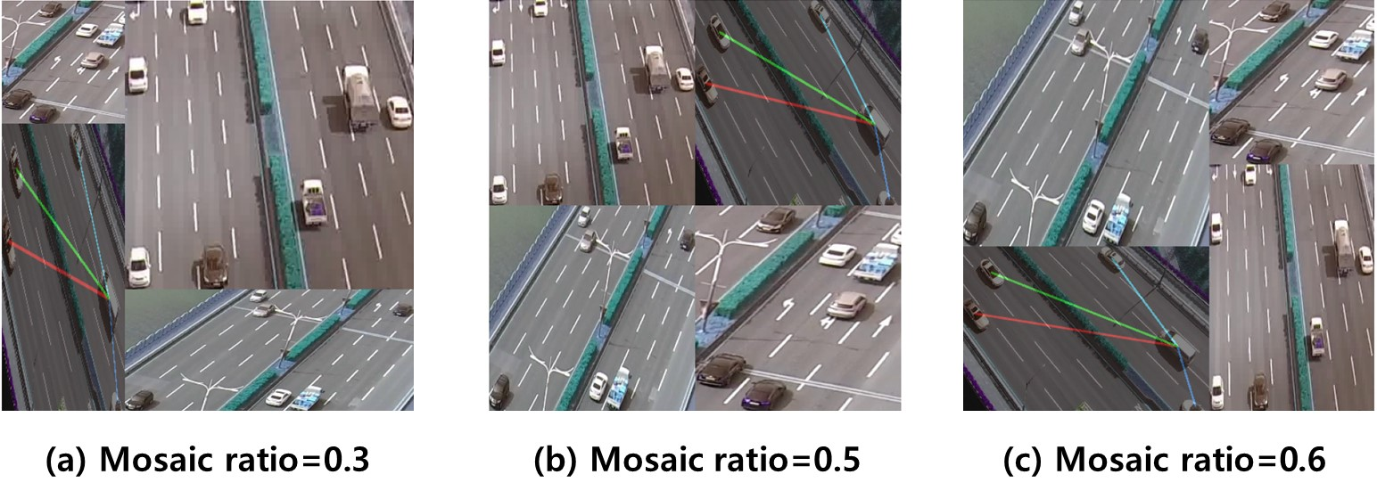
ACIIDS2023
Mosaic augmentation

Slide 16
Journal
Title: Object Detection for Drone Aerial Image Dataset
Introduction(writing, Jan 1st week)
Related Work(preparing, Jan 1st week)
Object Detection Datasets
Drone Image Datasets
Object Detection Methods
Proposed Specification for Object Detection Dataset (Jan 2nd week)
Object detection Dataset
Evaluation
Requirement
Method
Dataset Statistic and Evaluation
Data Distribution
Ablation Study
Evaluation for CNN Object Detection Algorithms
Discussion & Conclusion

Slide 17
List of data
Tourist | # of images | City | # of images
관광지_202007211651_60m_울산_대왕암공원_카메라_45도_2 | 9,821 | 도심지_202007171310_80m_대구_금호지구_카메라_90도_1 | 9,021
관광지_202008121612_40m_대구_두류공원_카메라_45도_1 | 9,022 | 도심지_202007171310_80m_대구_금호지구_카메라_90도_2 | 9,022
관광지_202008121612_40m_대구_두류공원_카메라_45도_2 | 9,021 | 도심지_202007171454_60m_대구_금호지구_카메라_45도_1 | 9,022
관광지_202008291720_60m_대구_수성못_카메라_45도_3 | 9,022 | 도심지_202007171454_60m_대구_금호지구_카메라_45도_2 | 9,021
관광지_202008291739_60m_대구_수성못_카메라_45도_2 | 9,021 | 도심지_202007171527_80m_대구_금호지구_카메라_45도_1 | 9,022
관광지_202008291803_60m_대구_수성못_카메라_45도_1 | 9,022 | 도심지_202007171527_80m_대구_금호지구_카메라_45도_2 | 9,021
관광지_202008291824_60m_대구_수성못_카메라_45도_2 | 9,022 | 도심지_202007201627_30m_울산_태화교_카메라_15도_1 | 9,818
관광지_202008311434_60m_울산_대왕암공원_카메라_45도_1 | 9,818 | 도심지_202008121144_60m_대구_금호지구_카메라_90도_1 | 9,021
관광지_202008311434_60m_울산_대왕암공원_카메라_45도_2 | 9,820 | 도심지_202008121144_60m_대구_금호지구_카메라_90도_2 | 9,021
관광지_202009211145_70m_울산_대왕암공원_카메라_45도_1 | 16,794 | 도심지_202008281521_70m_태화교_카메라_60도_1 | 16,834
관광지_202009211145_70m_울산_대왕암공원_카메라_45도_2 | 16,672 | 도심지_202008281521_70m_태화교_카메라_60도_2 | 16,170
관광지_202010211029_30m_울산_대왕암공원_카메라_50_1 | 9,819 | 도심지_202009081129_80m_대구_동성로_카메라_45도_2 | 9,022
관광지_202010211029_30m_울산_대왕암공원_카메라_50_2 | 9,822 | 도심지_202009081153_80m_대구_동성로_카메라_45도_2 | 9,021
관광지_202010211109_30m_울산_대왕암공원_카메라_50_1 | 9,818 | 도심지_202009190914_60m_제주_누웨마루거리_카메라_45도_1 | 8,723
관광지_202010211109_30m_울산_대왕암공원_카메라_50_2 | 9,822 | 도심지_202009190914_60m_제주_누웨마루거리_카메라_45도_2 | 4,954
Total | 156,336 | 도심지_202009220743_30m_제주_누웨마루거리_카메라_45도_1 | 8,724
 |  | 도심지_202009220743_30m_제주_누웨마루거리_카메라_45도_2 | 3,772
 |  | 도심지_202009231327_30m_제주_누웨마루거리_카메라_90도_1 | 8,723
 |  | 도심지_202009231327_30m_제주_누웨마루거리_카메라_90도_2 | 4,350
 |  | Total | 172,282

Slide 18
Semi-Supervised Learning with Faster R-CNN
Strategy
Model: Faster R-CNN
Predicting result = Generating pseudo label
Input: unlabeled images
Computing the loss for unlabeled data
Model(input, pseudo label)
Input: unlabeled images
Computing the loss
Backpropagation for updating weights
Train with labeled data
Model(input, labeled data)
Input: labeled images / labeled data: annotations
Computing the loss
Backpropagation for updating weights
Repeat

Slide 19
IW-FCV 2023
 | 4K FPS with Area_3,000 | 4K FPS with Area_4,000 | FHD FPS with Area_3,000 | FHD FPS with Area_4,000
Computer: AMD Ryzen 9 3900XT 12-Core Processor | 36.8 | 39.0 | 107.3 | 117.5
Jetson Nano: Quad-core ARM Cortex-A57 MPCore processor | 6.3 | 7.1 | 19.8 | 21.0
Raspberry Pi 4 Model B Rev 1.5: Quad-core A72 64-bit | 8.6 | 9.1 | 24.1 | 26.7

Slide 20
Area
Area: W$×$H(Detected bounding box)
W
H

