Slide 1
SpectFormer: Frequency and Attention is what you need in a Vision Transformer Badri Narayana Patro Microsoft, Vinay P. Namboodiri University of Bath, Vijay Srinivas Agneeswaran Microsoft
Russo Mohammad Ashraf Uddin
ashrafrusso@gmail.com
February 24th, 2024

Slide 2
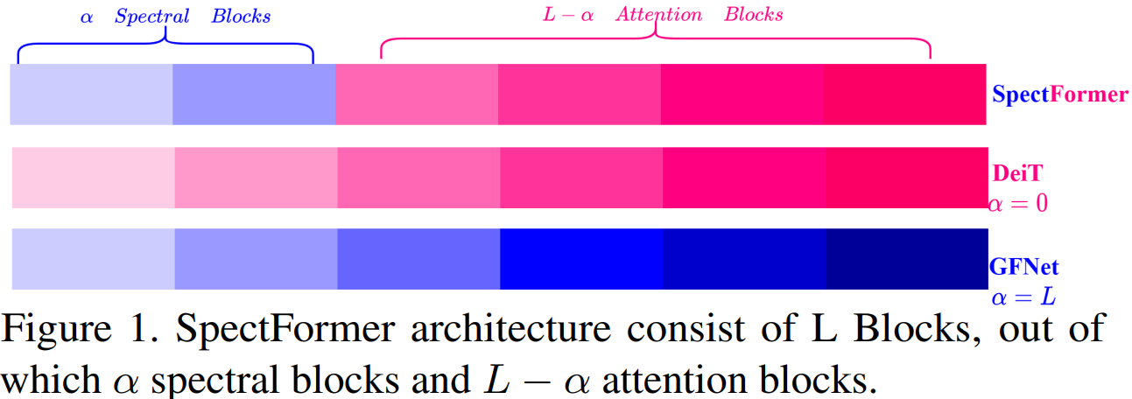
Introduction
This Paper presents a method to analyze the Frequency Components in the similar fashion of Attention Calculation

Slide 3
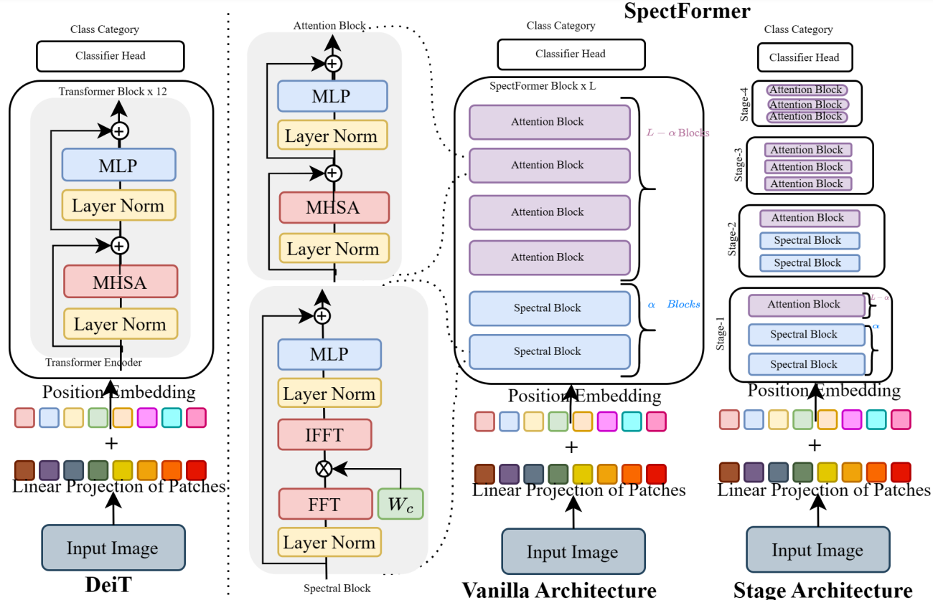
Overall Architecture of SpectFormer

Slide 4
Example: Attention Block Vs SpectralBlock
Input Shape: (Batch, N, dim)

Slide 5
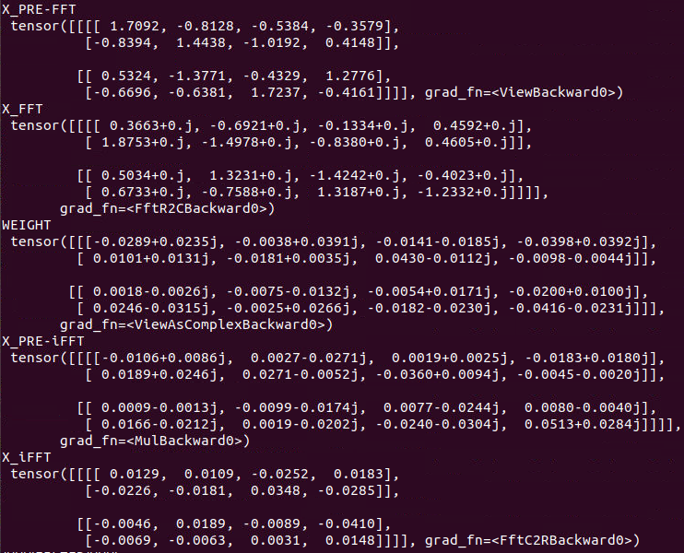
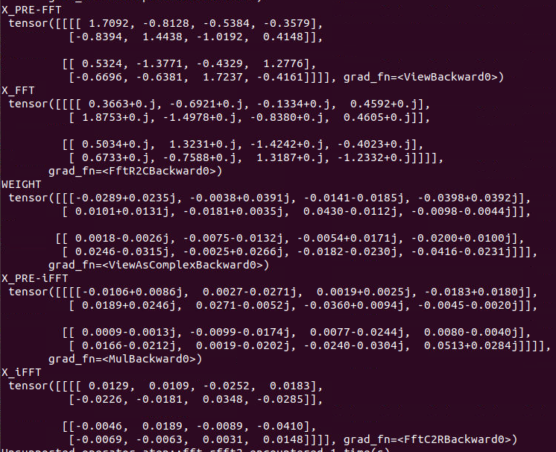
FFT Example

Slide 6
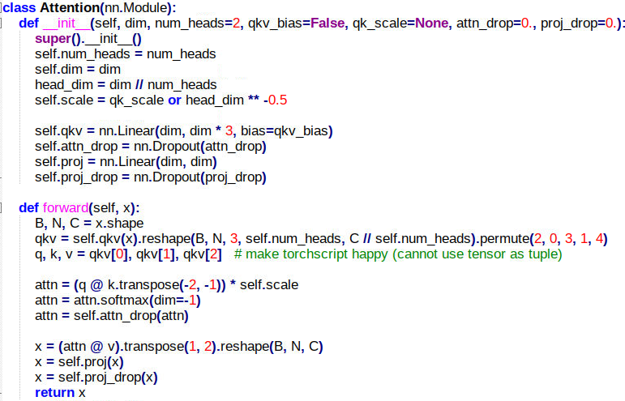
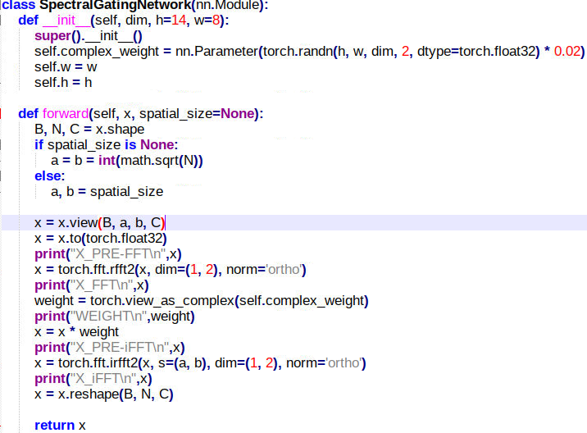
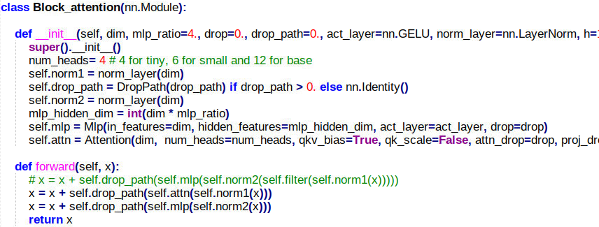
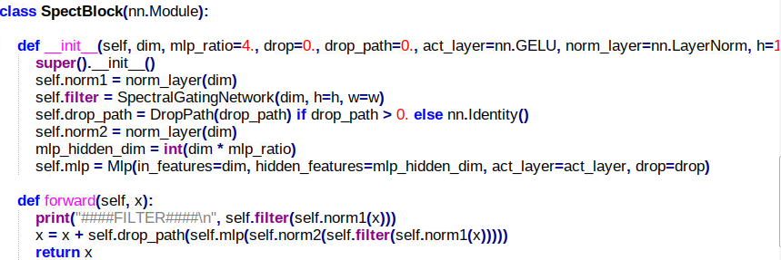
Code Comparison

Slide 7
Architecture Details of Hierarchical SpectFormers

Slide 8
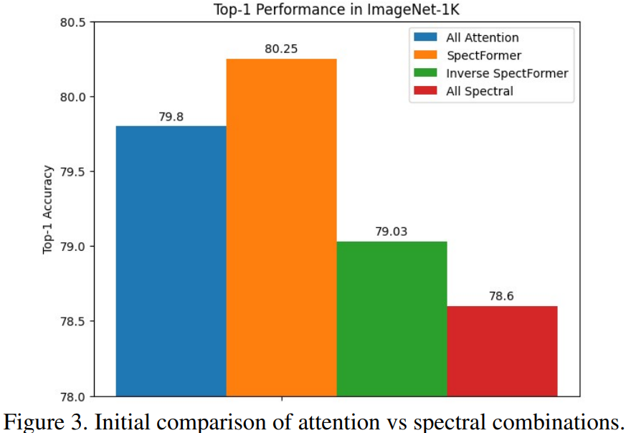
Attention Vs Spectral Combinations

Slide 9
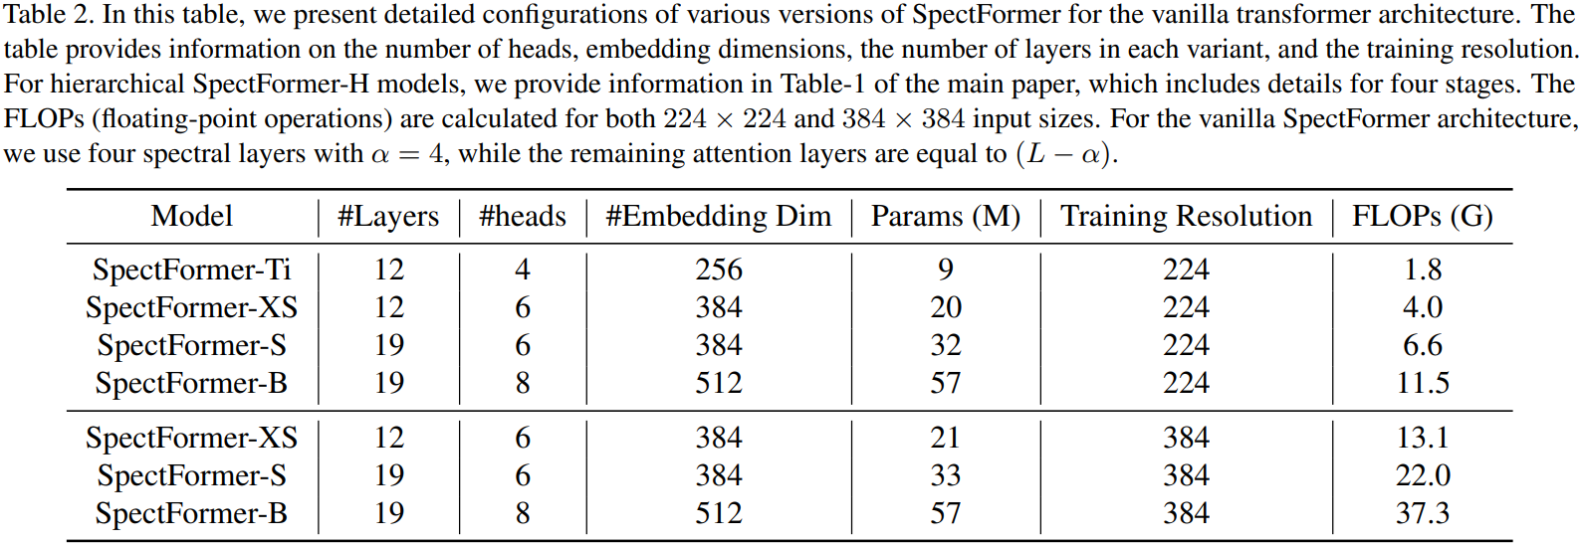
Hyperparameter Details of Vanilla and Hierarchical Architectures

Slide 10
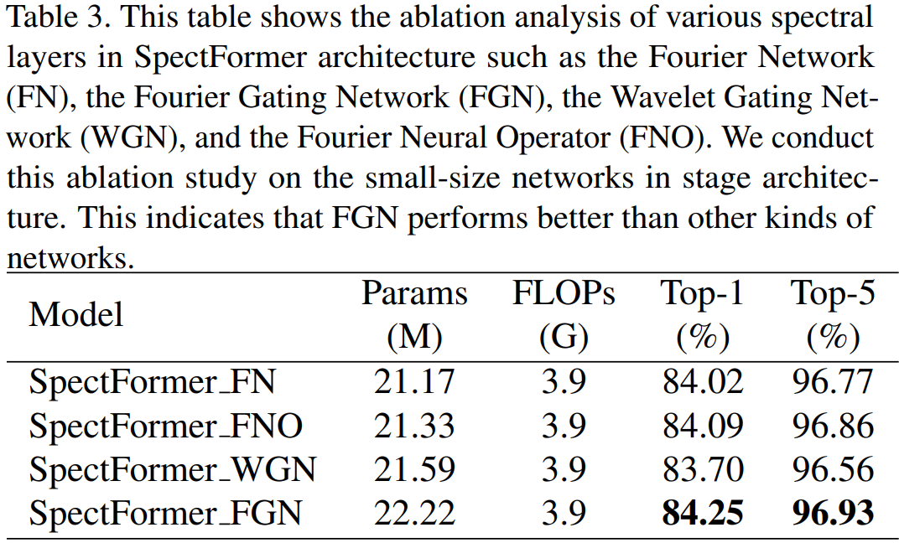
Ablation Study: Various Frequency-Based Networks

Slide 11
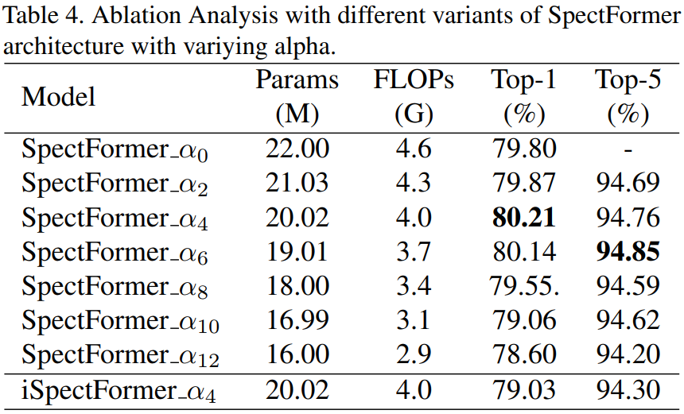
Ablation of Alpha: Ration Between Frequency and Attention Components

Slide 12
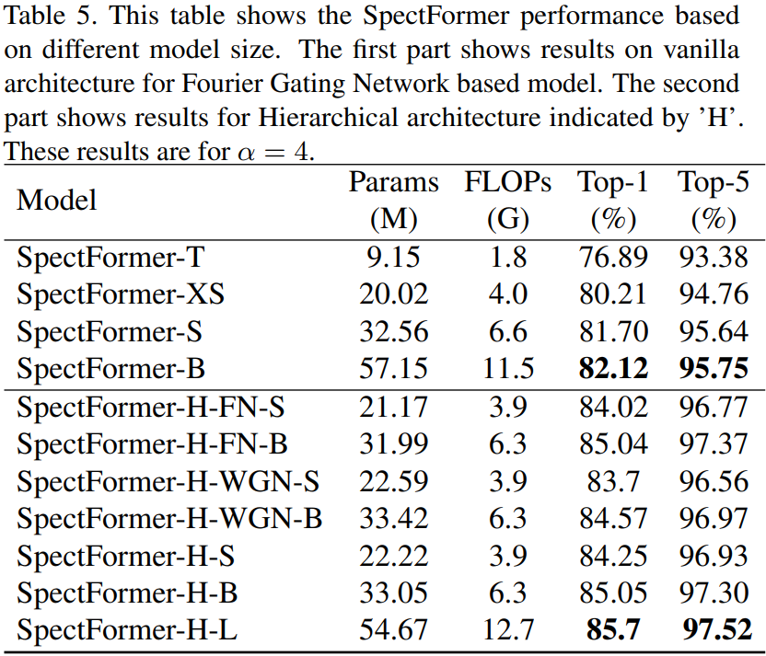
Results on Imagenet-1k Classification of all variants

Slide 13
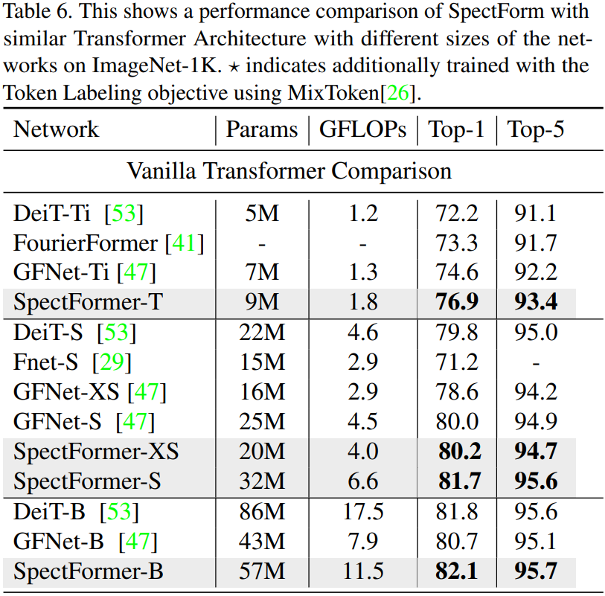
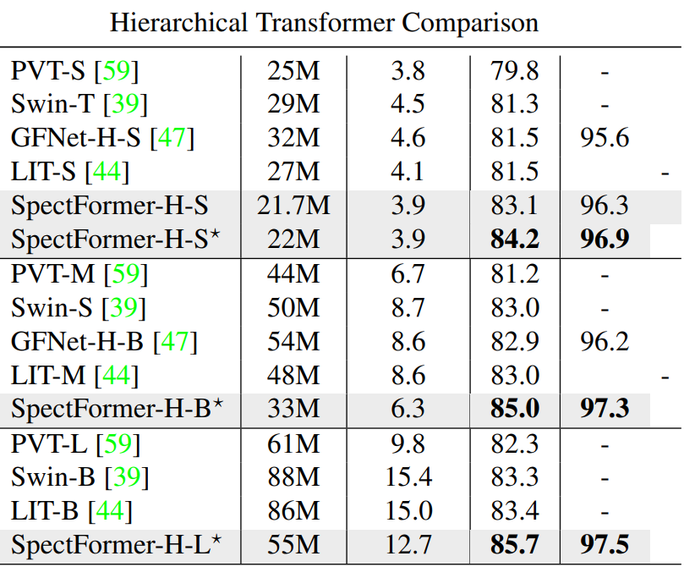
Similar Transformers Comparison on Imagenet-1k Classification

Slide 14
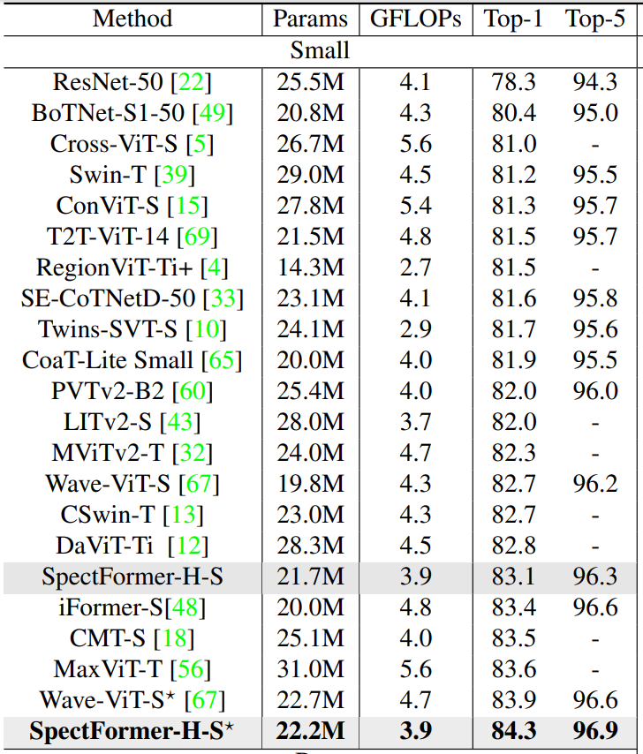
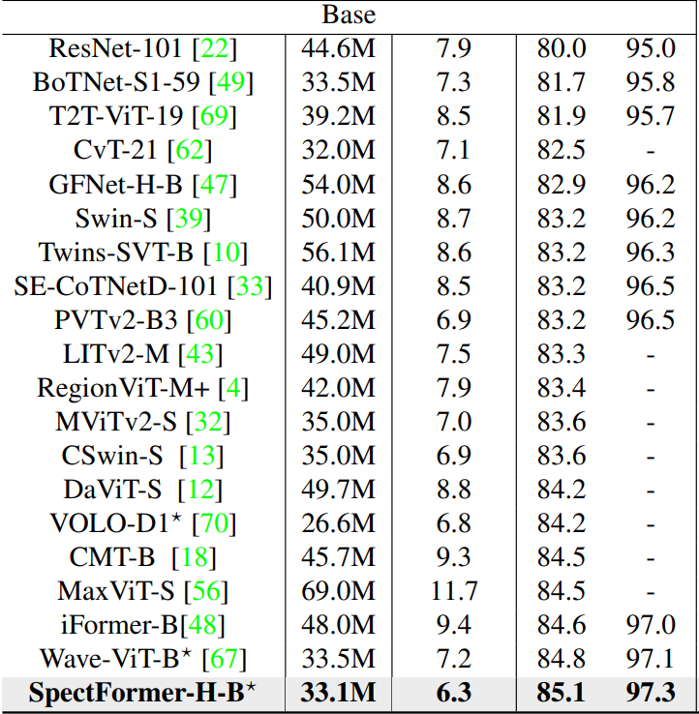
ImageNet 1k Results Comparison

Slide 15
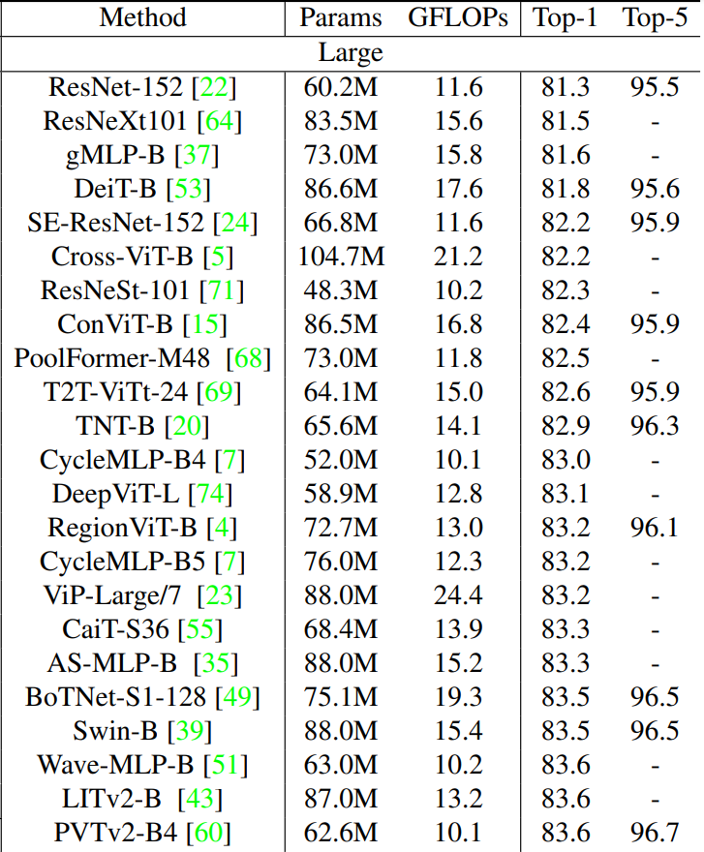
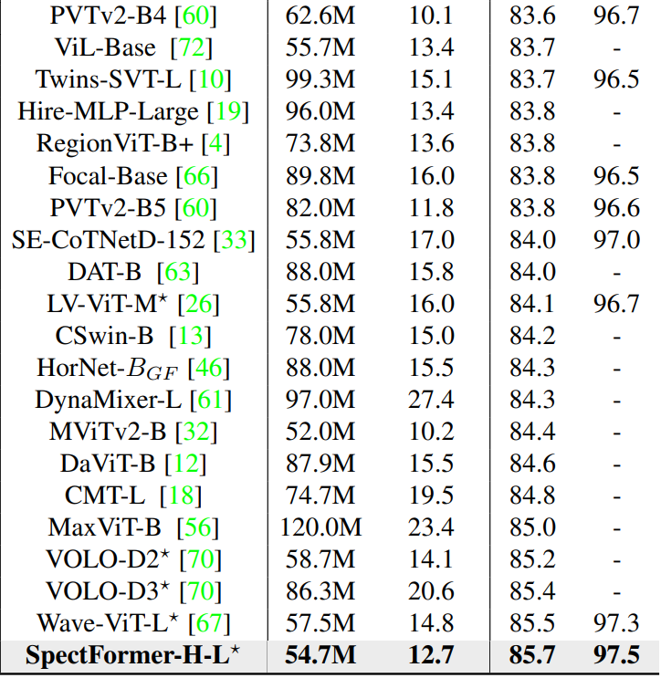
ImageNet 1k Results Comparison

Slide 16
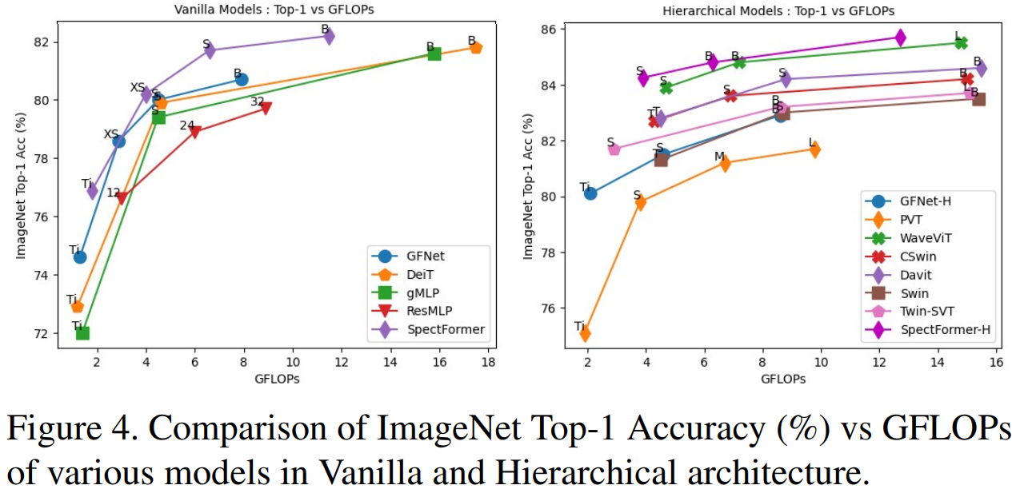
Accuracy vs GFLOPs

Slide 17
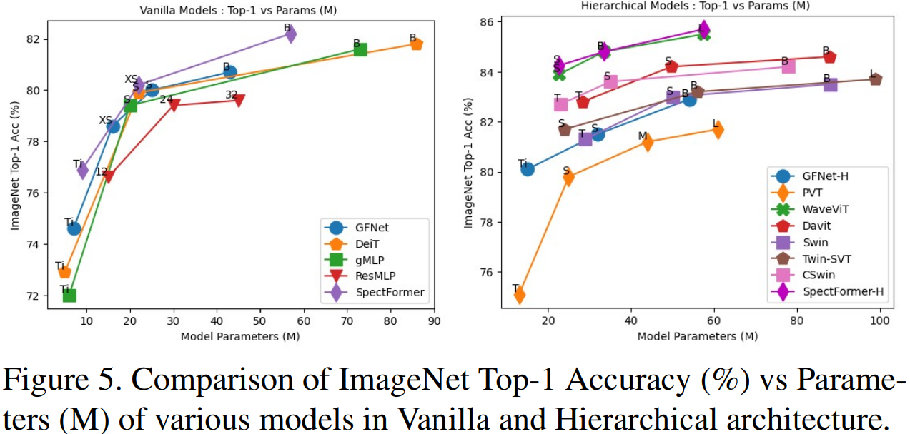
Accuracy vs Parameters

Slide 18
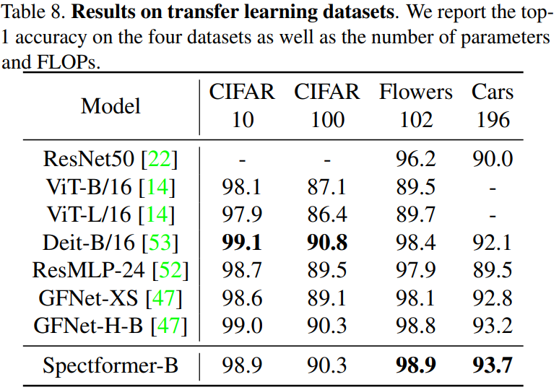
Results on Transfer Learning Datasets

Slide 19
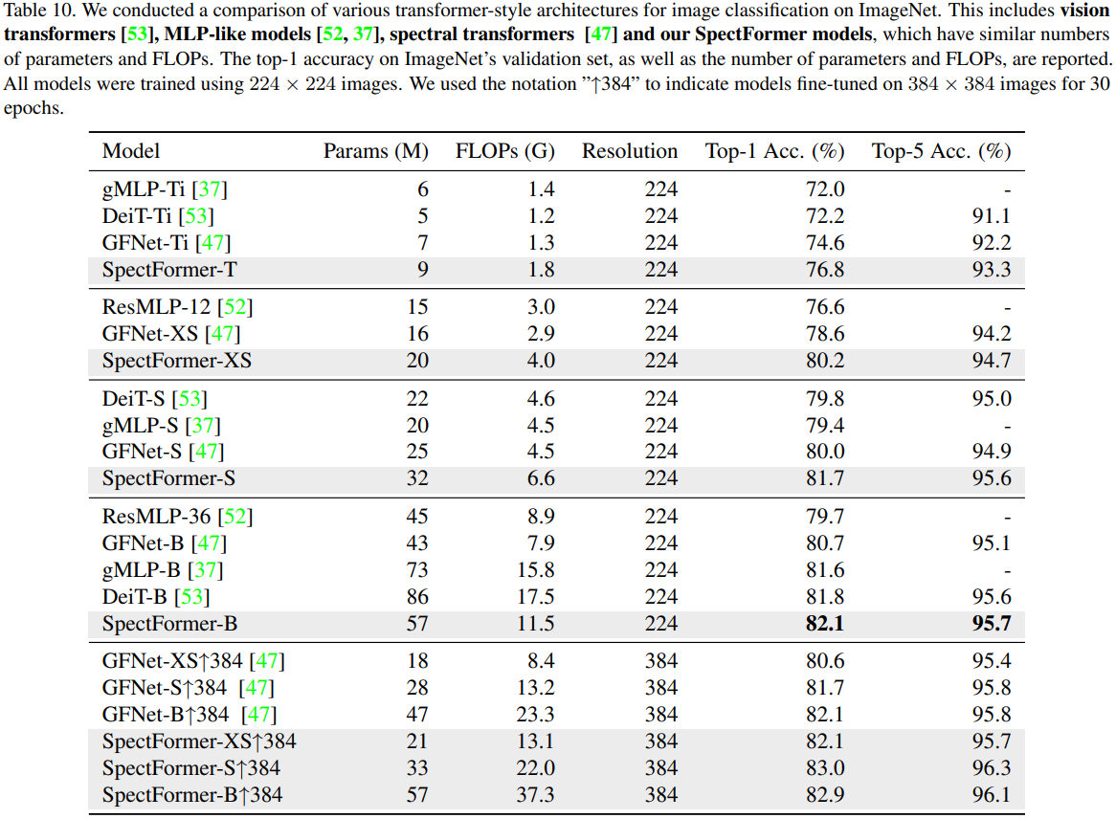
ImageNet Classification Comparison with Similar Methods

Slide 20
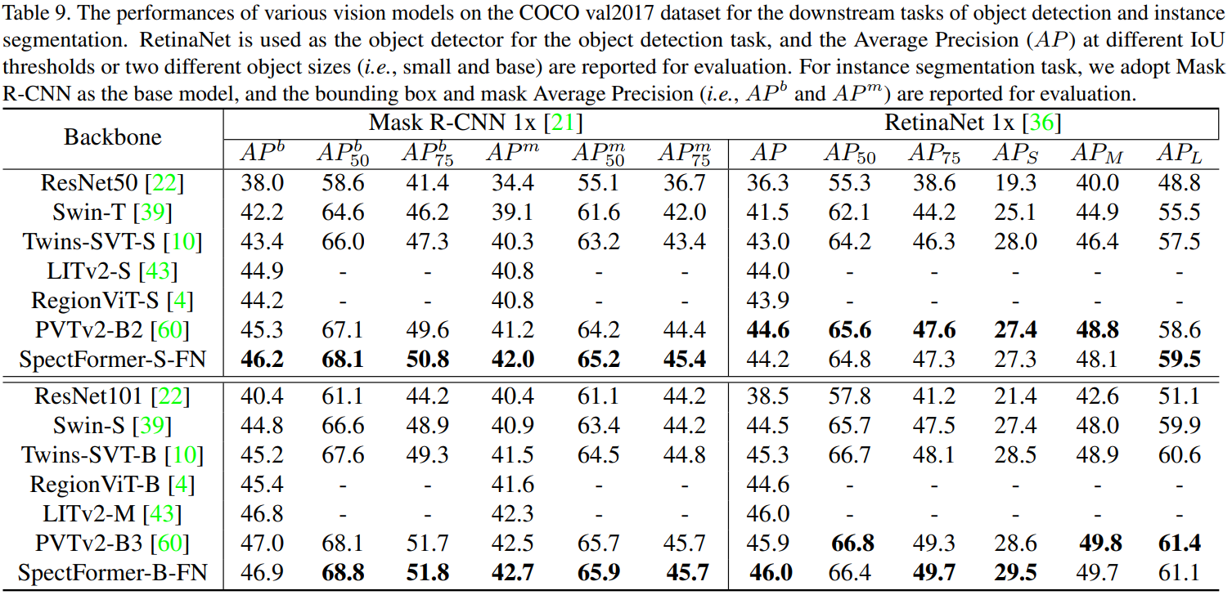
COCO Object Detection and Instance Segmentation Results

Slide 21
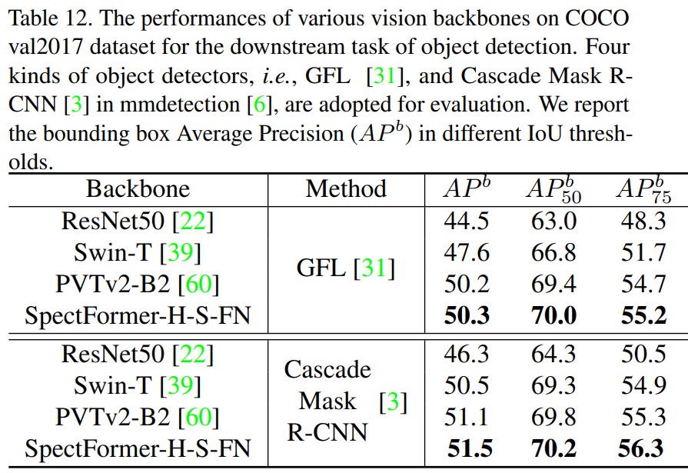
COCO Object Detection Results
GFL: Generalized focal loss: Learning qualified and distributed bounding boxes for dense object detection

Slide 22
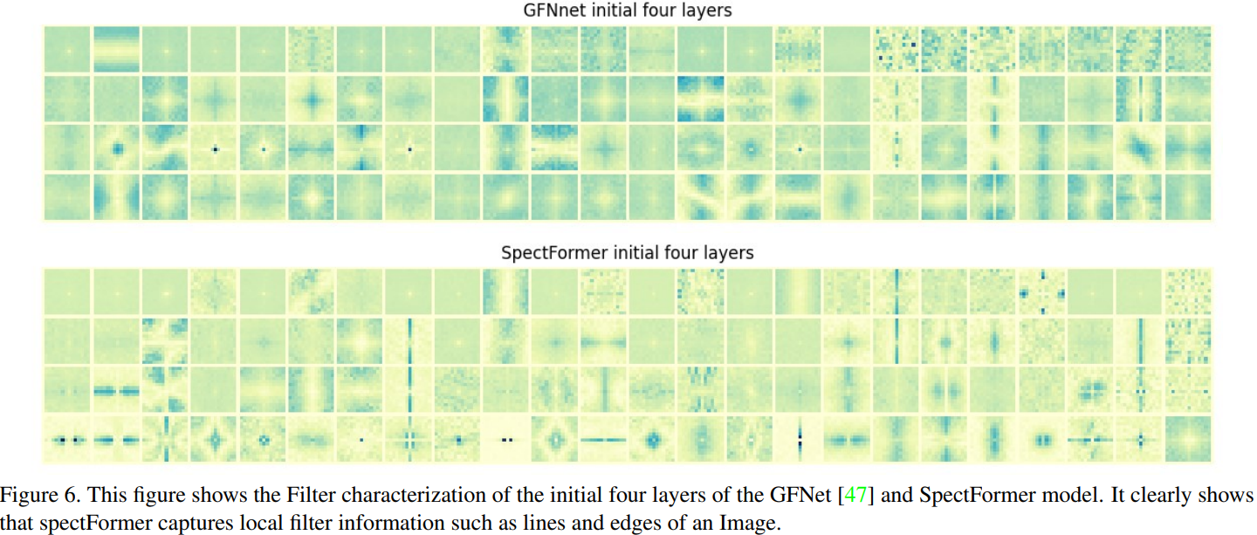
Visualization of First Four Layers

Slide 23
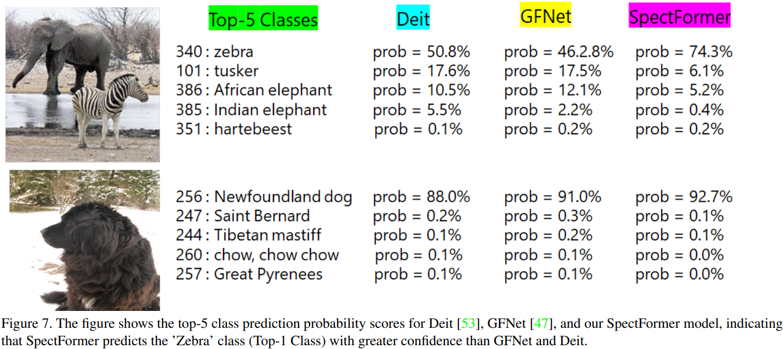
Model’s Confidence Improvement

Slide 24
Conclusion
Overall, the authors provide a smart way to mimic the Local context and global context capturing of MHSA operations using FFT and processing the frequency components.
This captures global information, but at much lower computational cost.
I have applied this method in my architecture for Journal Submission in the Remote Sensing Scene Analysis task and got improved results.

Slide 26
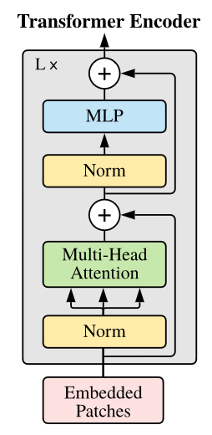
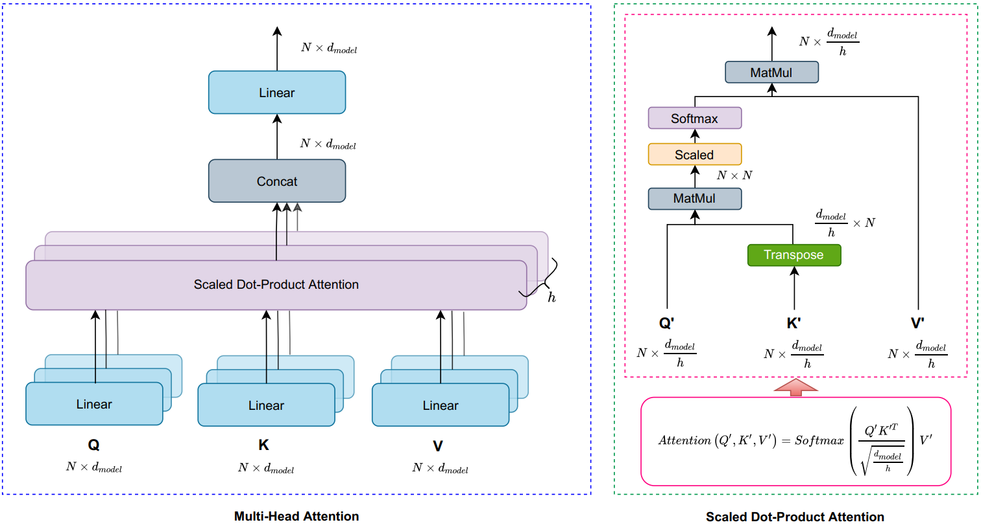
Vision Transformer (ViT)
$$N=197$$
$$d_{model}=768$$
https://arxiv.org/pdf/2010.11929v2.pdf

Slide 27
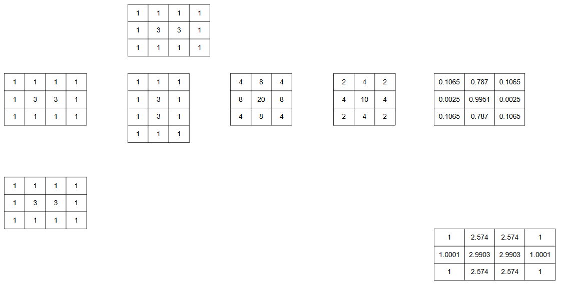
Vision Transformer (ViT)
Self-Attention: Learn relationship between one position and all positions
Example:
$$scale=\sqrt{\frac{d_{model}}{h}}=\sqrt{4}=2$$
$$K^{′}$$
attention weights
1 position in
image features
$$\sum{=1}$$
scale
softmax
$$Q^{′}$$
$$Q^{′}{K^{′}}^{T}$$
$${K^{′}}^{T}$$
$$⊗$$
$$V^{′}$$
Only example:
$h=1$
$d_{model}=4$
$N=3$

