Slide 1
Large Selective Kernel Network for Remote Sensing Object Detection Yuxuan Li, Qibin Hou, Zhaohui Zheng, Ming-Ming Cheng, Jian Yang and Xiang Li* IMPlus@PCALab & TMCC, CS, Nankai University
Russo Mohammad Ashraf Uddin
ashrafrusso@gmail.com
March 24th, 2023

Slide 2
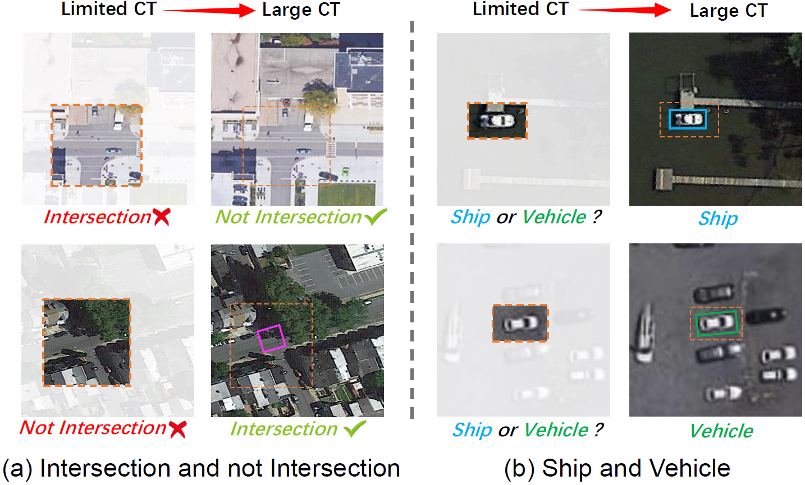
Introduction
Authors Large Selective Kernel Network, which aims to find the contextual information in high resolution remote sensing images.
Big receptive fields are effective in this context.
Factoring one big kernel convolution into several dilated depthwise convolution is considered.

Slide 3
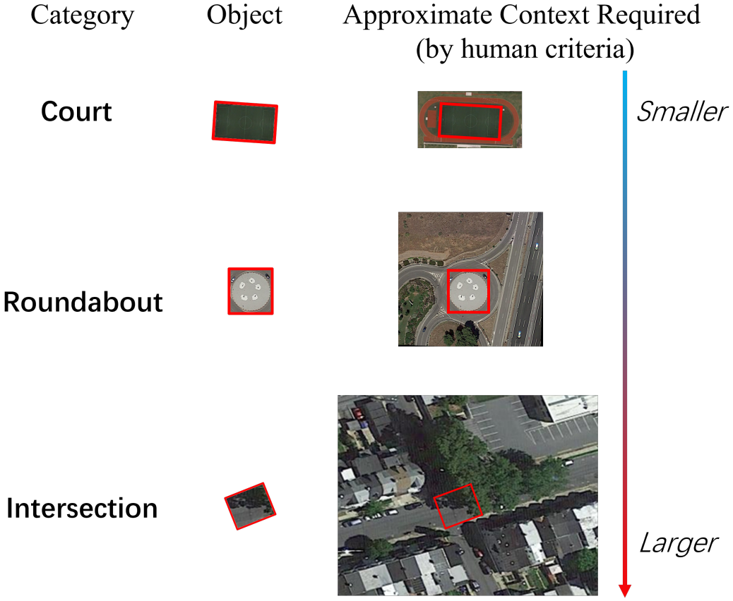
Contextual Information in Remote Sensing
The wide range of contextual information required is different for different object types.
Soccer-field may require less-to-no contextual information.
But, “Roundabout” maybe similar to gardens or ring-like buildings and require higher range of contexts.

Slide 4
Module Comparison

Slide 5
Overall Architecture

Slide 6
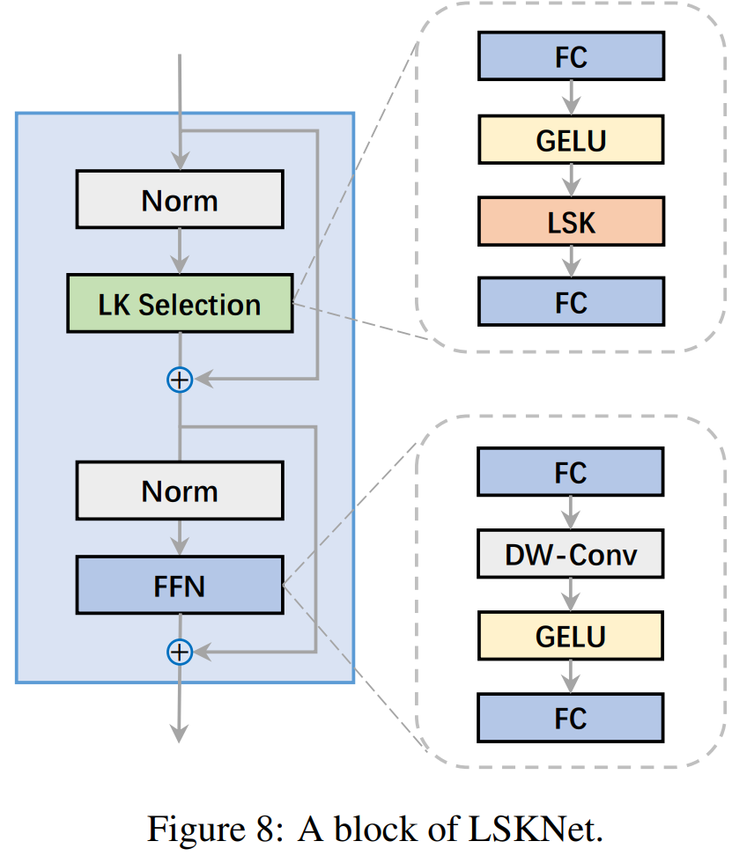
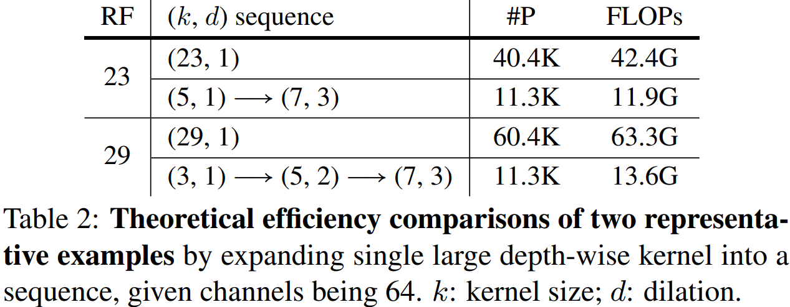
Design Variants

Slide 7
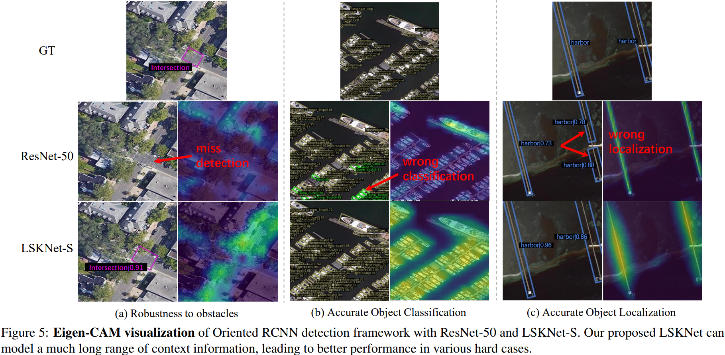
Eigen-Cam Visualization

Slide 8
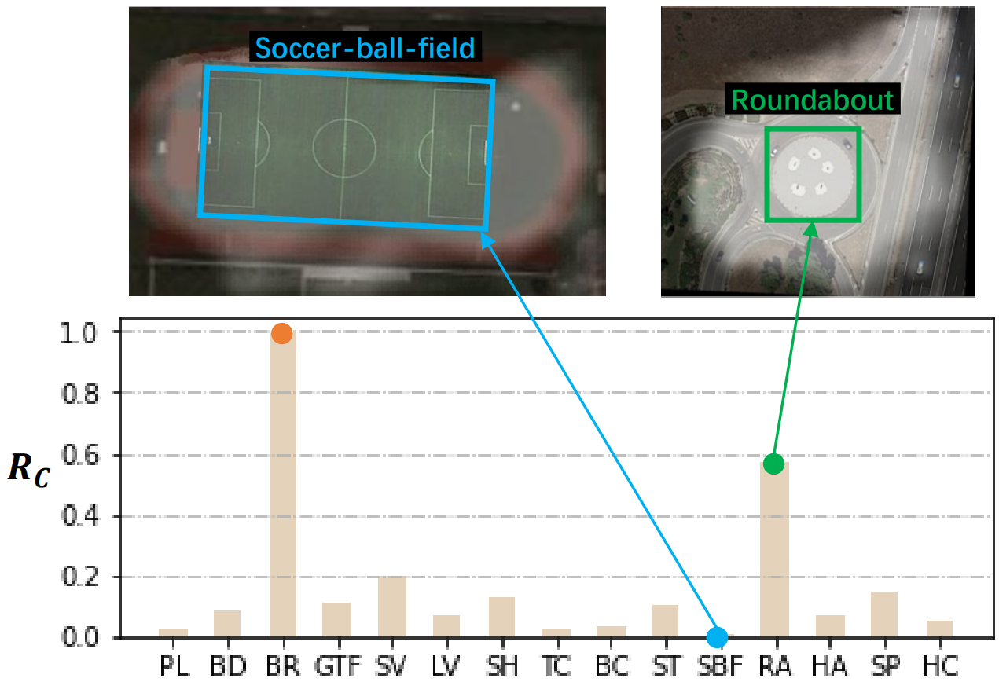
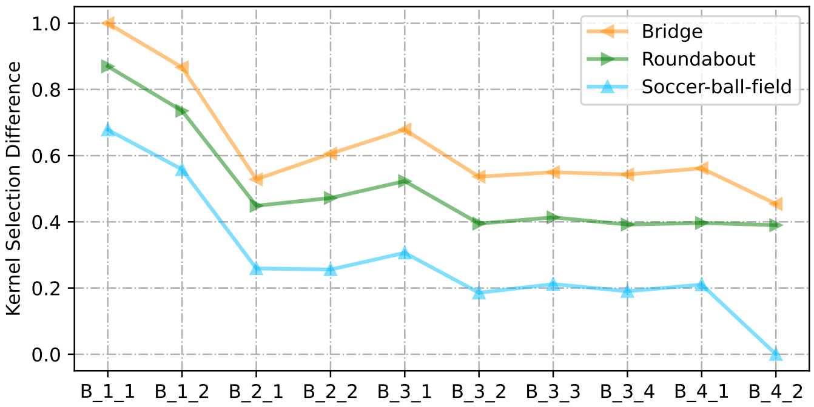
Importance of context for different objects

Slide 9
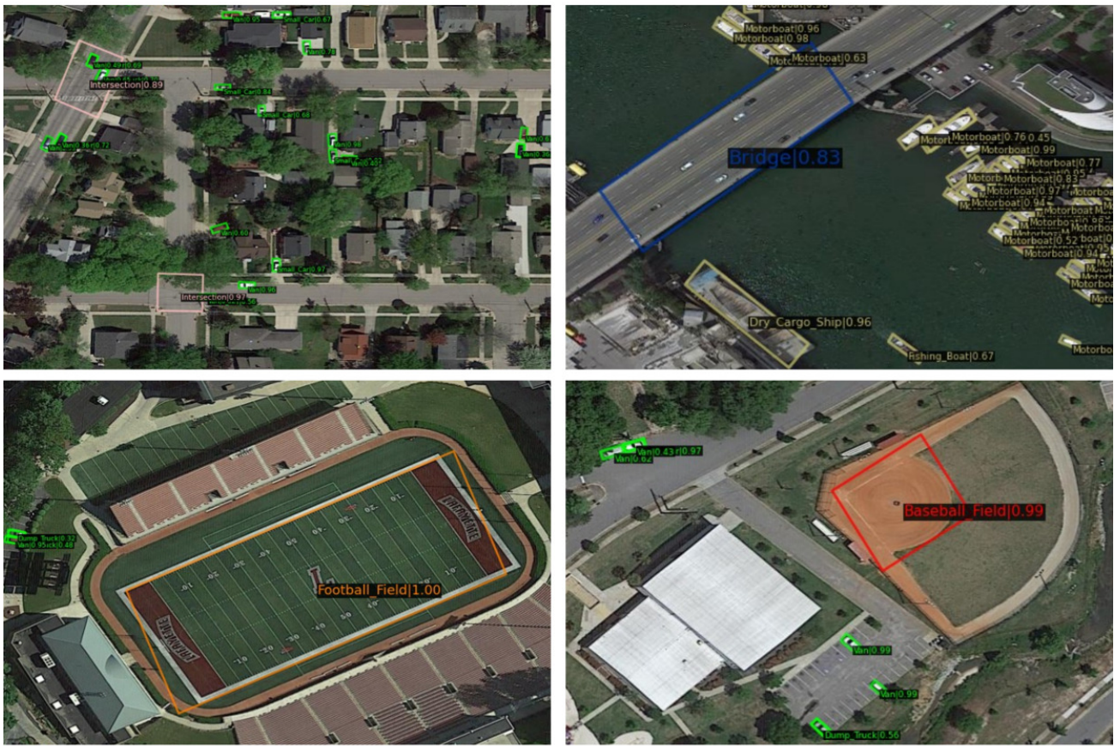
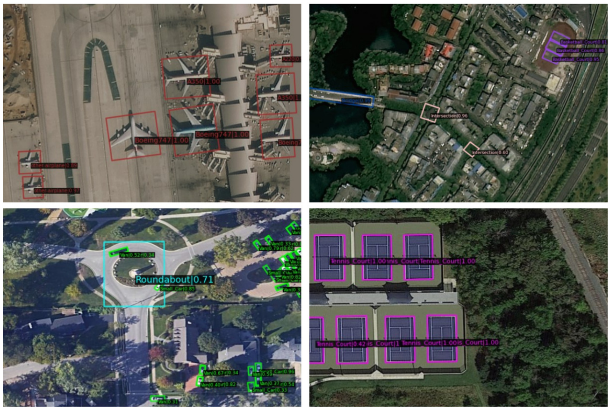
Qualitative Results

Slide 10
Comparative Architecture with SKNet

Slide 11
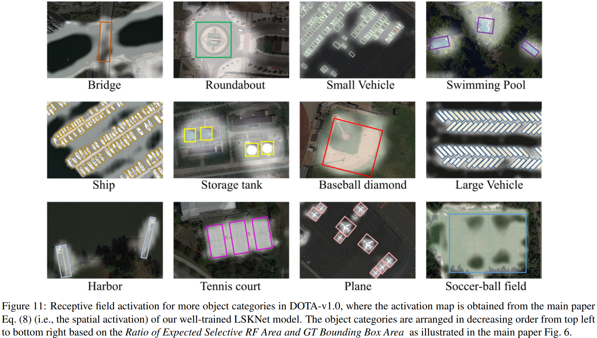
Receptive Field Activation Map

Slide 12
Datasets and Implementation Details
Datasets:
HRSC2016 (Remote Sensing for Ship Detection)
1061 images, 2976 instances of ship
DOTA-v1.0
2,806 images
188,282 instances, 15 categories
FAIR1m-v1.0
15,266 HR images
1million instances, 5 categories, 37 subcategories
Implementation:
8x 3090 GPUS, batch size = 8
Image size = 1024x1024, optimizer AdamW, Pretrained : IN(Imagenet), CO(MS-Coco), MA(Million-AID)
Epochs;LR = 36; 0.0004 (HRSC2016), 12; 0.0002 (DOTA), 12; 0.0002 (FAIR)

Slide 13
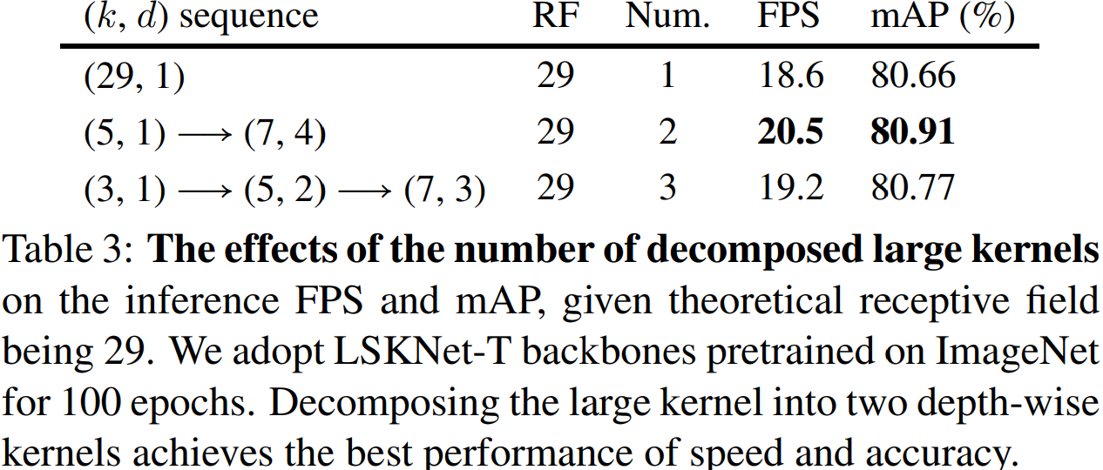
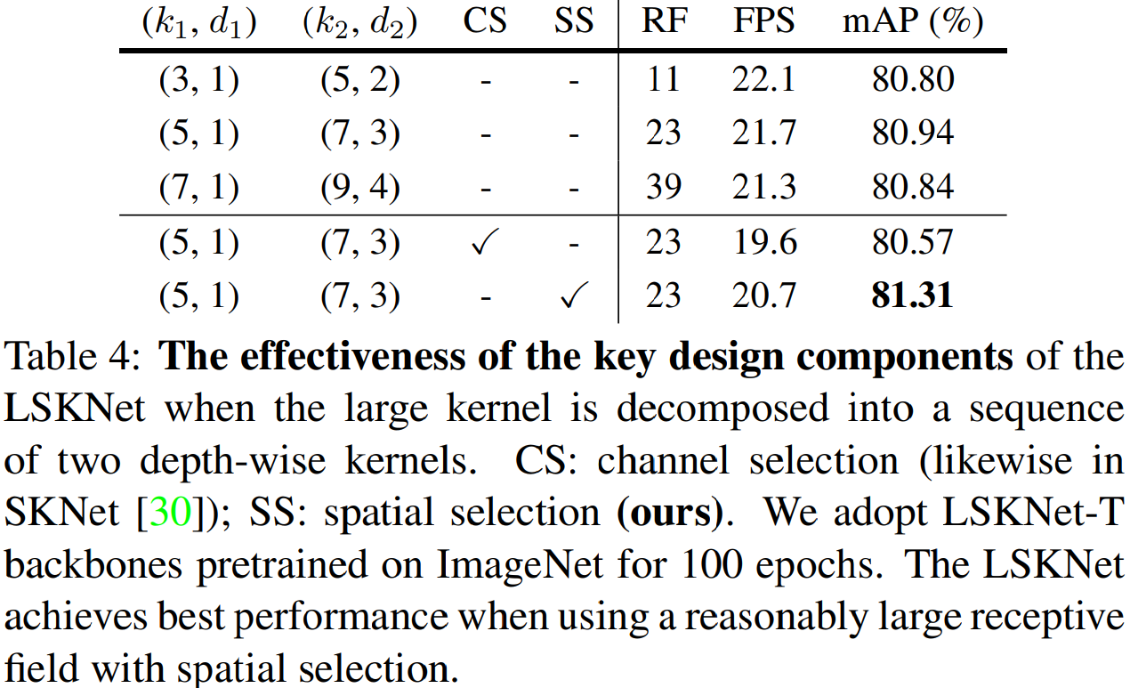
Experiments: Design Variants

Slide 14
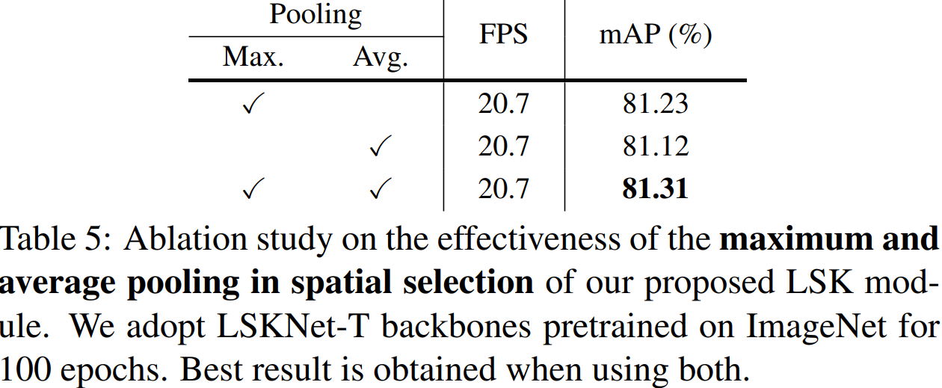
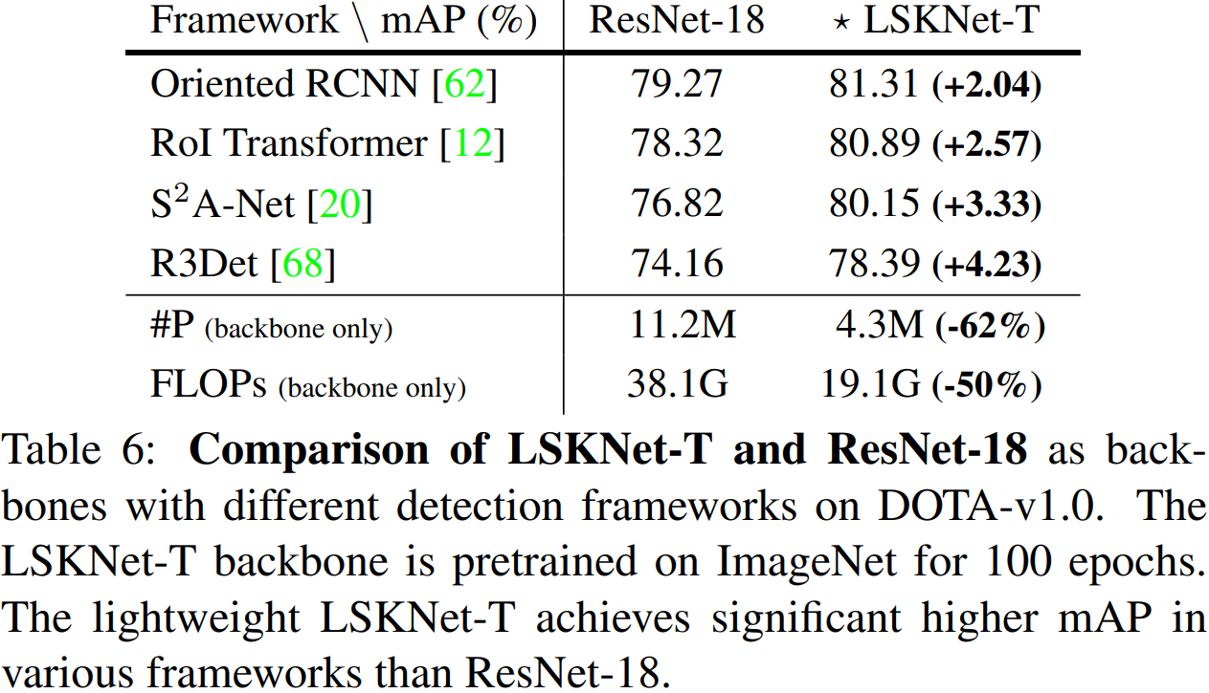
Experiments: Design Ablations

Slide 15
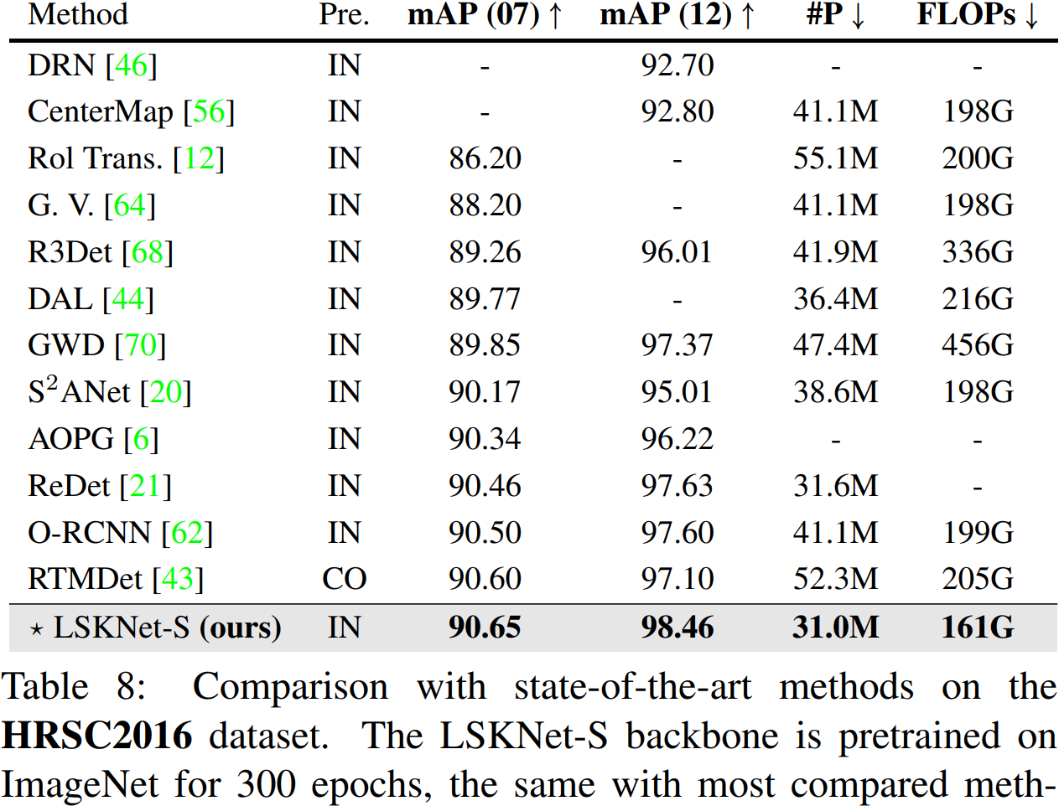
Experiments: HRSC2016

Slide 16
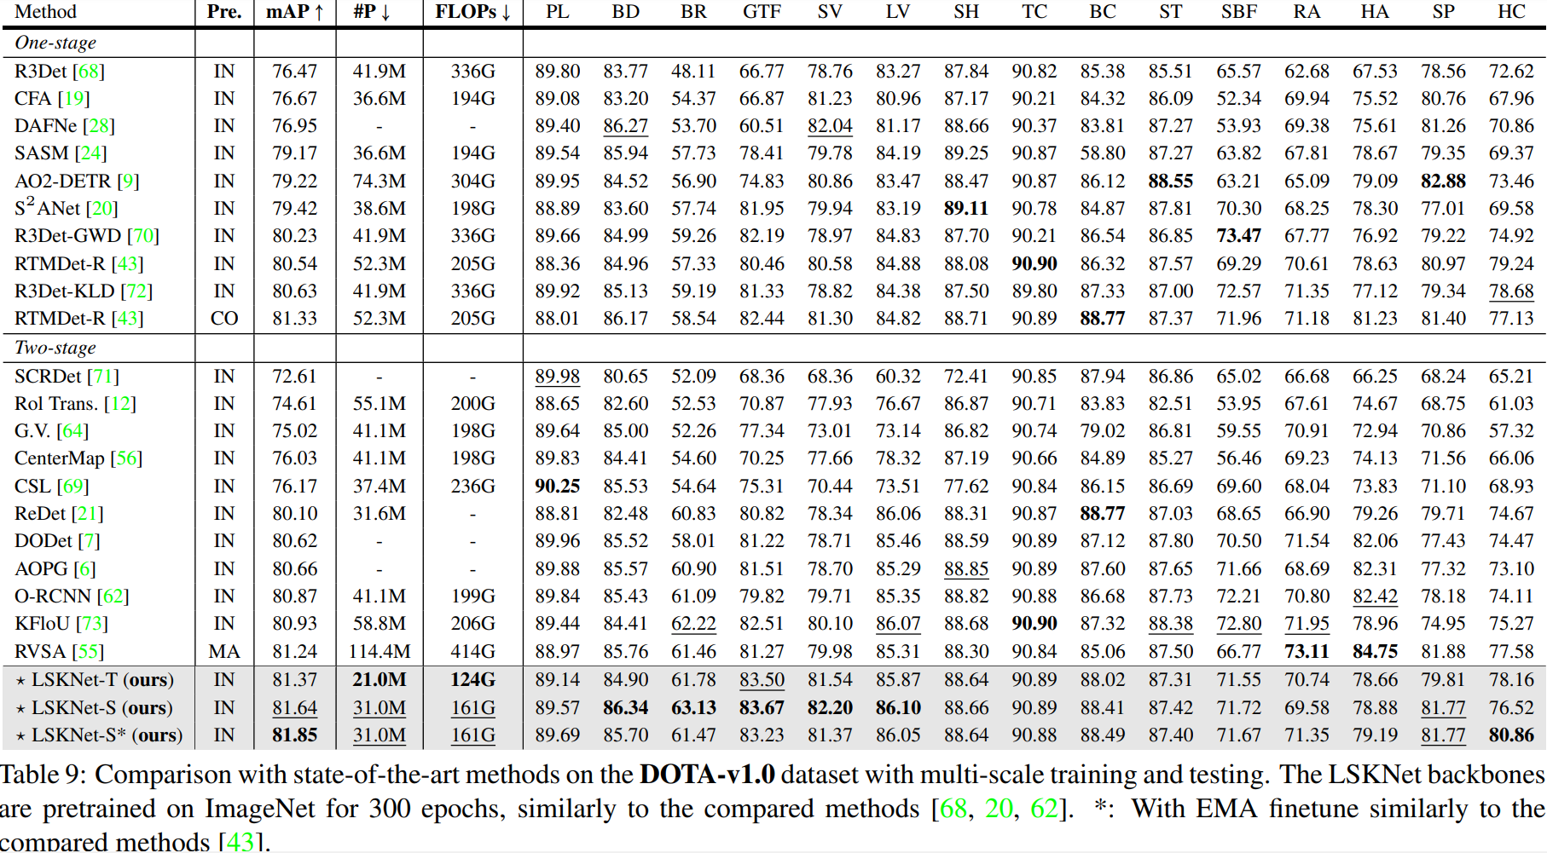
Experiments: Dota-v1.0

Slide 17
Experiments: FAIR1m-v1.0

Slide 18
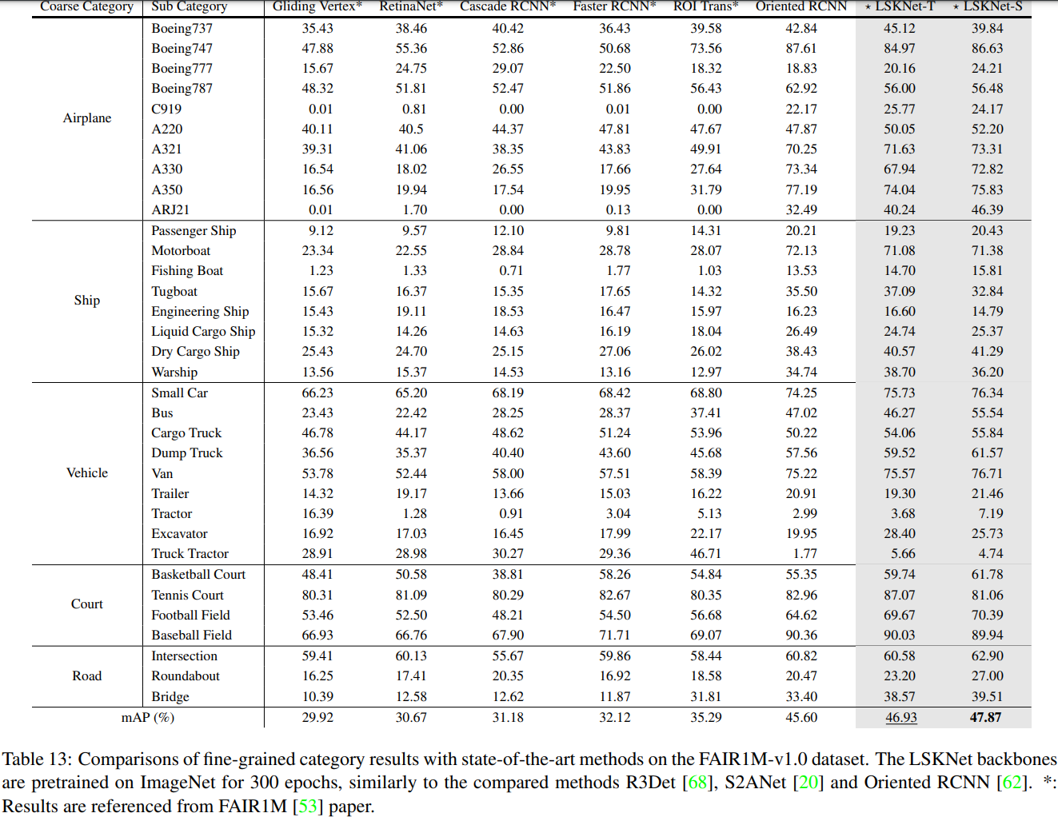
Experiments: FAIR1m-v1.0

Slide 19
Conclusion
The approach used in this paper is quite simple and the techniques are all previously explored and not new.
But, the authors manages to leverage these to find the best performing model in the major datasets, which is motivating for me to find a better model.

Slide 21
DepthWise Convolution

