Slide 1
SOLO: Segmenting Objects by Locations Xinlong Wang¹; Tao Kong²; Chunhua Shen¹; Yuning Jiang²; Lei Li² ¹ The University of Adelaide, Australia ² ByteDance AI Lab
Van-Thanh Hoang
thanhhv@islab.ulsan.ac.kr
May 16, 2020

Slide 2
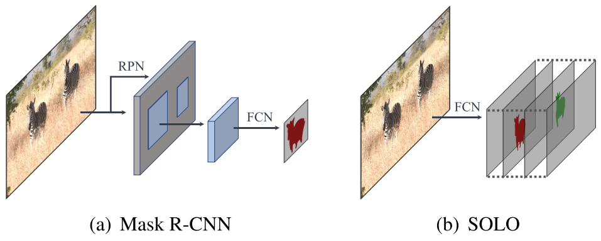
Introduction
Recent instance segmentation methods can be categorized into two groups
“Detect-then-Segment”
Detects bounding boxes
Then, segments the instance mask in each bounding box
=> heavily rely on accurate bounding box detection
“Use embedding vector”:
Assigning an embedding vector to each pixel
=> pushing away pixels belonging to different instances
and pulling close pixels in the same instance.
A grouping post-processing is needed
to separate instances
=> depend on per-pixel embedding learning
and the grouping processing.
=> Indirect approaches

Slide 3
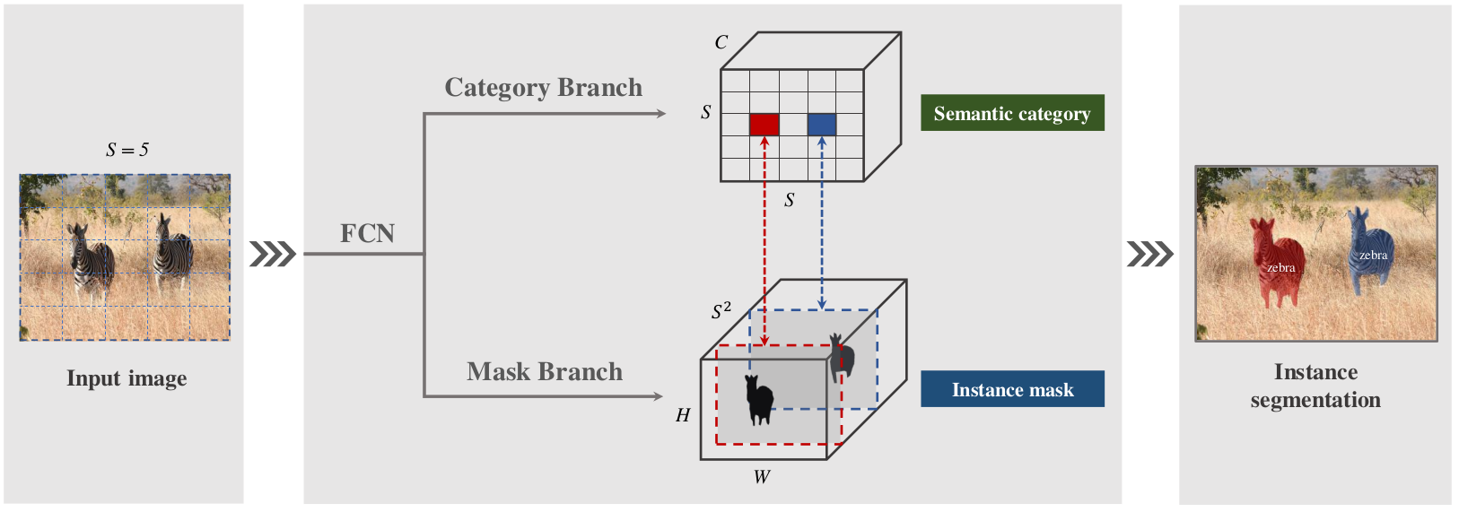
Proposed Method
SOLO
Core idea is to separate object instances by locations and sizes
Locations
Divides the input image into a uniform grids, i.e., S×S
If the center of an object falls into a grid cell, that grid cell is responsible for
1) predicting the semantic category
2) segmenting that object instance
=> converting the location prediction task into classification

Slide 4
Proposed Method
Sizes
Employ the feature pyramid network (FPN)
Assign objects of different sizes to different levels of feature maps, as the object size classes.
SOLO
Optimized end-to-end without the need of box supervision
Directly maps an input image to masks for each individual instance
Does not rely on intermediate operators like RoI feature cropping, or grouping post-processing

Slide 5
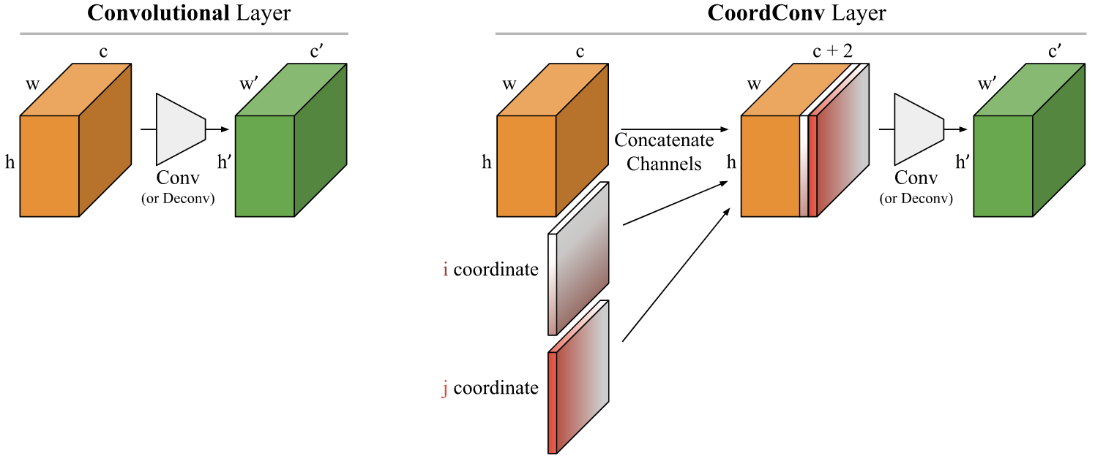
CoordConv
Reason
Conventional convolutional operations are spatially invariant to some degree
SOLO must be spatially variant, or position sensitive
CoordConv
Concat more channels about coordinate information before Conv layer
They can be x,y coordinates, distance from center r

Slide 6
Training SOLO
Label Assignment
S×S grid
grid (i, j) is considered as a positive sample if it falls into the center region of any ground truth mask
Given a mass center (c_{x}, c_{y}), width w, and height h of the ground truth mask
Scale factors α=0.2: (c_{x}, c_{y}, αw, αh)
There are on average 3 positive samples for each ground truth mask

Slide 7
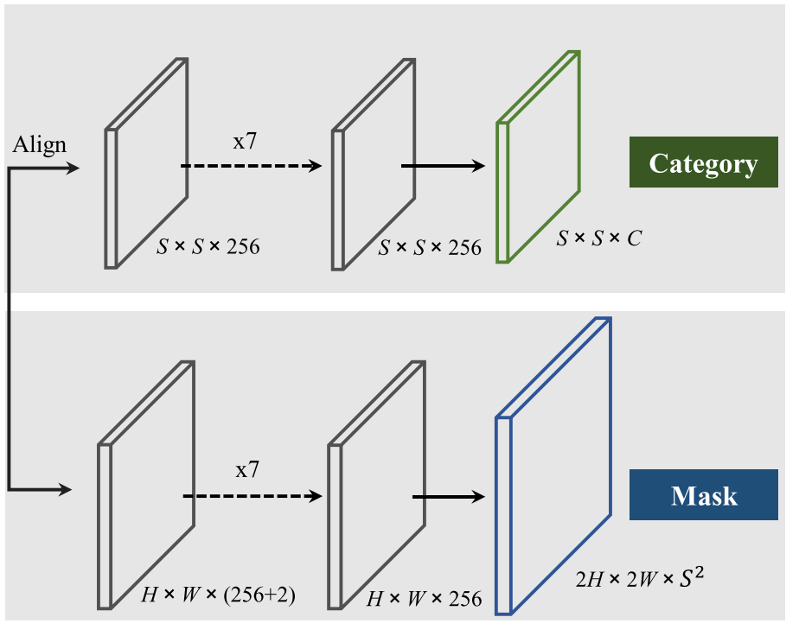
Training SOLO
Head architecture
All convolutions are 3×3, except output conv
‘Align’ means adaptive-pooling, interpolation or region-grid-interpolation
During inference, the mask branch outputs are further upsampled to the original image size
CoordConv is applied at the begining of
mask branch

Slide 8
Training SOLO
Loss Function
Training loss: L = L_{cate} + λL_{mask}
λ=3
L_{cate}: Focal loss
L_{mask} is the loss for mask prediction
d_{mask}(·, ·): Binary Cross Entropy (BCE), Focal Loss and Dice Loss
Dice Loss
L_{Dice} = 1 - D(p,q)

Slide 9
SOLO Inference
Inference
Use a confidence threshold of 0.1 to filter out predictions with low confidence
Select the top 500 scoring masks and feed them into the NMS operation
Use a threshold of 0.5 to binaries the predicted soft masks
Keep the top 100 instance masks for evaluation

Slide 10
Experiments
Dataset
COCO instance segmentation
Training: 118K images
Val: 5K images
Test-dev: 41K images
Implementation
Use SGD optimizer
8 GPUs
16 images per mini-batch (2 images per GPU)
36 epochs
Initial learning rate of 0.01
then divided by 10 at 27th and again at 33th epoch

Slide 11
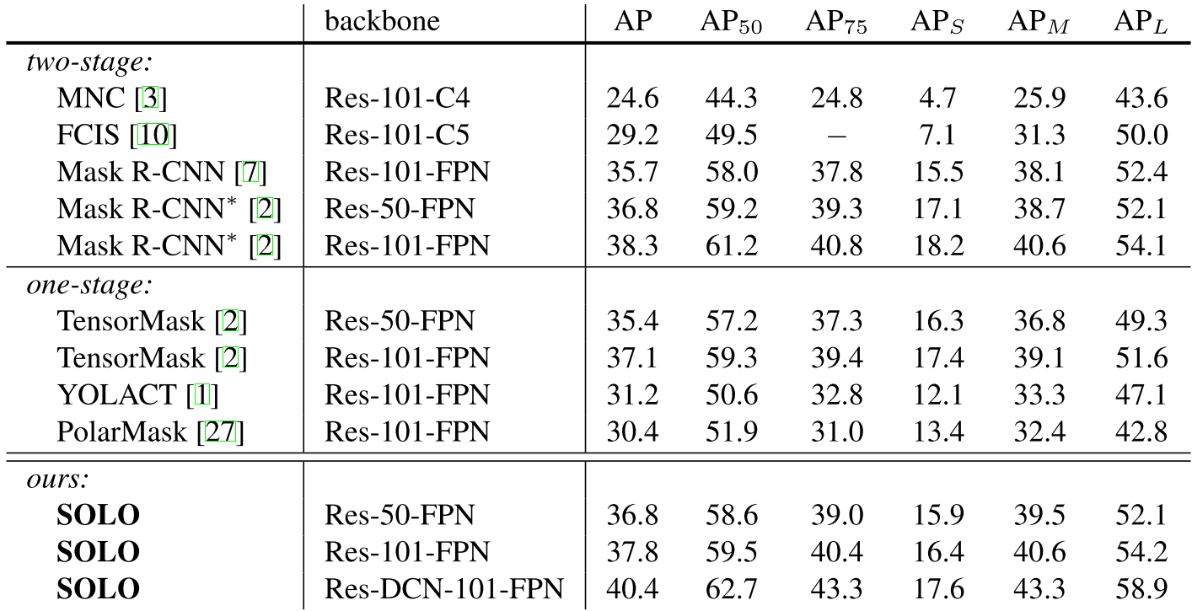
Main Results

Slide 12
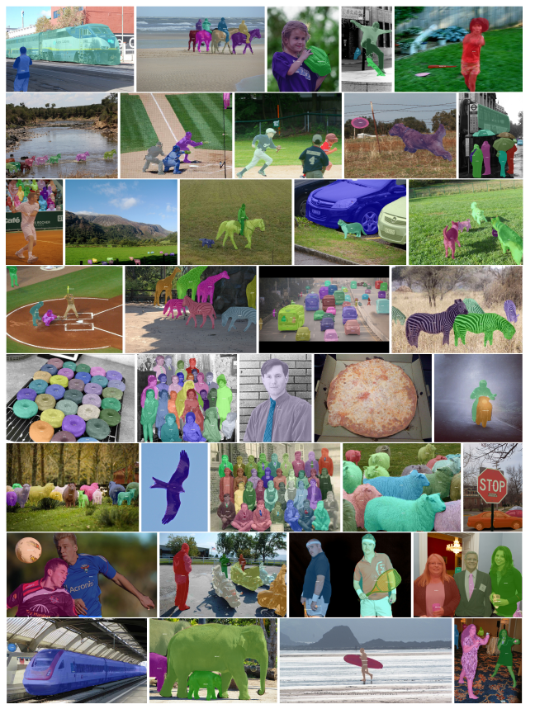
Main Results
Qualitative results
SOLO achieves good results even under challenging conditions

Slide 13
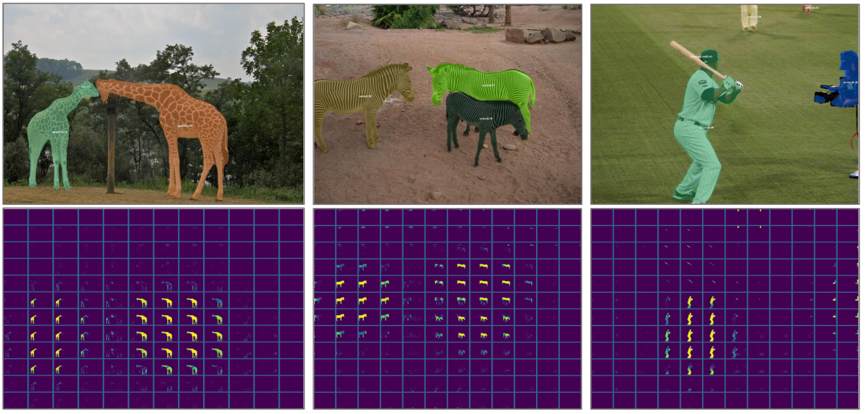
SOLO Behavior
Only one instance will be activated at each grid
One instance may be predicted by multiple adjacent mask channels
During inference, NMS is used to suppress these redundant masks.

Slide 14
Ablation Experiments
Grid number

Slide 15
Ablation Experiments
CoordConv
Add CoordConv improve scores
Two or more CoordConvs do not
bring noticeable improvement
Loss function
The majority of pixels of an instance mask are in background
Focal Loss is designed to mitigate the sample imbalance problem by decreasing the loss of well-classified samples
Dice Loss views the pixels as a whole object and could establish the right balance between foreground and background pixels automatically

Slide 16
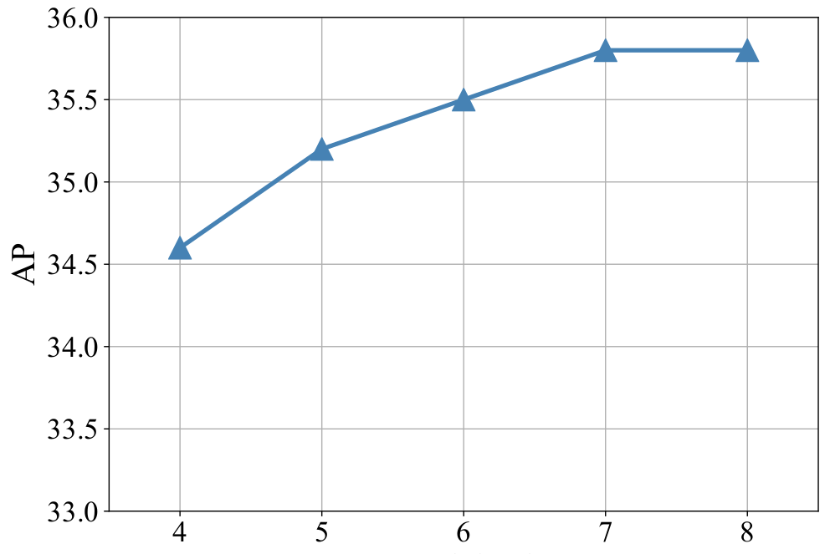
Ablation Experiments
Alignment in the category branch
Method to align
Interpolation: Directly bilinear interpolating to the target grid size
Adaptive-pool: Applying a 2D adaptive max-pool over H×W to S×S
Region-grid-interpolation: For each grid cell, we use bilinear interpolation conditioned on dense sample points, and aggregate the results with average
There is no noticeable performance gap between these variants (± 0.1AP), indicating the alignment process is fairly flexible
Different head depth
The computational overhead for semantic
category branch is negligible
since S² << H×W

Slide 17
Ablation Experiments
SOLO-512
A smaller version of SOLO designed to speed up the inference
shorter image size of 512 instead of 800

Slide 18
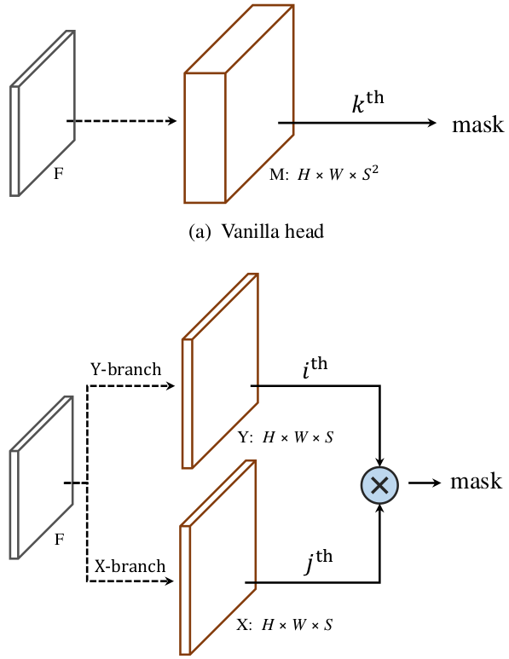
Decoupled SOLO
Motivation
Prediction is somewhat redundant as in most cases the objects are located sparsely in the image
Decoupled SOLO
the original output tensor M∈R^{H×W×S2} is replaced with two output tensors X∈R^{H×W×S} and Y∈R^{H×W×S}
The mask prediction of an object located at grid location (i, j) is defined as the element-wise multiplication of two channel maps

Slide 19
Further Analysis
Error Analysis
For each predicted binary mask, compute IoUs with ground-truth masks, and replace it with the most overlapping ground-truth mask
There are still ample room for improving the mask branch

Slide 20
Conclusion
SOLO
Simplicity and strong performance
Model is end-to-end trainable and can directly map a raw input image to the desired instance masks with constant inference time
Can be applied in wide range of instance-level recognition tasks
Comments
Good idea for single-stage real-time instance segmentation
The bottle-neck is Mask prediction

Slide 21
Thank you for your attention!

Slide 22
FCOS

Slide 23
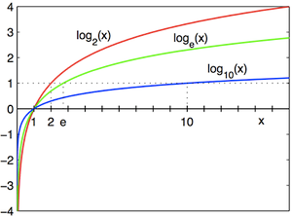
Binary Cross Entropy
Loss

Slide 24
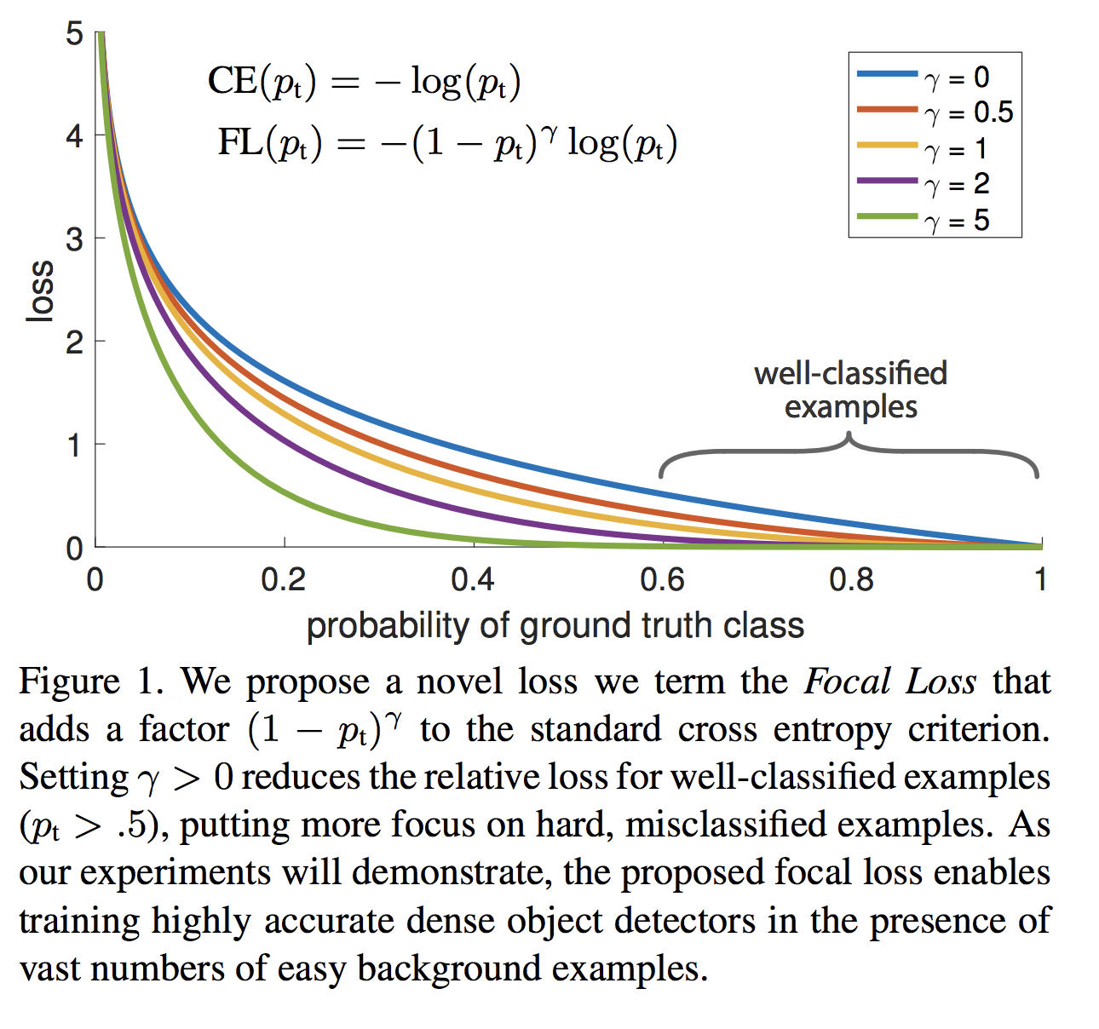
Focal Loss
Loss

