Slide 1
Improving Object Localization with Fitness NMS and Bounded IoU Loss Lachlan Tychsen-Smith, Lars Petersson CSIRO (Data61), CSIRO-Synergy Building, Acton, ACT, 2601 (data61.csiro.au) CVPR 2018
Van-Thanh Hoang
thanhhv@islab.ulsan.ac.kr
May 11, 2019

Slide 2
Introduction
Problem
NMS identifies only a sufficently accurate bounding box, rather than the best available one
Bounding box loss is just L2 loss => not consider about the main metric IoU
Contributions
Propose Fitness NMS
a simple and fast modification of NMS
Can be used in conjunction with Soft NMS
Proposed bounded IoU loss

Slide 3
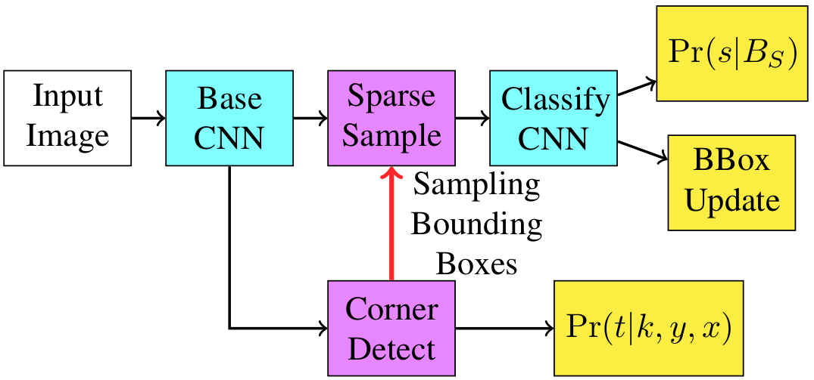
DeNet (1/3)
Real-time Anchorless Object Detector
Modify from faster R-CNN with FPN
Replace RPN with a Corner-based RoI Detector
Use Deconv instead of upsampling

Slide 4
DeNet (2/3)
Step to generate proposals
Search the corner distribution for 4 corners which have Pr(t=1|k,x,y)>λ
For each corner type, select top M corners based on probability
Generate a set of unique bounding boxes by matching every corner within candidates of top−left and bottom−right
Calculate the probability of each bounding box being non-null via:
Pr(object|bbox) = Pr(top_left|x₀,y₀)Pr(top_right|x₁,y₀)Pr(bottom_left|x₀,y₁)Pr(bottom_right|x₁,y₁)
Repeat steps 2 and 3 with corners of type top−right and bottom−left
Select bounding box with top probability as proposals

Slide 5
DeNet (3/3)
Advantages
Improved the localization of the proposals
Significantly more likely to overlap objects of interest nicely
Problem
The better fitting proposals were not neccessarily being selected after the final classifier

Slide 6
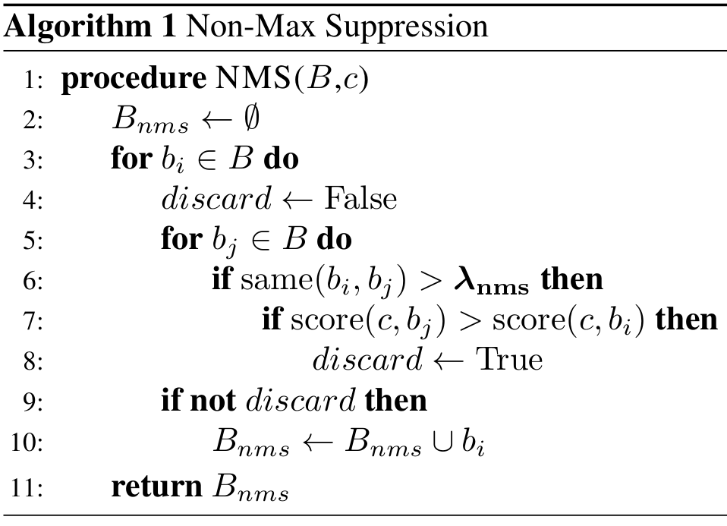
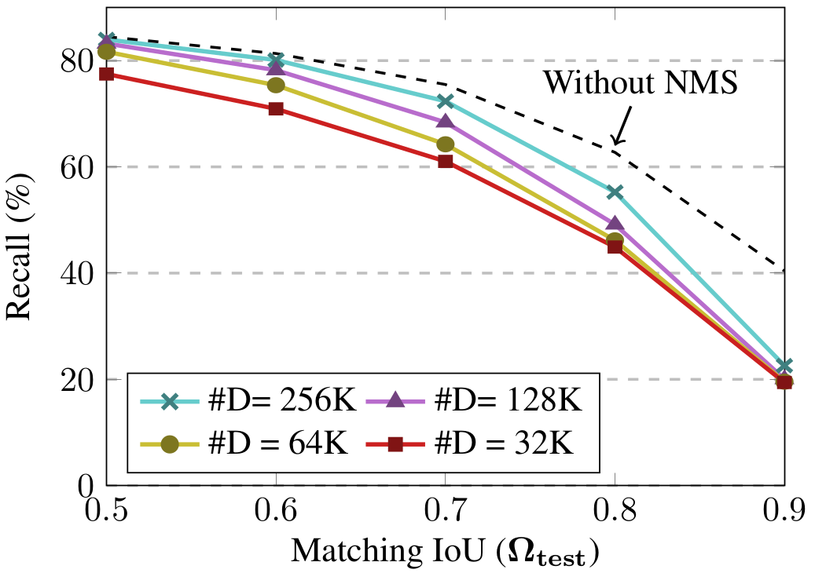
Fitness NMS (1/)
NMS removes the high overlapped bbox

Slide 7
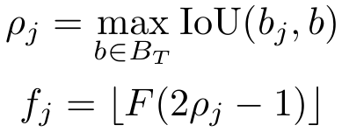
Fitness NMS (2/)
Original NMS
Fitness NMS
E[f_{j}|c]: expected value of f_{j} given the class c
f_{j}: fitness, a discrete random variable indicating the IoU overlap between the bounding box b_{j} and any overlapping groundtruth box
F = 5
λ_{n}=1/2 + n/(2F)

Slide 8
Fitness NMS (3/)
Independent Fitness (I_{F})
Pr(c|b_{j}) and Pr(f_{j}|c) independently and assume fitness is independent of class, i.e., Pr(f_{j}|c) = Pr(f_{j})
Network output Pr(f_{j}|b_{j}) and Pr(c|b_{j})
=> |C| + |F| + 2 outputs per RoI (for classification) (?)
Joint Fitness (J_{F})
=>|C||F | + 1 outputs per RoI (?)

Slide 9
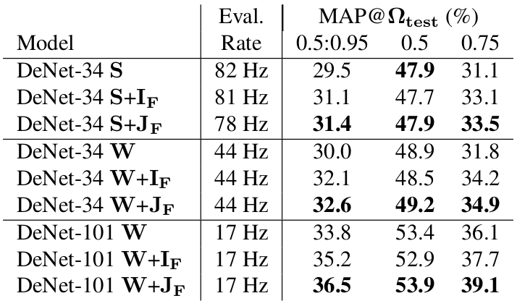
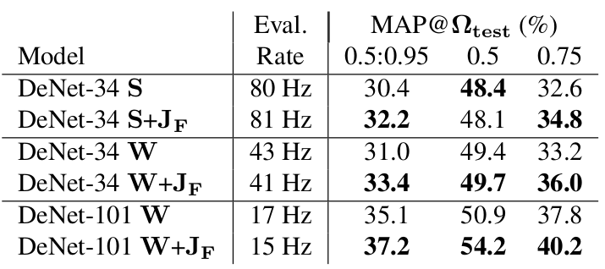
Fitness NMS (4/)
Fitness NMS vs NMS
FitnessNMS w/ and w/o SoftNMS

Slide 10
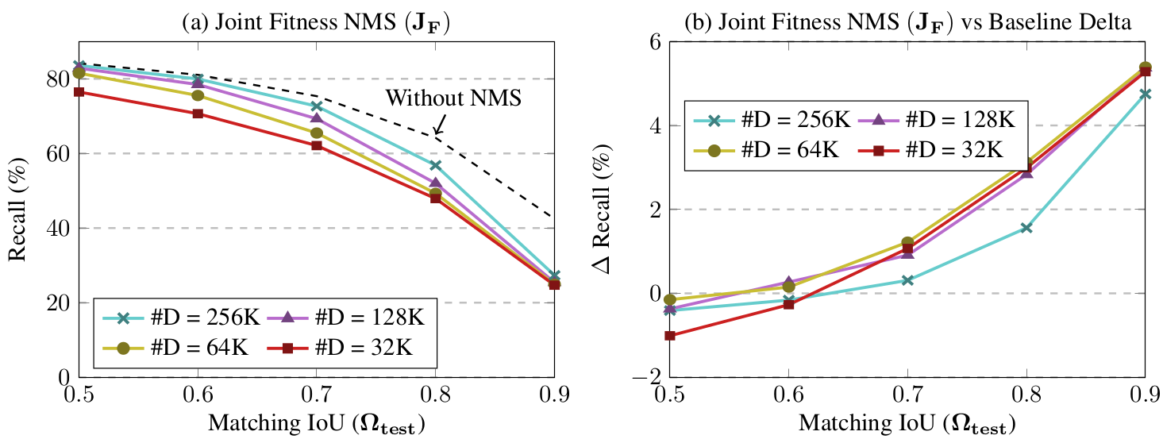
Fitness NMS (5/)

Slide 11
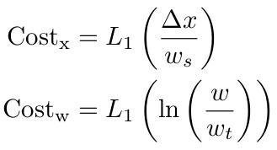
Bounded IoU Loss (1/)
Aims to maximise the IoU overlap between the RoI and the associated groundtruth bounding box
R-CNN cost
∆x = x - x_{t}
L₁ loss

Slide 12
Bounded IoU Loss (2/)
Bound IoU Loss
train the bounding box regression to directly minimize the IoU
Cost = L₁(1 − IoU(b,b_{t}))
CNN’s struggle to minimize this loss under gradient descent due to the high non-linearity, multiple degrees of freedom and existence of multiple regions of zero gradient of the IoU function => hard to converge
Bounded Loss
IoU(b,b_{t}) ≤ IoU_{B}(i,b_{t}): upper bound of the IoU function with the free parameter i∈{x, y, w, h}
IoU_{B}(x,b_{t}) provides the IoU as a function of x when y=y_{t}, w=w_{t} and h=h_{t}

Slide 13
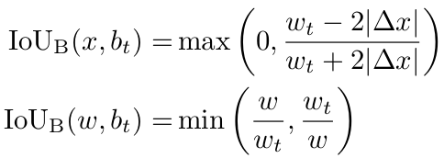
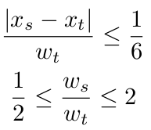
Bounded IoU Loss (3/)
Bound IoU Loss
IoU(b,b_{t}) ≤ IoU_{B}(i,b_{t}): upper bound of the IoU function with the free parameter i∈{x, y, w, h}
IoU_{B}(x,b_{t}) provides the IoU as a function of x when y=y_{t}, w=w_{t} and h=h_{t}
Since bbox regression is only applied to boxes which have IoU(b_{s},b_{t}) ≥ 0.5

Slide 14
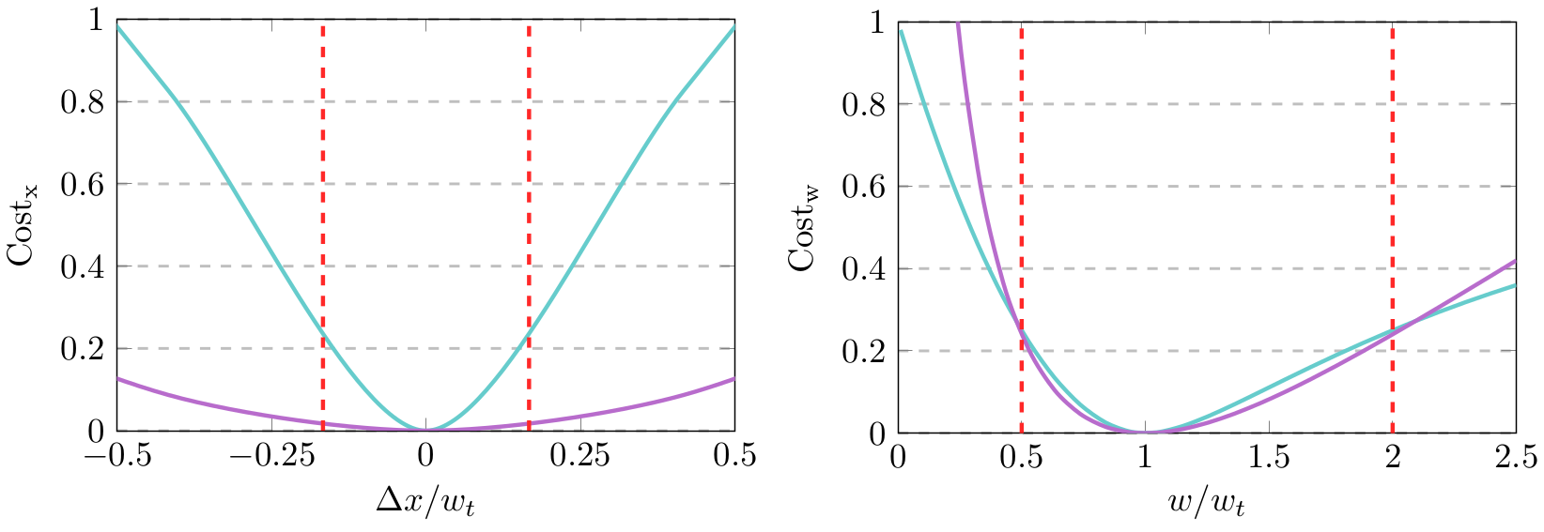
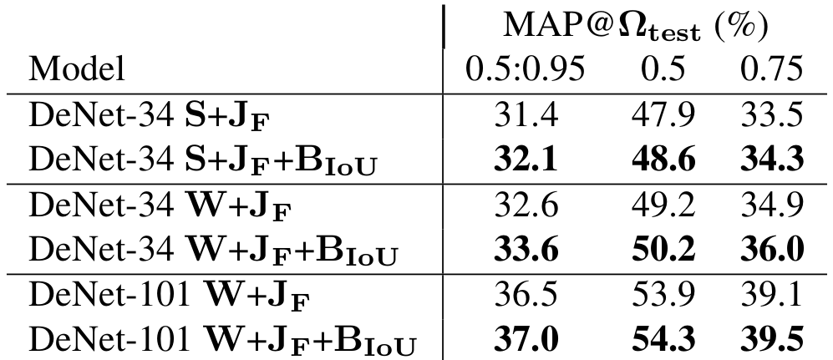
Bounded IoU Loss (4/)

Slide 15
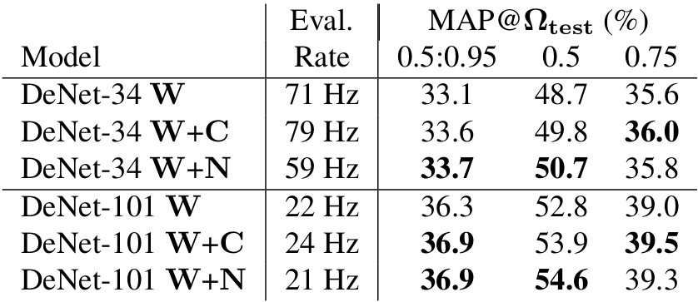
RoI Clustering
W: w/o NMS
W+C: w/ NMS at corner
For each (x,y) position, do NMS
for all bbox (2m+1)x(2m+1)(?)
W+N: w/ NMS at bbox
The corner clustering method appears to perform slightly better at high matching IoU and worse at low matching IoUs

Slide 16
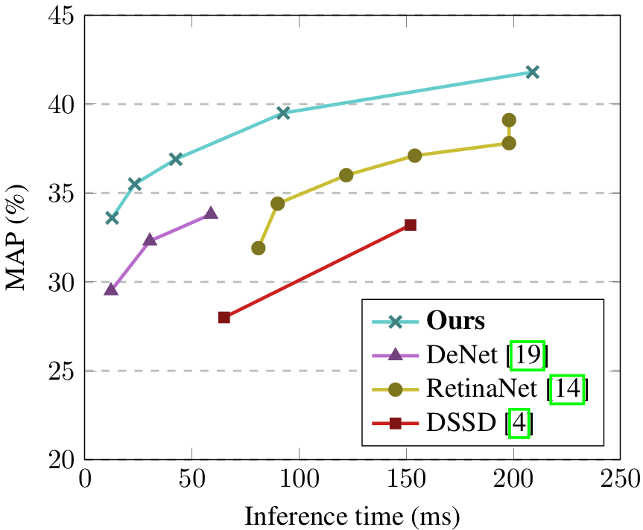
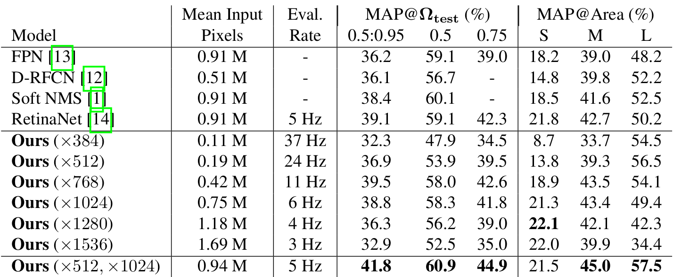
Input Image Scaling

Slide 17
Conclusions
Introduced a novel bounded IoU loss and Fitness NMS
Comments
Good idea about anchorless
Differenct way to calculate confidence
New loss considers about IoU
Only applied for 2-stage detector => can be applied to Yolo, SSD

Slide 18
Thank you for your attention!

Slide 19
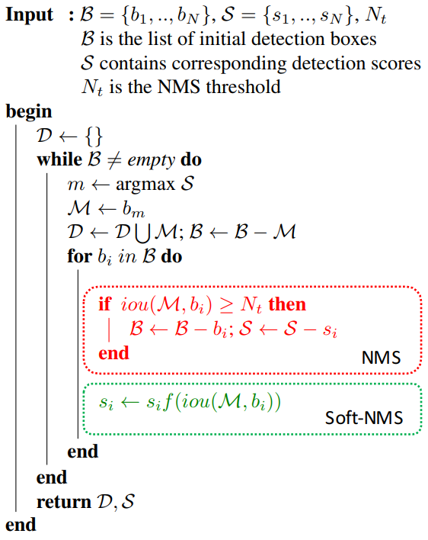
SoftNMS
Update score of the remaining bbox based on the IoU with kept bbox

