Slide 1
A New Approach to Track Multiple Vehicles With the Combination of Robust Detection and Two Classifiers
Weidong Min , Mengdan Fan, Xiaoguang Guo, and Qing Han
IEEE Transactions on Intelligent Transportation Systems, Vol. 19, No. 1, Jan 2018
Presented by: Yang Yu {yuyang@islab.ulsan.ac.kr}
May. 26, 2018

Slide 2
Overview
Track multiple vehicles with the combination of robust detection and two classifiers.
Multiple vehicles detection: Grayscale spatial information to build dictionary of pixel life length
Remove ghost shadows and residual shadows.
Classify tracking rectangles with confidence values by local binary pattern (LBP) with SVM classifier, then using CNN for the second time to remove interference areas.
Resolve vehicle occlusion.

Slide 3
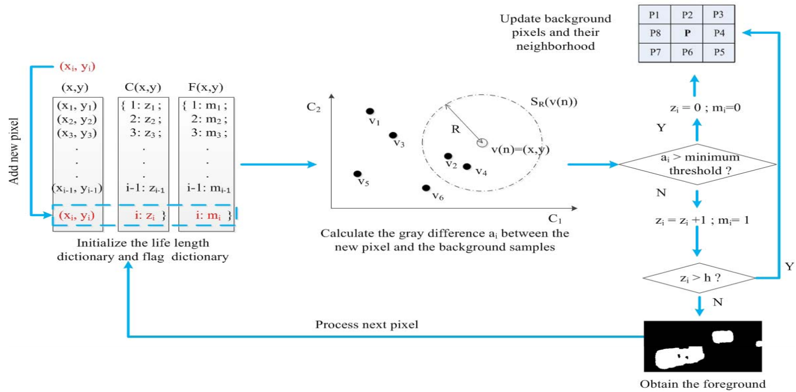
Improved ViBe Method
Visual Background Extractor. Samples-based background subtraction.
Random selection and neighborhood propagation--establish and update template. Life length dictionary is used to save the time information of the foreground.
1. Background template definition.
2. Template initialization. Randomly selected pixel from neighborhood -- background sample
3. Foreground detection. Gray difference.
4. Background updating. Randomly update sample and neighborhood

Slide 4
Reducing Ghost Shadows (1/2)
Combination of life cycle of pixels and random updating and neighborhood expansion.
Grayscale spatial information--build dictionary of pixel life length ----remove ghost shadows and residual shadows.
Advantage:
Remove misjudgment area
Fast speed and low complexity.

Slide 5
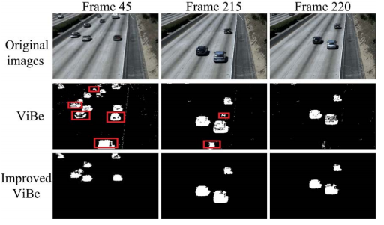
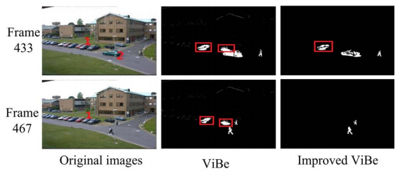
Reducing Ghost Shadows (2/2)
Detection results of dataset PETS2009. Ghost shadows are labeled with red rectangles. Suppress ghost effectively.

Slide 6
Dynamic Threshold Method
Fixed threshold is unstable in scenes with changes.
OTSU -- calculate variance to find a suitable gray level. For image segmentation--minimize the probability of misclassification.
First frame of selecting sample is used as background frame to calculate differential image.
Gray level--two categories.
The variance between the two categories
The optimal value of the inter-class variance t∗ is the optimal dynamic threshold after the whole image is traversed.
Expansion and corrosion--eliminate thin objects, smooth boundaries and fill small holes.
Moving object contour. The holes of smaller density area are filled through image growth method.

Slide 7
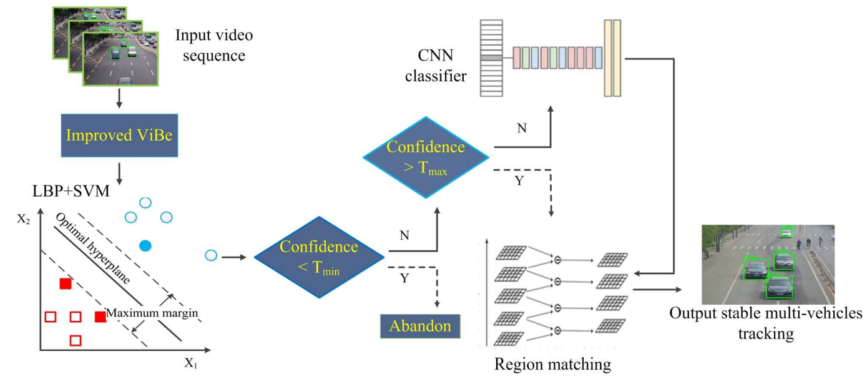
Detect Multiple Vehicles
Occlusion and interference causes wrong multiple vehicles tracking.
Two classifiers method
Time efficiency—SVM.
High accuracy --CNN.
Connected region matching algorithm --correlation analysis for the motion

Slide 8
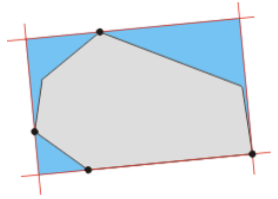
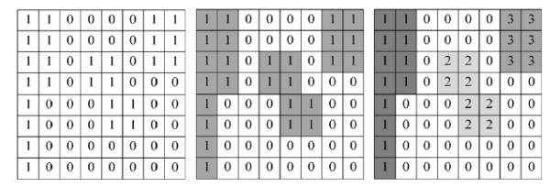
Extraction of Connected Region
Segmentation of binary foreground
Extraction of minimum enclosing rectangle
Connected region --same category of pixels connected.
Double scan method --scan foreground image according to the relation between adjacent 8 neighborhood pixels. .
Different location label are assigned. Normalize.
Classify pixels with same relationship.
Small connected regions are removed.

Slide 9
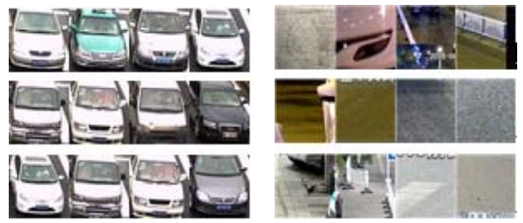
SVM Classification Based on LBP Feature
LBP --rotation invariance and gray invariance
(01111100)10=124
16×16 cell. Histogram. Normalize. Connect as feature vector.
SVM--Time efficiency
Confidence level of tracking rectangle
1) Vehicle positive and negative samples. LBP features are extracted.
2) Train SVM classifier.
3) Connected area rectangles --input for scanning one by one. Confidence value of each tracking rectangle is calculated.
4) Confidence level is less than Tmin -- discarded.
Greater than Tmax -- add into regional connectivity table.
Between Tmin and Tmax -- candidate vehicle tracking rectangle. Be classified twice.

Slide 10
CNN Classification Based on CNN Feature
Possible false detection.
CNN -- High accuracy, time-consuming.
Most reliable tracking rectangle.
1) CNN feature --extract from vehicle samples and negative samples.
2) Train CNN classifier.
3) Connecting regions with confidence level between Tmin and Tmax are classified by the CNN.

Slide 11
Vehicles Tracking Based on Region Matching
Vehicle occlusion causes loss of tracking rectangle and vehicle label drift.
Region matching method--analyze connected region of tracking rectangles.
1) History vehicle table Old-list -- Oi , detected vehicles.
2) New vehicle table New-list -- Ni , current frame detecting vehicle tracking rectangle.
3) Observation vehicle table Current-list -- Ci , observed vehicle tracking rectangle. Multiple vehicles tracking is matching process between Ni and Oi .
4) Calculat matching degree of Ni and Oi .
5) Traversing New-list and Old-list and updating the Current-list and Old-list.

Slide 12
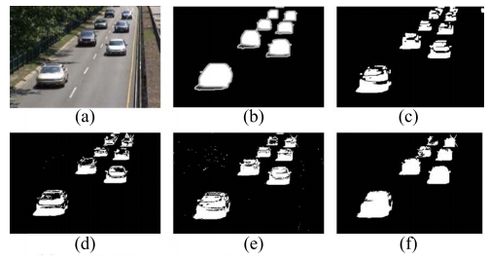
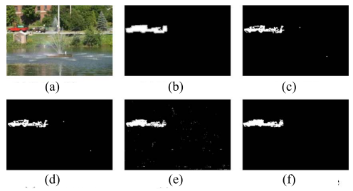
Experimental results (1/4)
Qualitative Analysis of Multiple Vehicles Detection.
(a) to (f) : original image, true value map, detection results of GMM, LBP-OTSU, ViBe and improved ViBe.
Effectively eliminates ghost shadows.
Less false detected pixels.

Slide 13
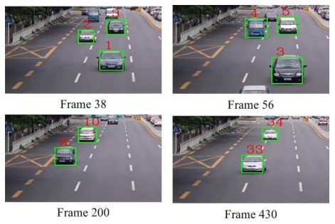
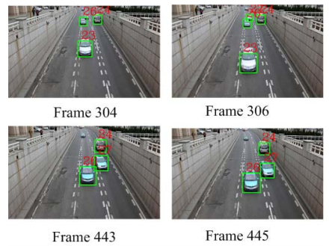
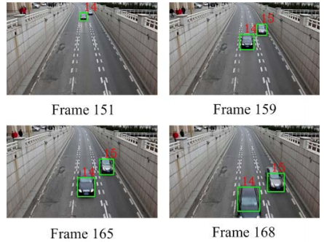
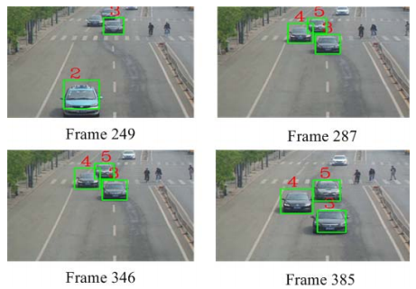
Experimental results (2/4)
Qualitative Analysis of Multiple Vehicles Tracking.
Vehicles moving from separation to occlusion situation.
Robustness to avoid interference and occlusion of vehicles

Slide 14
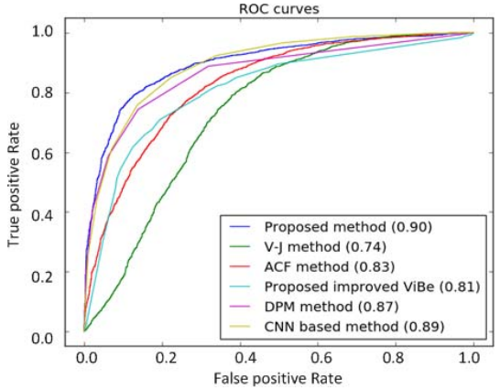
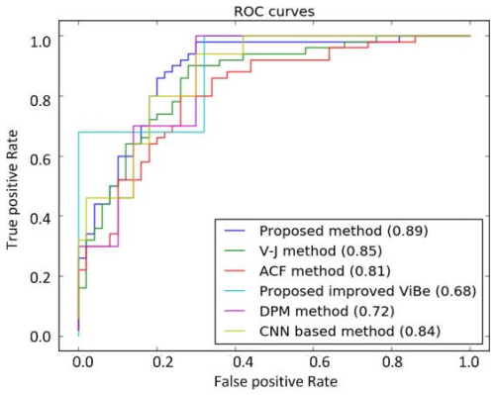
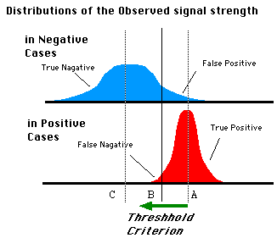
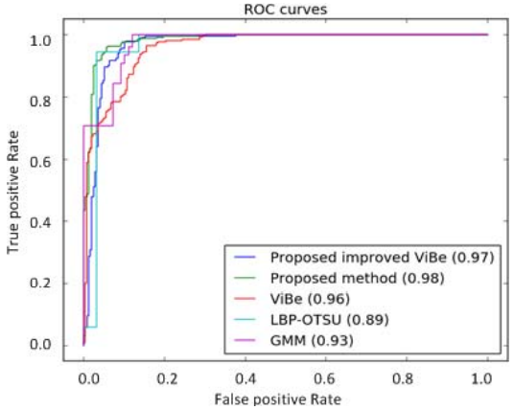
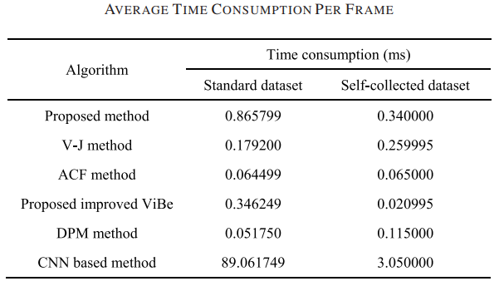
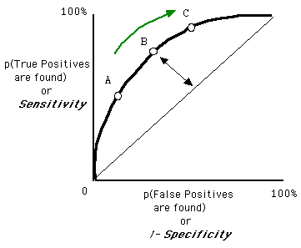
Experimental results (3/4)
Quantitative Analysis of Multiple Vehicles Detection.
Average ROC (receiver operating characteristic curve) of object detection methods on standard dataset and self-collected dataset.
Each point reflects the susceptibility to the same signal stimulus
Average ROC of foreground detection methods on videos.

Slide 15
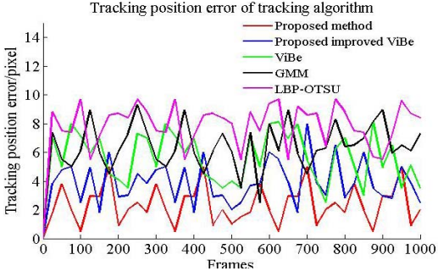
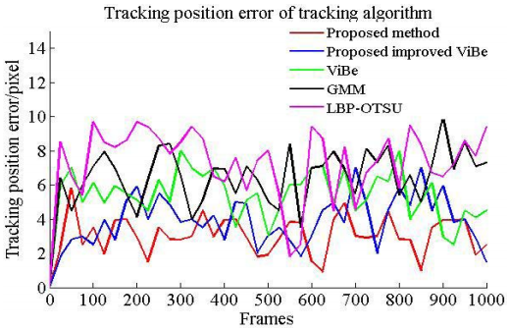
Experimental results (4/4)
Quantitative Analysis of Multiple Vehicles Tracking.
Tracking error of tracking algorithms on Highway video and Fountain video.

Slide 16
Conclusion
Track multiple vehicles with combination of robust detection and two classifiers.
Improved ViBe for robust and accurate detection of multiple vehicles. Restrains dynamic noise and removes the ghost shadows and object’s residual shadows.
Two classifiers to attack the problem of failure to track vehicles with occlusions. It has time efficiency advantage of SVM and high accuracy advantage of CNN.

Slide 17
Thank you for attention!

