Slide 1
Effective and Efﬁcient Detection of Moving Targets From a UAV’s Camera
Sara Minaeian, Jian Liu, and Young-Jun Son
IEEE Transactions on Intelligent Transportation Systems, Vol. 19, No. 2, Feb 2018
Presented by: Yang Yu {yuyang@islab.ulsan.ac.kr}
March. 10, 2018

Slide 2
Overview
Accurately detect and segment multiple independently moving foreground targets from a video taken by a monocular moving camera.
  Camera motion is estimated through tracking background keypoints using pyramidal Lucas–Kanade.
  Foreground segmentation is applied by integrating a local motion history function with spatio-temporal differencing over a sliding window.
  Perspective homography is used at image registration for effectiveness
  Detection interval is adjusted dynamically.

Slide 3
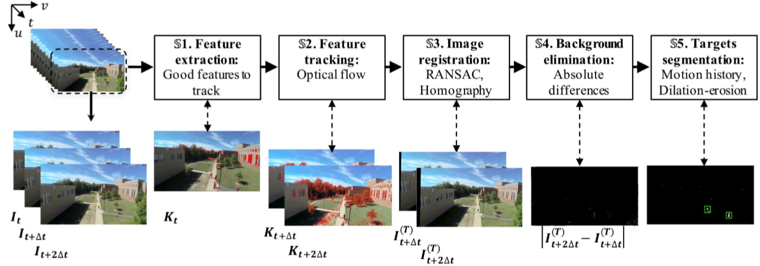
Framework of Moving Target Detection (1/2)
Framework for detection of moving targets via a monocular moving camera.
  Compensating the camera motion.
  Subtract the moving background.

Slide 4
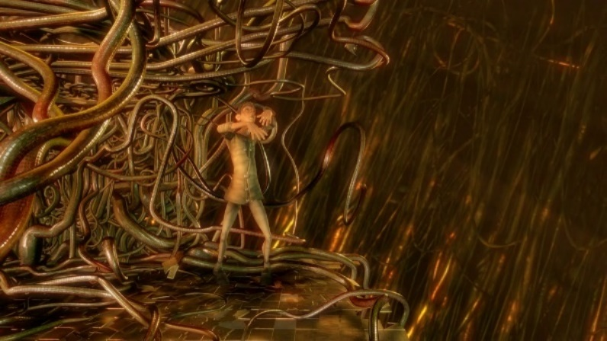
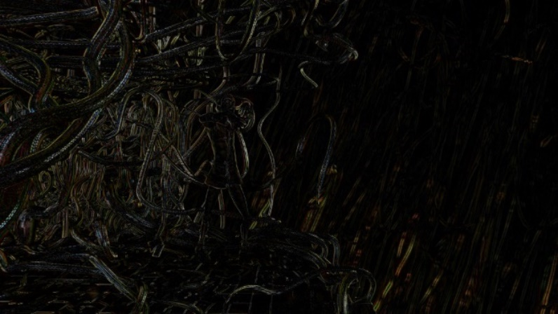
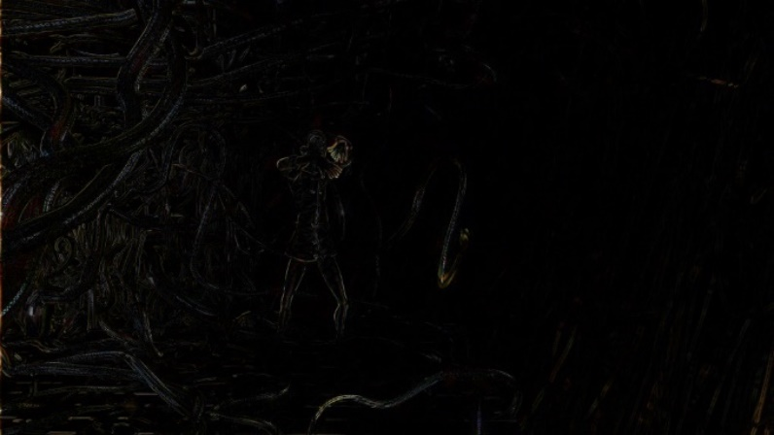
Motion compensation
Predict a frame in a video by accounting for motion of the camera.
  Original. Difference. Motion compensated difference.
  Shifted right by 2 pixels. Shifting frame compensates for panning of camera, thus there is greater overlap between two frames.

Slide 5
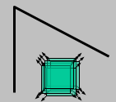
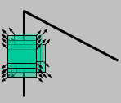
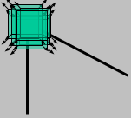
Corner Detection
Average grayscale change along direction [u,v].
Direction of rapid change
λ_{max}, λ_{min} ← Eigenvalues of M
Direction of slow change
(λ_{max})^{-1/2}
(λ_{min})^{-1/2}

Slide 6
Harris corner
Harris corner.
  Corner response function

Slide 7
Good Features To Track
Good Features To Track. KLT.
  Directly computes .
  Under certain assumptions, the corners are more stable for tracking.
Smaller eigenvalue is higher than a threshold (min(λ1,λ2)>λ)
  Threshold: image resolution and illumination, compensate for part of the noise.
  Lower bound on λ: a region of the image with rather uniform brightness,
  Upper bound: a highly-textured region.

Slide 8


Sliding Window
Use temporal sliding window of 3 frames with gap
for compensating the background
motion at different scales.
Extracted keypoints of frame t (non-constant reference) are tracked over two successive frames of and .
(number of frames in the interval)
  Frame per second (fps) rate of the video stream (R(c)),
  UAV’s altitude (A(v)),
  Algorithm computational complexity (O(c))
  UAV’s speed (S(v)).

Slide 9
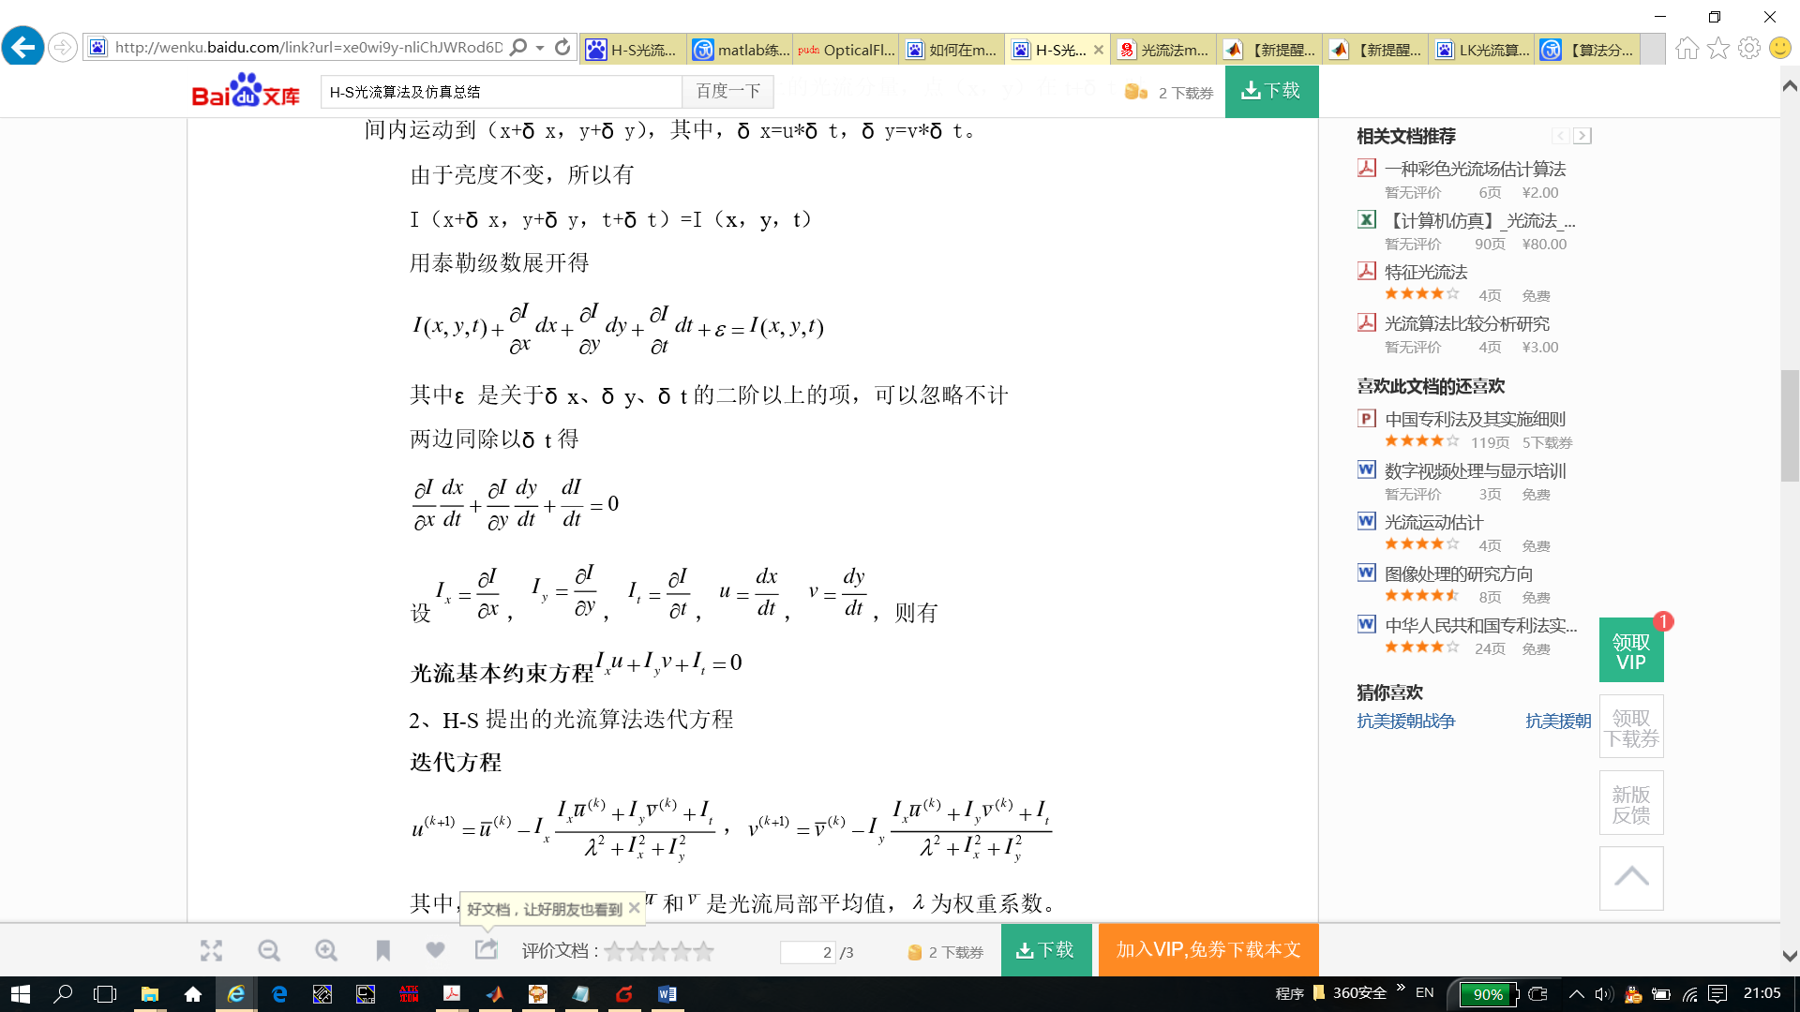
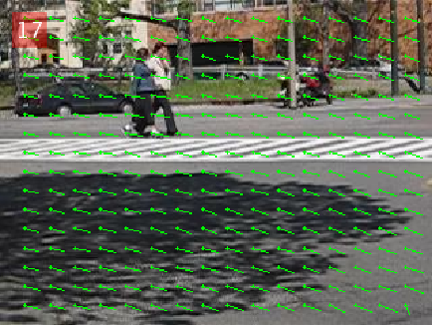
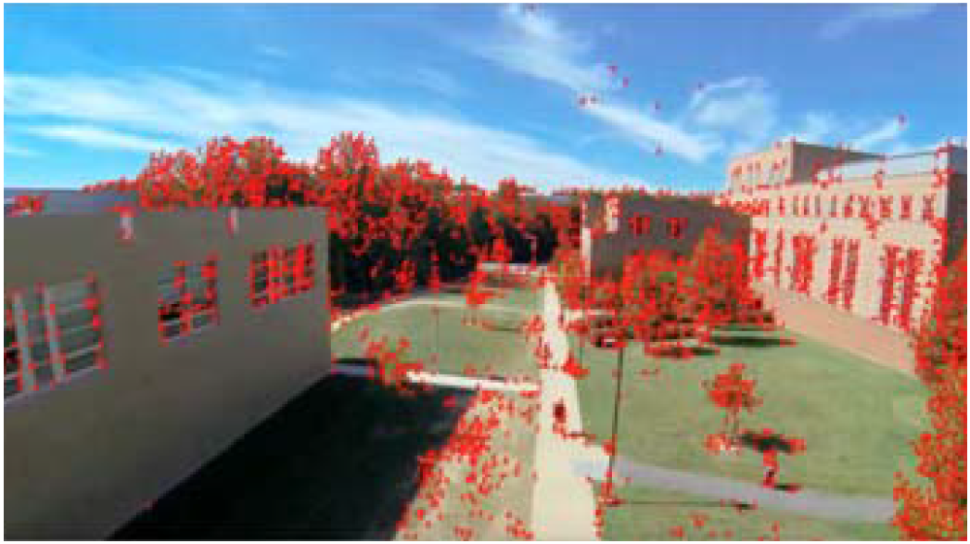
Optical Flow
Optical flow
Basic optical flow constraint equation.

Slide 10

Keypoints Matching
Optical flow: pyramidal Lucas–Kanade (PLK)
Consider keypoint neighborhood and solve an over-constrained system of equations for estimating the displacement.
Weighted least squares, a local, fast method
Keypoints displacement vector
  Vertical and horizontal displacements
  Spatial gradients and time-based derivative
Track keypoints over larger spatial scales of pyramid
Reﬁne initial motion velocity assumptions through its lower levels to raw image pixels.

Slide 11
Image Registration (1/2)
Transform each frame onto the reference frame based on camera motion estimation.
Homography (perspective transformation) estimation.
3× 3 Homography matrix: relationship between keypoints through a projective mapping from one plane (frame) to another
Filter out moving foreground keypoints and noise as outliers.
  Random sample consensus (RANSAC) is an iterative method to estimate parameters of a mathematical model from a set of observed data that contains outliers.
  RANSAC: define global motion, it ﬁnds a solution with the largest inlier support

Slide 12
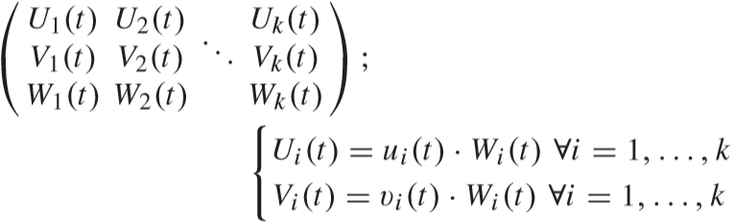
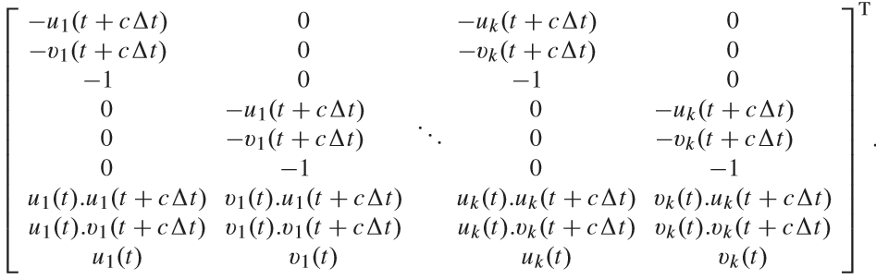
Image Registration (2/2)
Homography can be estimated.
  K: homogeneous coordinates of reﬁned keypoints (inliers).
    Vertical and horizontal position. arbitrary scalar(1, homogeneous coordinate)
  H: unknown Homography matrix.
  Can be estimated by solving Ah = 0, using homogeneous linear least squares.

Slide 13
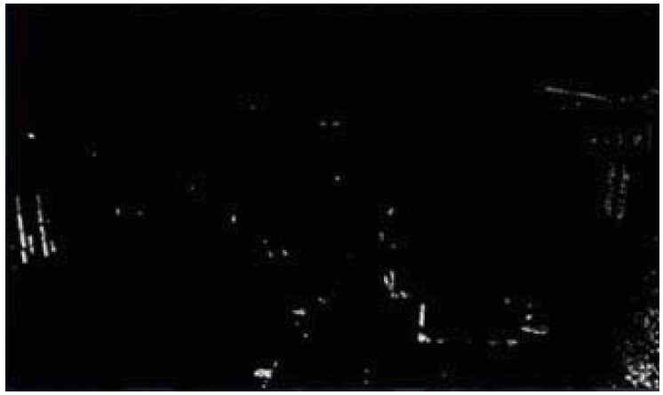

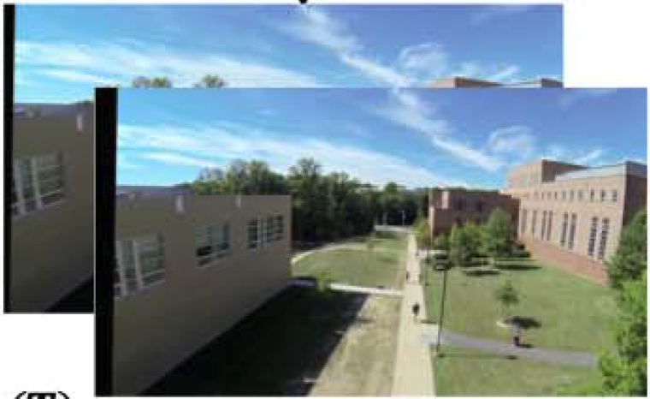
Background Eliminate
New pixel values of transformed frame , after being warped into frame t.
Eliminate background by taking absolute differences of these two perspective transformed images
  Registration error is minimized: use an independent reference image for transforming the successive frames.
  Threshold: get rid of shadowing regions and creating the silhouette mask of potential moving foreground.
Set boundary bars as background.
Registration and warping.

Slide 14
Moving Targets Segmentation (1/2)
Differentiate and segment multiple independently moving targets based on the local motion of their detected blobs.
Gaussian mask: separate independently moving targets regions
  Kernel size needs to be large enough to cover most of segmented blobs, but not so large that multiple blobs are overlapped at a time.
Connected-components analysis: camera motion estimation error
  Cluster the closely moving foreground regions that are potentially parts of a uniﬁed target

Slide 15
Moving Targets Segmentation (2/2)
Morphological operations (erosion and dilation)
  Remove separate noises and ﬁlling the holes in the segmented blobs belonging to the same uniﬁed moving targets in the foreground.
  Edge regions: segmented due to slight movement.
  “Large enough” blobs: multiple uniﬁed moving foreground targets
Local motion history: track segmented blobs over time
  Form a representation of overall motion, by taking gradient of silhouette image over time.
  Motion gradient and orientation parameters of every single region: estimate the general movement direction of each moving target.
  Motion segmentation routine: separate independently moving targets based on their local motions.

Slide 16
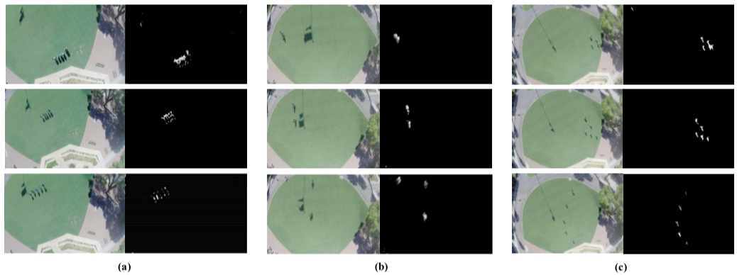
Experimental results (1/6)
Results of different scenarios captured by UAV:
  (a) A crowd of 4 people moving together;
  (b) A crowd of 4 people splitting into two groups and a bicyclist passing by (at faster speed);
  (c) A group of 5 people scattering.

Slide 17
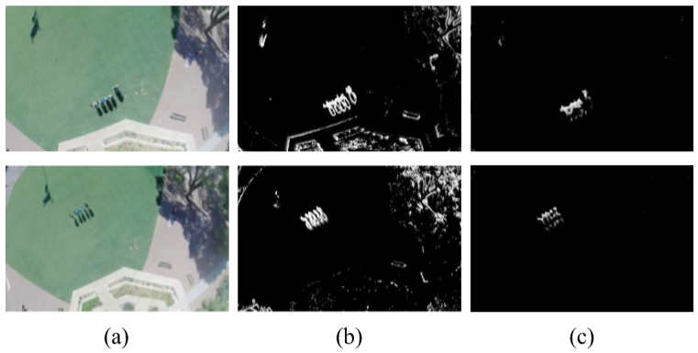
Experimental results (2/6)
Comparison with perspective and afﬁne transformation:
  (a) Original video frames;
  (b) Results of afﬁne transformation;
  (c) Results of the proposed method.

Slide 18
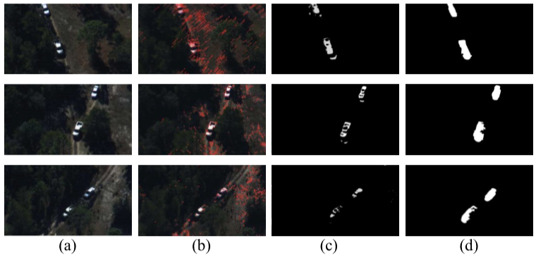
Experimental results (3/6)
Results of Dataset1, at three frames: t=185; t=329; t=521:
  (a) Original frames; (b) Optical ﬂow vectors;
  (c) Detected foreground; (d) Ground-truth blobs

Slide 19
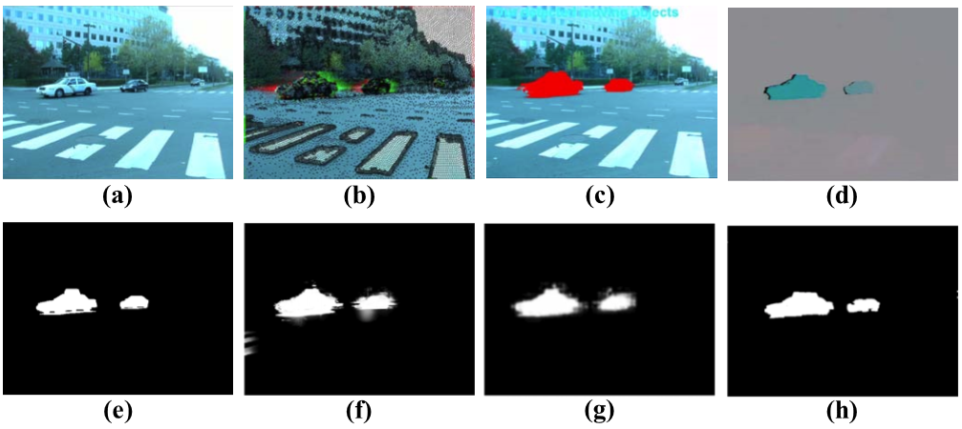
Experimental results (4/6)
Comparison with exiting methods on Dataset2:
  (a) Original frame; (e) Ground-truth data;
  (b) Multi-layer Homography (MLH); (c) Background motion subtraction (BMS); reconstruct camera motion by interpolation
  (d) Particle video (PV); (f) Moving camera background subtraction (MCBS);
  (g) Segmentation with effective cue (SEC); (h) Results of our proposed method.

Slide 20
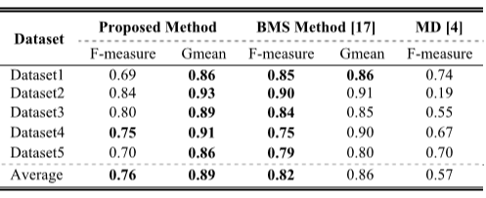
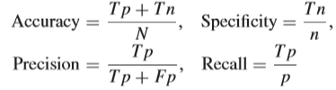

Experimental results (5/6)
Quantitative performance analyses compared to some other methods which have reported their results on the datasets.
  p: positive (foreground) pixels number
  n: negative (background) pixels number reported by detection algorithm
  Tp: true positives
  Tn: true negatives in test frame compared to ground truth
  Fp: false positives
  Fn: false negatives in the test frame
  N: total number of pixels in test frame, depending on image resolution.

Slide 21
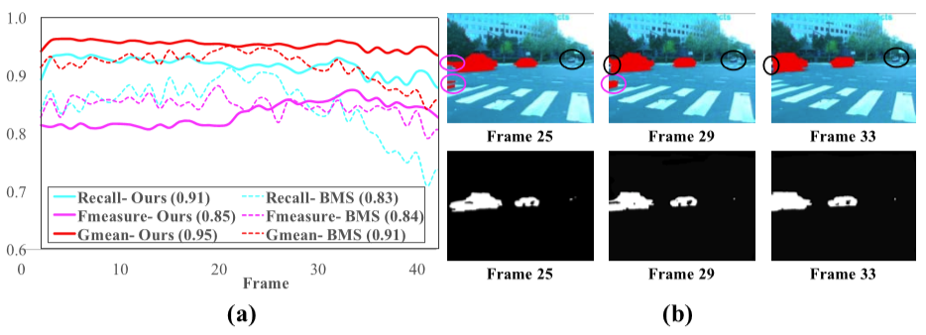
Experimental results (6/6)
Performance comparison with BMS on parts of Dataset2:
  (a) Mean and standard deviation of the metrics;
  (b) Results of applying the two methods on a series of frames to justify better performance of the proposed method on Recall.

Slide 22
Conclusion
Detecte multiple independently moving targets from a monocular moving camera.
Keypoints are extracted and tracked onto the next two frames in Sliding-window framework.
Frames are registered through perspective transformation onto frame t.
Local motion history is used to separate the independently moving targets.

Slide 23
Thank you for attention!

Slide 24


Image Matching using RANSAC
Key point matches
Choose a random subset
Calculate the geometrical transformations (H) of key points between images
$$H$$
Calculate outliers
Save the transformation if it gives smaller outliers, also save the selected subset of correspondences
$$\tilde{H}$$
Is satisfied?
Removes bad correspondences

Slide 25






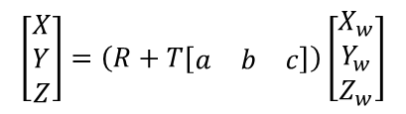



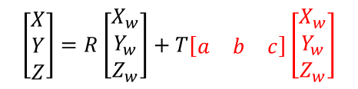


Plane + Perspective Projection
Plane equation: $aX+bY+cZ=1$
Plane equation in perspective projection
Simplify:
Each element:
$$\left[\begin{matrix}a & b & c\end{matrix}\right]\left[\begin{matrix}X \\ Y \\ Z\end{matrix}\right]=1$$
$$\left[\begin{matrix}X \\ Y \\ Z\end{matrix}\right]=R\left[\begin{matrix}X_{w} \\ Y_{w} \\ Z_{w}\end{matrix}\right]+T\left[\begin{matrix}a & b & c\end{matrix}\right]\left[\begin{matrix}X_{w} \\ Y_{w} \\ Z_{w}\end{matrix}\right]$$
$$=1$$
$$\left[\begin{matrix}X \\ Y \\ Z\end{matrix}\right]=\left(R+T\left[\begin{matrix}a & b & c\end{matrix}\right]\right)\left[\begin{matrix}X_{w} \\ Y_{w} \\ Z_{w}\end{matrix}\right]$$
$$\left[\begin{matrix}X \\ Y \\ Z\end{matrix}\right]=A\left[\begin{matrix}X_{w} \\ Y_{w} \\ Z_{w}\end{matrix}\right]$$
Normalize by $Z_{w}$
$$X=a_{1}X_{w}+a_{2}Y_{w}+a_{3}Z_{w}$$
$$x=\frac{X}{Z}=\frac{a_{1}x_{w}+a_{2}y_{w}+a_{3}}{a_{7}x_{w}+a_{8}y_{w}+a_{9}}$$
$$Y=a_{4}X_{w}+a_{5}Y_{w}+a_{6}Z_{w}$$
Scale ambiguity:
$$a_{9}=1$$
$$Z=a_{7}X_{w}+a_{8}Y_{w}+a_{9}Z_{w}$$
$$y=\frac{Y}{Z}=\frac{a_{4}x_{w}+a_{5}y_{w}+a_{6}}{a_{7}x_{w}+a_{8}y_{w}+a_{9}}$$

Slide 26
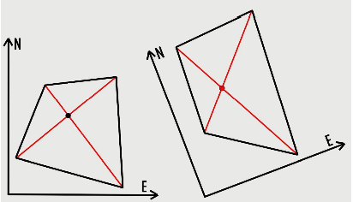



The Homography Transformation
Solution: solve the following linear equation using 8 sample points
$$x′=\frac{ax+by+c}{gx+hy+1}$$
$$y^{′}=\frac{dx+ey+f}{gx+hy+1}$$
Example of homography transform
$$\left[\begin{aligned}\begin{matrix}x_{1} & y_{1} & 1 & 0 & 0 & 0 & −x_{1}x_{1}^{′} & −y_{1}x_{1}^{′} \\ x_{2} & y_{2} & 1 & 0 & 0 & 0 & −x_{2}x_{2}^{′} & −y_{2}x_{2}^{′} \\ x_{3} & y_{3} & 1 & 0 & 0 & 0 & −x_{3}x_{3}^{′} & −y_{3}x_{3}^{′} \\ x_{4} & y_{4} & 1 & 0 & 0 & 0 & −x_{4}x_{4}^{′} & −y_{4}x_{4}^{′}\end{matrix} \\ \begin{matrix}0 & 0 & 0 & x_{1}^{′} & y_{1}^{′} & 1 & −x_{1}y_{1}^{′} & −y_{1}y_{1}^{′} \\ 0 & 0 & 0 & x_{2}^{′} & y_{2}^{′} & 1 & −x_{2}y_{2}^{′} & −y_{2}y_{2}^{′} \\ 0 & 0 & 0 & x_{3}^{′} & y_{3}^{′} & 1 & −x_{3}y_{3}^{′} & −y_{3}y_{3}^{′} \\ 0 & 0 & 0 & x_{4}^{′} & y_{4}^{′} & 1 & −x_{4}y_{4}^{′} & −y_{4}y_{4}^{′}\end{matrix}\end{aligned}\right]\left[\begin{matrix}a \\ b \\ c \\ d \\ e \\ f \\ g \\ h\end{matrix}\right]=\left[\begin{matrix}x_{1}^{′} \\ x_{2}^{′} \\ x_{3}^{′} \\ x_{4}^{′} \\ x_{5}^{′} \\ x_{6}^{′} \\ x_{7}^{′} \\ x_{8}^{′}\end{matrix}\right]$$
Image: http://www.corrmap.com/features/homography_transformation.php

