Slide 1
Temporal Convolutional Networks for Action Segmentation and Detection
Colin Lea, Michael D. Flynn, Ren´e Vidal, Austin Reiter, Gregory D. Hager
Johns Hopkins University, CVPR-2017
Sowmya Kasturi
sowmya@islab.ulsan.ac.kr
Feb. 10, 2018

Slide 2
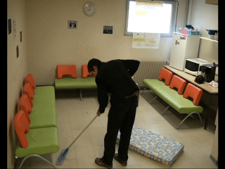
Main idea
To identify and temporally segment fine grained human action (Focus on modeling situated activities) throughout a video
Segment : start time, end time, and class label
  Action segmentation methods predict what action is occurring at every frame in a video
Action : Sparse set of segments
Typical approaches extract local spatiotemporal features from video frames and feed them into a temporal classifier that captures high level temporal patterns
For action segmentation and detection despite being the same problem the metrics by which they are evaluated are different

Slide 3

Temporal Convolutional Networks
Time-series models, called Temporal Convolutional Networks (TCNs) overcome the previous shortcomings by capturing long range patterns using a hierarchy of temporal convolutional filters
TCN’s capable of capturing action compositions, segment durations, transitions between segments and long range dependencies
Computations are performed layer-wise, meaning every time-step is updated simultaneously, instead of updating sequentially per-frame
Convolutions are computed across time
$T$ may vary for each video sequence
Encoder-decoder TCN
Uses temporal convolutions, pooling, up sampling
Uses dilated convolutions
Relatively small number of layers
Each layer contains a set of long convolutional filters
Adds skip connections between layers
Dilated TCN
Relatively short filters and more layers
Notes:
As already mentioned encoder uses temporal convolutions
Pooling enables us to efficiently compute activations over long temporal windows

Slide 4
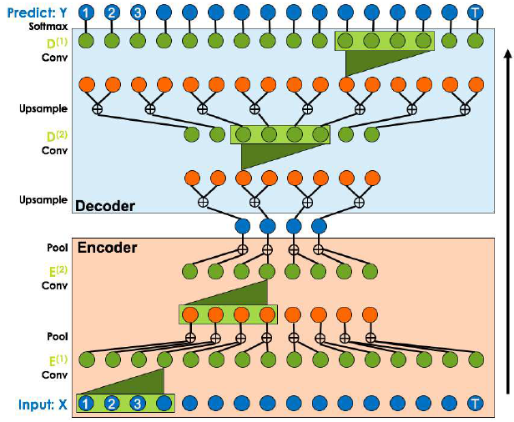
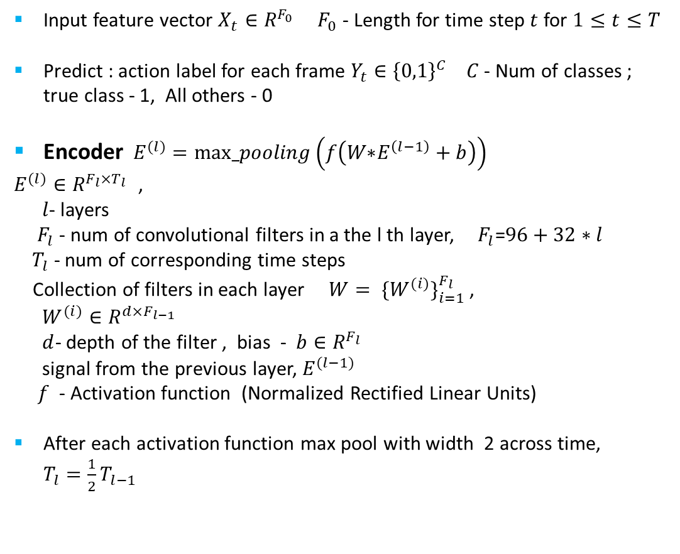
Encoder decoder TCN(1/2)
Input feature vector $X_{t}∈R^{F_{0}}$ $F_{0}$ - Length for time step $t$ for $1≤t≤T$
Predict : action label for each frame $Y_{t}∈{\left\{0,1\right\}}^{C}$ $C$ - Num of classes ; true class - 1, All others - 0
Encoder $E^{(l)}=max_pooling\left(f\left(W\text{∗}E^{\left(l−1\right)}+b\right)\right)$
$E^{(l)}∈R^{F_{l}×T_{l }}$,
$l$- layers
${ F}_{l}$ - num of convolutional filters in a the l th layer, ${ F}_{l}$=$96+32∗l$ ${ T}_{l}$ - num of corresponding time steps
Collection of filters in each layer ${W= \{W^{(i)}\}}_{i=1}^{F_{l}}$ ,
$W^{(i)}∈R^{d×F_{l−1}}$
$d$- depth of the filter , bias - $b∈R^{F_{l}}$
signal from the previous layer, $E^{(l−1)}$
$f$ - Activation function (Normalized Rectified Linear Units)
After each activation function max pool with width 2 across time, $T_{l}=\frac{1}{2}T_{l−1}$
Notes:
Encoder : Each layer consists of temporal convolutions, a non-linear activation function, and max pooling across time

Slide 5
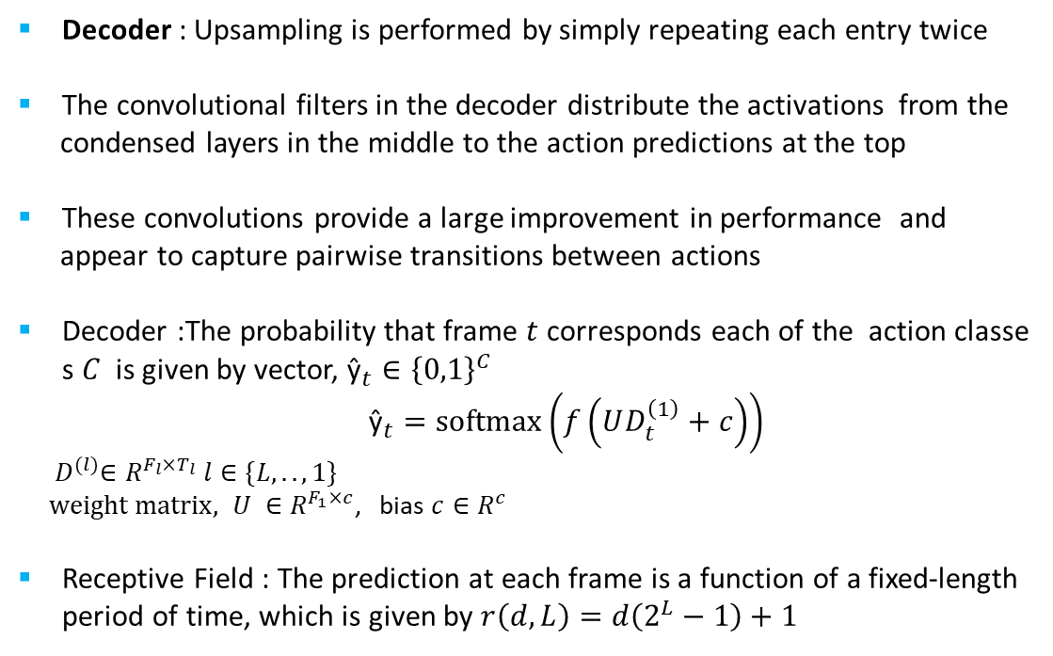
Encoder decoder TCN(2/2)
Decoder : Upsampling is performed by simply repeating each entry twice
The convolutional filters in the decoder distribute the activations from the
condensed layers in the middle to the action predictions at the top
These convolutions provide a large improvement in performance and
appear to capture pairwise transitions between actions
Decoder :The probability that frame $t$ corresponds each of the action classes $C$ is given by vector, ${\text{ŷ}}_{t}∈{\left\{0,1\right\}}^{C}$
${\text{ŷ}}_{t}=softmax\left(f\left(UD_{t}^{\left(1\right)}+c\right)\right)$
${ D}^{(l)}∈R^{F_{l}×T_{l}} l∈\{L,..,1\}$
$weight matrix, U ∈R^{F_{1}×c}$, bias $c∈R^{c}$
Receptive Field : The prediction at each frame is a function of a fixed-length period of time, which is given by $r\left(d,L\right)=d\left(2^{L}−1\right)+1$

Slide 6
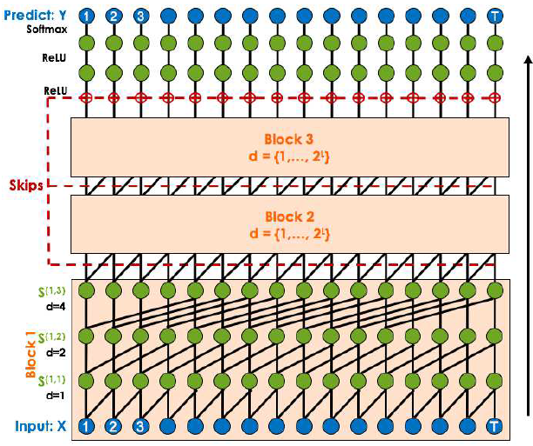
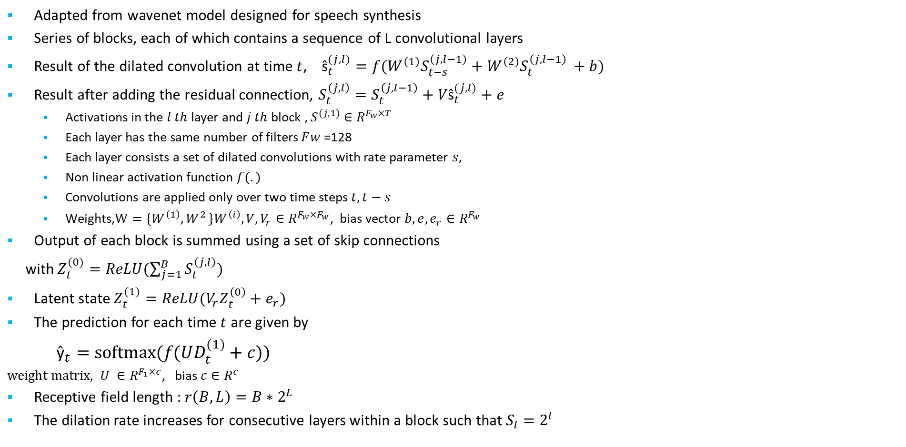
Dilated TCN
Adapted from wavenet model designed for speech synthesis
Series of blocks, each of which contains a sequence of L convolutional layers
Result of the dilated convolution at time $t$, ${\text{s}\text{̂}}_{t}^{(j,l)}=f(W^{\left(1\right)}S_{t−s}^{\left(j,l−1\right)}+W^{\left(2\right)}S_{t}^{\left(j,l−1\right) }+b)$
Result after adding the residual connection, $S_{t}^{\left(j,l\right)}=S_{t}^{\left(j,l−1\right)}+V{\text{s}\text{̂}}_{t}^{(j,l)}+e$
  Activations in the $l th$ layer and $j th$block , $S^{(j,1)}$ $∈R^{F_{w}×T}$
  Each layer has the same number of filters $F﷮w$ =128
  Each layer consists a set of dilated convolutions with rate parameter $s,$
  Non linear activation function $f(.)$
  Convolutions are applied only over two time steps $t, t−s$
  ${\text{Weights}\text{,}W=\{W^{\left(1\right)}{,W}^{2}\}W}^{\left(i\right)},V,V_{r}∈R^{F_{w}×F_{w}}$, bias vector $b,{e,e_{r}∈R}^{F_{w}}$
Output of each block is summed using a set of skip connections
with $Z_{t}^{(0)}=ReLU(\sum_{j=1}^{B}{S_{t}^{\left(j,l\right)}})$
Latent state $Z_{t}^{(1)}=ReLU(V_{r}Z_{t}^{\left(0\right)}+e_{r})$
The prediction for each time $t$ are given by
${\text{ŷ}}_{t}=softmax(f(UD_{t}^{(1)}+c))$
$weight matrix, U ∈R^{F_{1}×c}$, bias $c∈R^{c}$
Receptive field length : $r\left(B,L\right)=B∗2^{L}$
The dilation rate increases for consecutive layers within a block such that $S_{l}=2^{l}$
Notes:
Because models with causal convolutions do not have recurrent connections, they are typically faster to train than RNNs, especially when applied to very long sequences
$F﷮w$ , which enables us to combine activations from different layers using skip connections later.

Slide 7
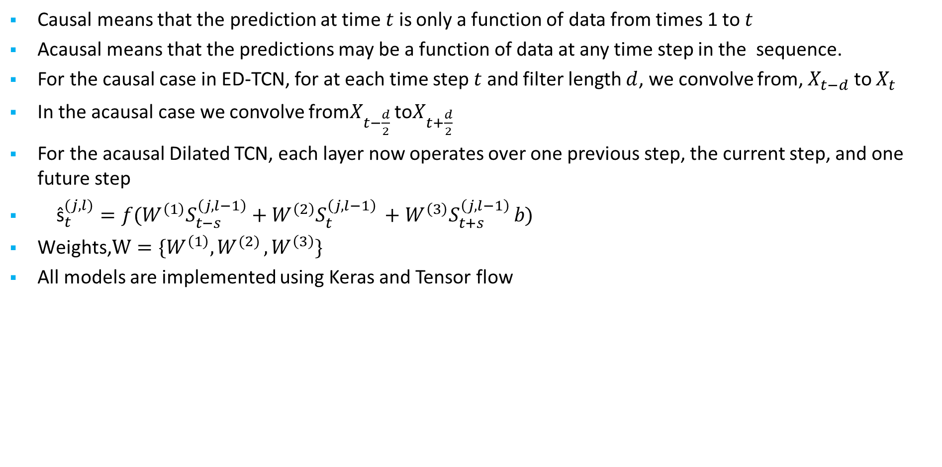
Causal versus Acausal
Causal means that the prediction at time $t$ is only a function of data from times 1 to $t$
Acausal means that the predictions may be a function of data at any time step in the sequence.
For the causal case in ED-TCN, for at each time step $t$ and filter length $d$, we convolve from, $X_{t−d}$ to $X_{t}$
In the acausal case we convolve from$X_{t−\frac{d}{2}}$ to$X_{t+\frac{d}{2}}$
For the acausal Dilated TCN, each layer now operates over one previous step, the current step, and one future step
${\text{s}\text{̂}}_{t}^{(j,l)}=f(W^{\left(1\right)}S_{t−s}^{\left(j,l−1\right)}+W^{\left(2\right)}S_{t}^{\left(j,l−1\right) }+W^{\left(3\right)}S_{t+s}^{\left(j,l−1\right) }b)$
$\text{Weights}\text{,} W=\{W^{\left(1\right)}{,W}^{(2)},W^{\left(3\right)}\}$
All models are implemented using Keras and Tensor flow

Slide 8
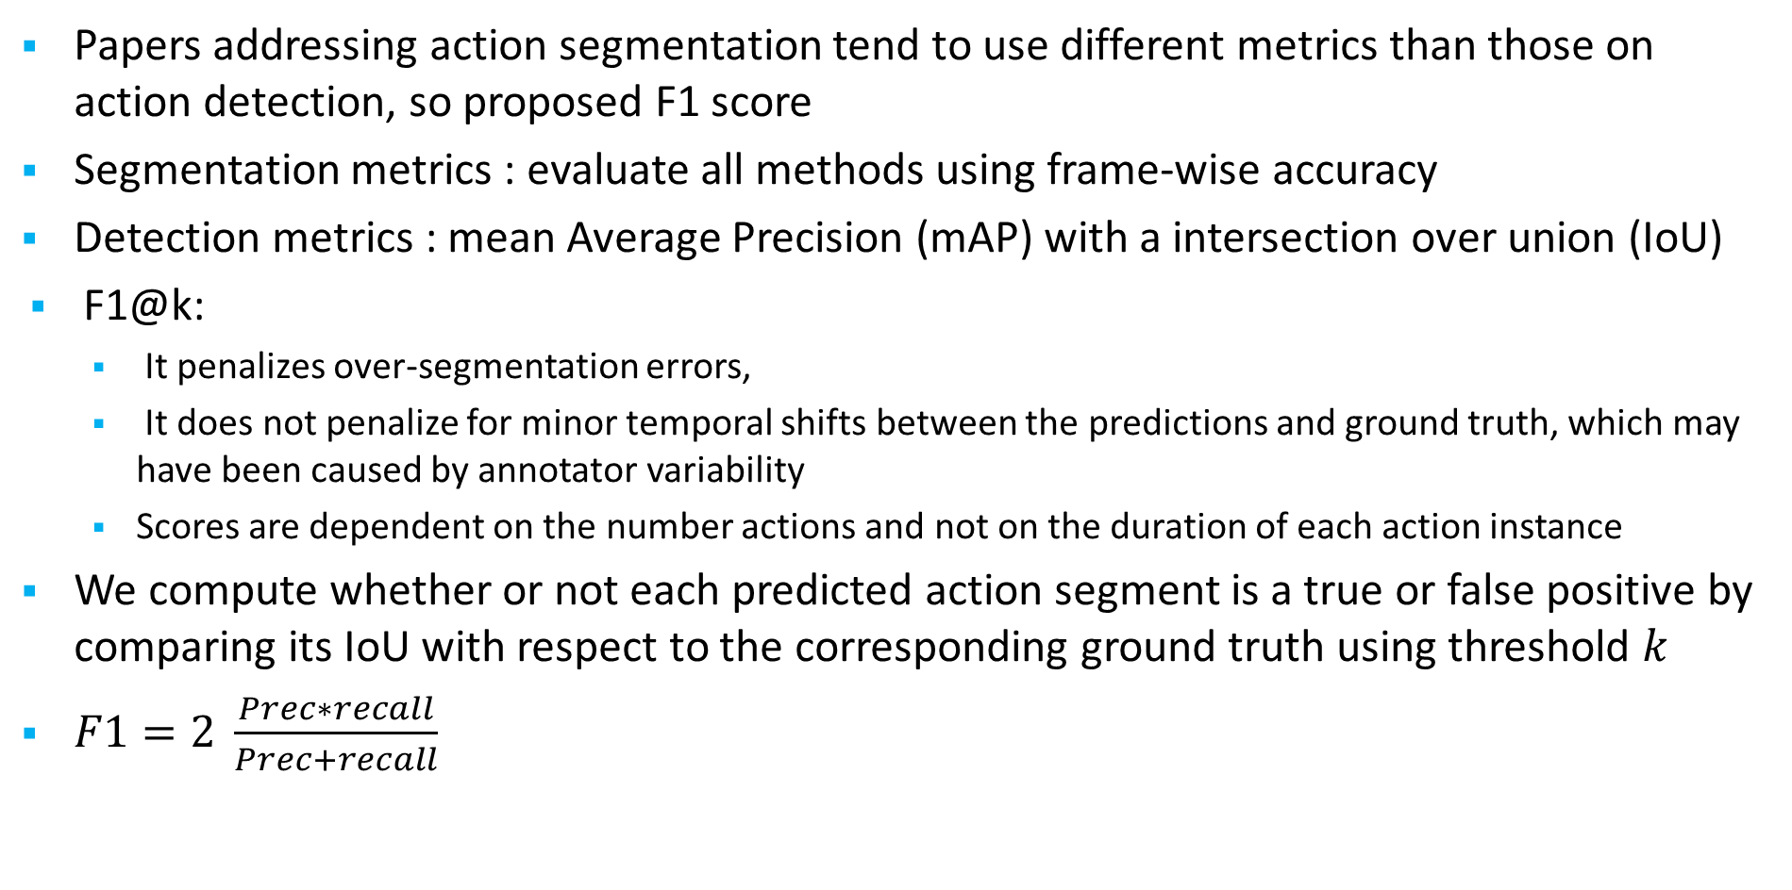
Evaluation metrics
Papers addressing action segmentation tend to use different metrics than those on action detection, so proposed F1 score
Segmentation metrics : evaluate all methods using frame-wise accuracy
Detection metrics : mean Average Precision (mAP) with a intersection over union (IoU)
F1@k:
  It penalizes over-segmentation errors,
  It does not penalize for minor temporal shifts between the predictions and ground truth, which may have been caused by annotator variability
  Scores are dependent on the number actions and not on the duration of each action instance
We compute whether or not each predicted action segment is a true or false positive by comparing its IoU with respect to the corresponding ground truth using threshold $k$
$F1=2 \frac{Prec∗recall}{Prec+recall}$
Notes:
mAP@k is computed my comparing the overlap score for each segment with respect to the ground truth action of the same class
IoU score $>$ $k$ percent true positive otherwise it is a false positive.

Slide 9
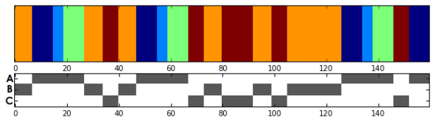
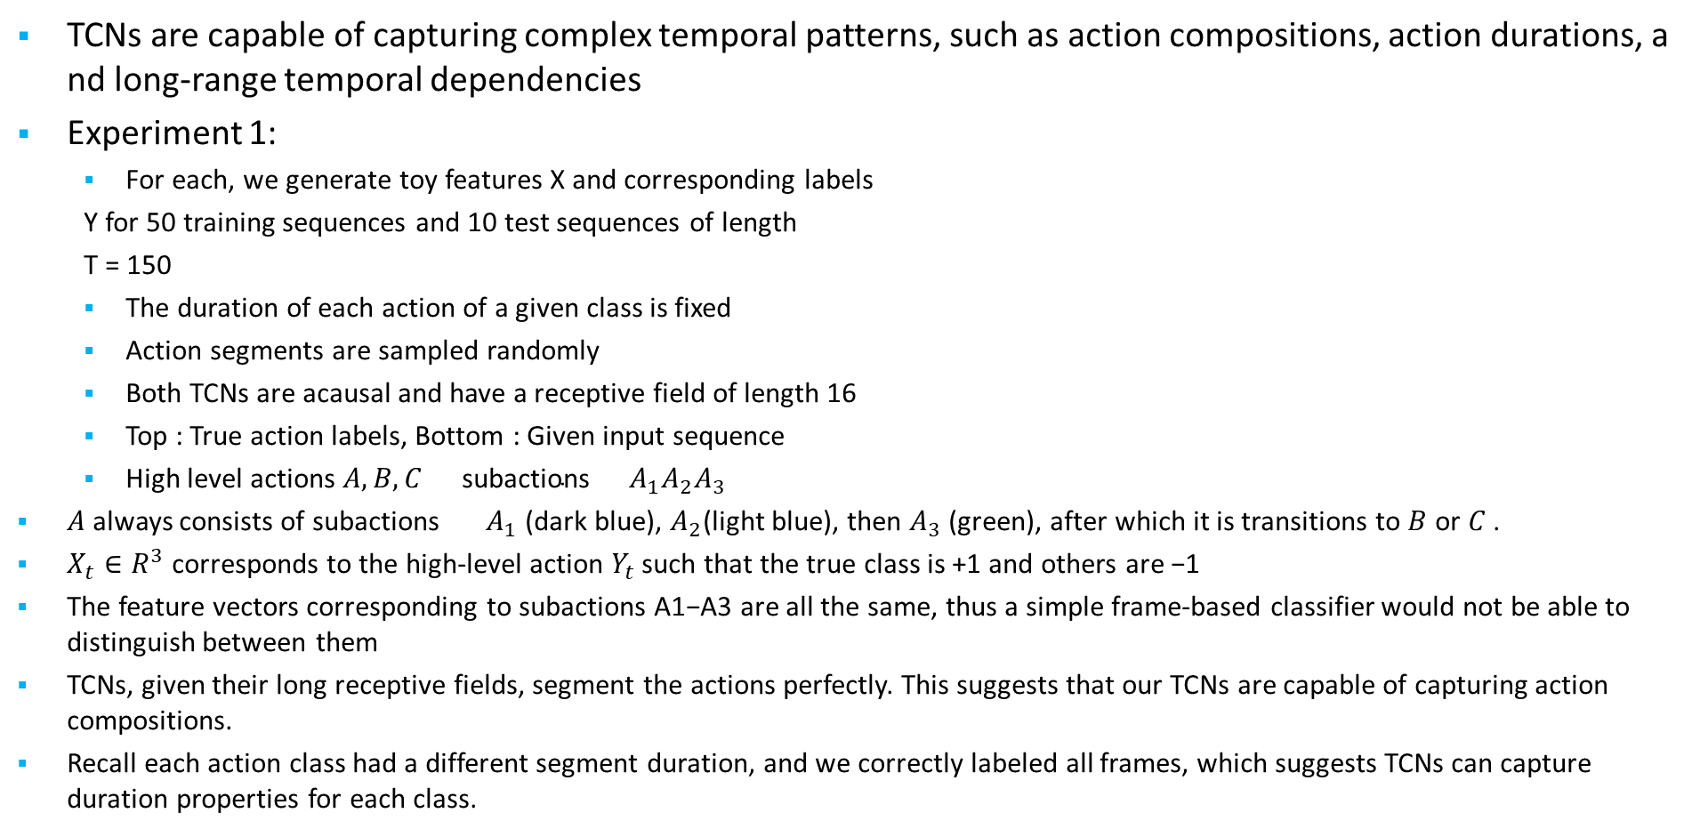
Synthetic Experiments(1/2)
TCNs are capable of capturing complex temporal patterns, such as action compositions, action durations, and long-range temporal dependencies
Experiment 1:
  For each, we generate toy features X and corresponding labels
  Y for 50 training sequences and 10 test sequences of length
  T = 150
  The duration of each action of a given class is fixed
  Action segments are sampled randomly
  Both TCNs are acausal and have a receptive field of length 16
  Top : True action labels, Bottom : Given input sequence
  High level actions $A,B,C \text{subactions}{{ A}_{1}A}_{2}A_{3}$
$A$ always consists of subactions ${ A}_{1}$(dark blue), $A_{2}$(light blue), then $A_{3}$(green), after which it is transitions to $B$ or $C$ .
$X_{t}∈R^{3}$ corresponds to the high-level action $Y_{t}$ such that the true class is +1 and others are −1
The feature vectors corresponding to subactions A1−A3 are all the same, thus a simple frame-based classifier would not be able to distinguish between them
TCNs, given their long receptive fields, segment the actions perfectly. This suggests that our TCNs are capable of capturing action compositions.
Recall each action class had a different segment duration, and we correctly labeled all frames, which suggests TCNs can capture duration properties for each class.

Slide 10
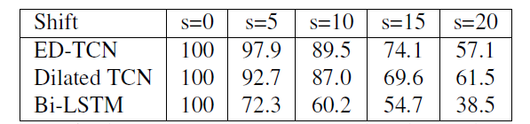
Synthetic Experiments(2/2)
Experiment 2 :
Shifting input features in time with respect to true labels and observe F1 scores
This experiment shows TCNs are capable of learning these long-range temporal patterns by adding a temporal delay to the features.
As the delay increases, ED-TCN and Dilated TCN perform very well up to about half the length of the receptive field.

Slide 11
Datasets(1/3)
University of Dundee 50 Salads : (Both)
25 people preparing 2 mixed salads each and contains over 4h of annotated accelerometer and RGB-D video data ( 640x480 pixels at 30 Hz)
Used only Video data 5-10 minutes in duration each video ,30 instances of actions such as cut tomato or peel Cucumber
Total 50 instances
Cross validation with 5 splits on Higher level action classes (9) - add dressing, add oil, cut, mix ingredients, peel, and place, background class
Mid level action classes (17) – Cut tomato, cut cucumber
CNN features from a VGG style model trained on 50 salads [1]
Data was downsampled to approximately 1 Frame Per Second (FPS).
[1] C. Lea, A. Reiter, R. Vidal, and G. D. Hager. Segmental spatio-temporal CNNs for fine-grained action segmentation 2016

Slide 12
Datasets(2/3)
MERL shopping - Mitsubishi Electric Research Laboratories (action detection)
106 surveillance-style videos in which users interact with items on store shelves, few seconds long
The camera viewpoint is fixed and only one user is present in each video
Five action classes,
  Reach to shelf
  Retract hand from shelf
  Hand in shelf
  Inspect product
  Inspect shelf
VGG-style spatial CNNs: RGB, optical flow cropped RGB, optical flow. We stack the four feature types for each frame and use Principal Components Analysis with 50 components to reduce the dimensionality.
The train, validation, and test splits are the same as described in [2]
Data is sampled at 2.5 FPS
[2] B. Singh, T. K. Marks, M. Jones, O. Tuzel, and M. Shao. A multi-stream bi-directional recurrent neural network for finegrained action detection. 2016

Slide 13
Datasets(3/3)
Georgia Tech Egocentric Activities (GTEA) : (Action Segmentation)
Contains 28 videos 4 subjects performing of 7 kitchen activities such as making a sandwich and making coffee(Top view pointed towards hands)
Each videos is about a minute long and contains on average 19 (non-background) actions
We use the 11 action classes : Pick, Open, Scoop, Close, Pour, Stir, Background, spread, put, fold, dip
Cross-validation is performed over users 1-3
Frame rate of 3 FPS
Spatial CNNs using [1] simplified VGG-style network where the input for each frame is a pair of RGB and motion images

Slide 14
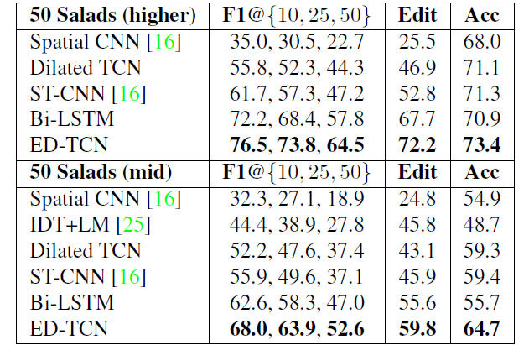
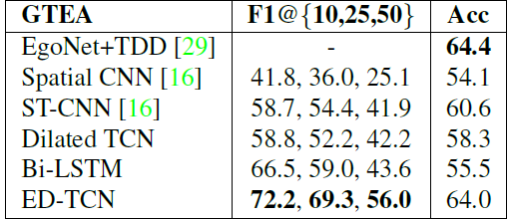
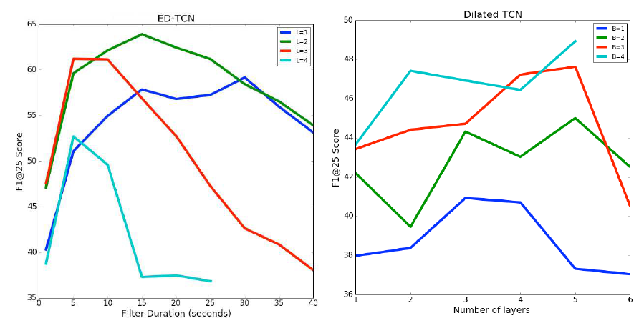
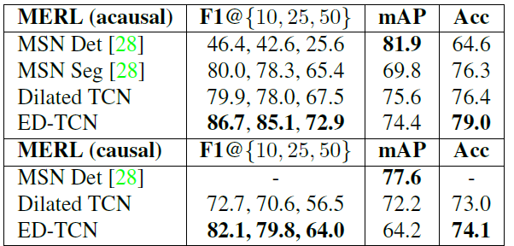
Experimental results (1/2)

Slide 15
Experimental results (22/2)
Notes:
GPC : gated pixel CNN

Slide 16
Conclusion
Introduced Temporal Convolutional Networks, which use a hierarchy of convolutions to capture long-range temporal patterns
Showed on synthetic data that TCNs are capable of capturing complex patterns such as compositions, action durations, and are robust to time-delays
Outperformed strong baselines, including Bidirectional LSTM, and achieve state of the art performance on challenging datasets
The long filters in ED-TCN have a strong positive affect on F1 performance, in particular because they prevent over-segmentation issues. The Dilated TCN performs well on metrics like accuracy, but is less robust to over-segmentation. This is likely due to the short filter lengths in each layer
My impression :
Idea is good for long action sequences
Results are promising and wide range of experiments are performed
Planning to adapt this idea and give the output of my spatio-temporal 3DCNN features

Slide 17


Slide 18
APPENDIX

Slide 19
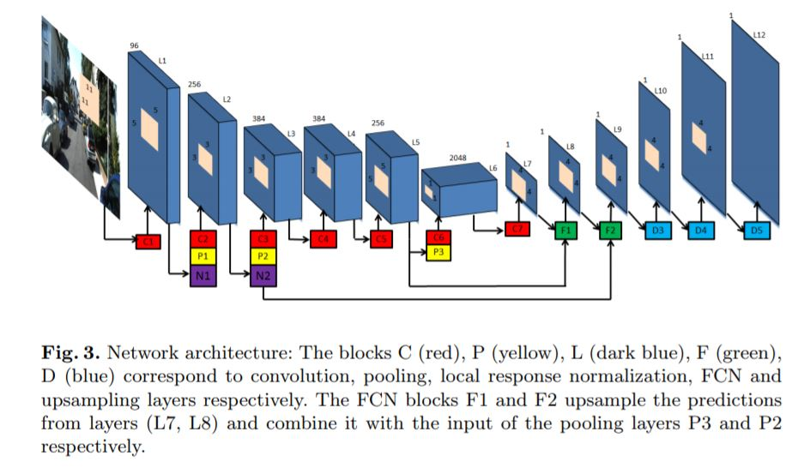
Skip architecture
Skip architecture : skips some layer in the neural network and feeds the output of one layer as the input to the next layer as well as some other layer (instead of only the next layer)
There was some information that was captured in the initial layers and is required for reconstruction during the up-sampling done using the FCN layer
If we would not have used the skip architecture that information would have been lost
So the information that we had in the primary layers can be fed explicitly to the later layers using the skip architecture.

Slide 20
Residual block

Slide 21
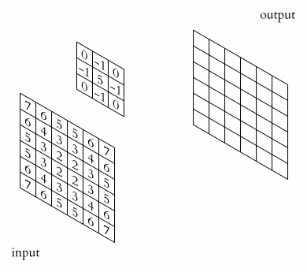
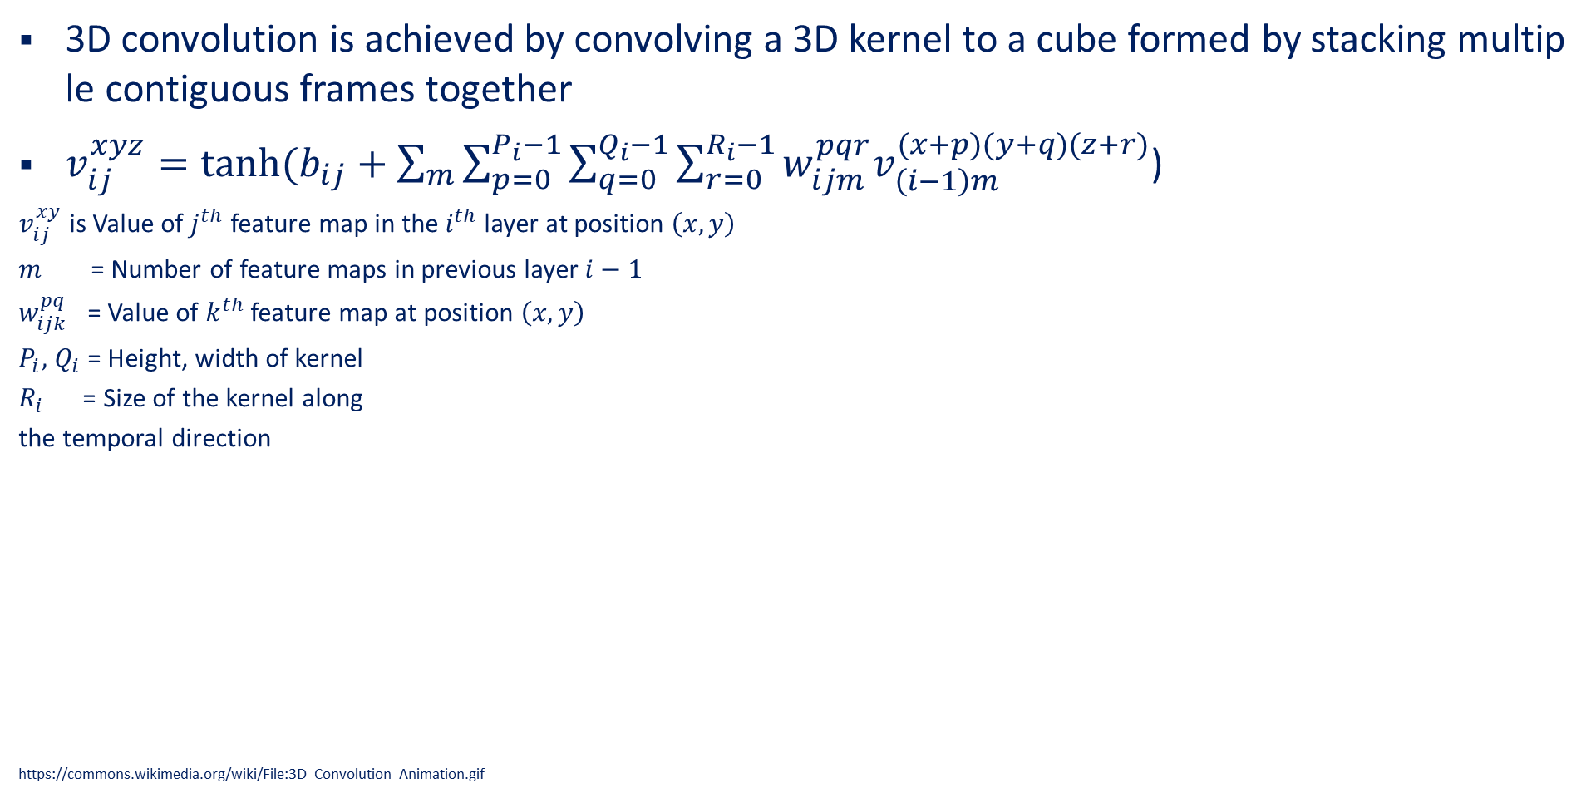
Temporal convolution
3D convolution is achieved by convolving a 3D kernel to a cube formed by stacking multiple contiguous frames together
$v_{ij}^{xyz}=tanh⁡(b_{ij}+\sum_{m}{\sum_{p=0}^{P_{i}−1}{\sum_{q=0}^{Q_{i}−1}{\sum_{r=0}^{R_{i}−1}{w_{ijm}^{pqr}v_{\left(i−1\right)m}^{(x+p)(y+q)(z+r)}}}}}$)
$v_{ij}^{xy}$ is Value of $j^{th}$ feature map in the $i^{th}$layer at position $\left(x,y\right)$
$m$= Number of feature maps in previous layer $i−1$
$w_{ijk}^{pq}$ = Value of $k^{th}$ feature map at position $\left(x,y\right)$
$P_{i},$ $Q_{i}$= Height, width of kernel
$R_{i}$ = Size of the kernel along
the temporal direction
https://commons.wikimedia.org/wiki/File:3D_Convolution_Animation.gif

Slide 22
A dilated convolution is a convolution where the filter is applied over an area larger than its length by skipping input values with a certain step
It is equivalent to a convolution with a larger filter derived from the original filter by dilating it with zeros, but is significantly more efficient.
output has the same size as the input
As a special case, dilated convolution with dilation 1 yields the standard convolution
Because models with causal convolutions do not have recurrent connections, they are typically faster to train than RNNs, especially when applied to very long sequences
One of the problems of causal convolutions is that they require many layers, or large filters to increase the receptive field.
use dilated convolutions to increase the receptive field by orders of magnitude, without greatly increasing computational cost.

Slide 23
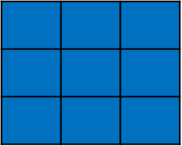
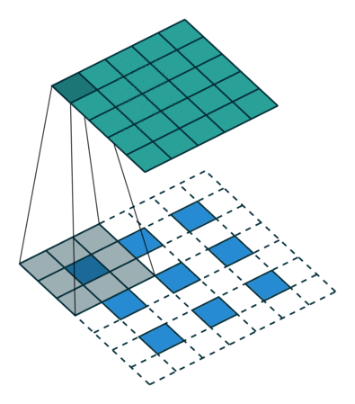
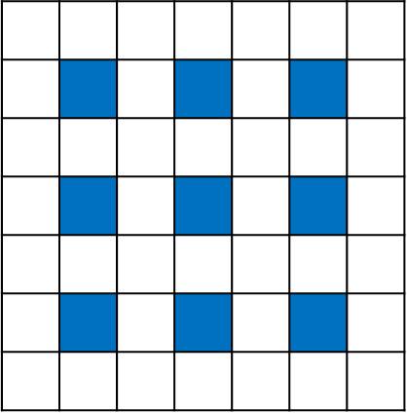
Dilated convolution

Slide 24
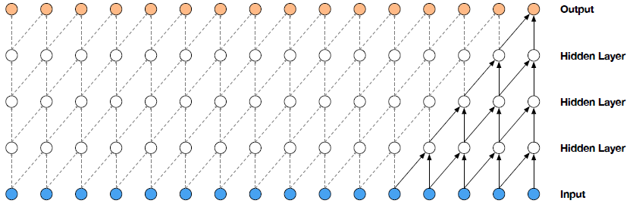
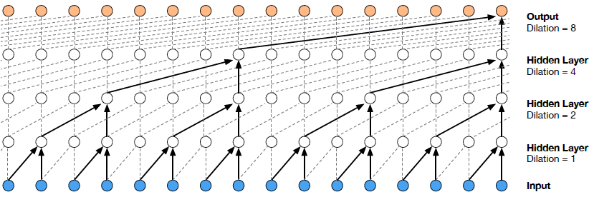
Visualization of a stack of causal convolutional layers
Visualization of a stack of dilated causal convolutional layers

Slide 25
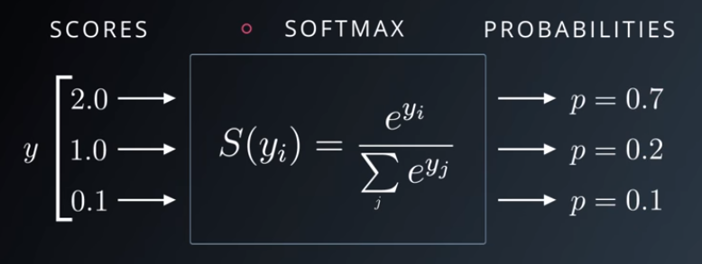
Soft max

Slide 26
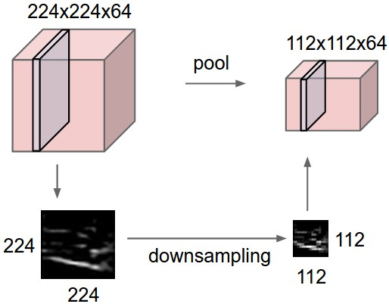
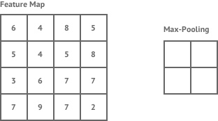
Max Pooling
Operates over each activation map independently.
Makes representations smaller and more manageable

Slide 27
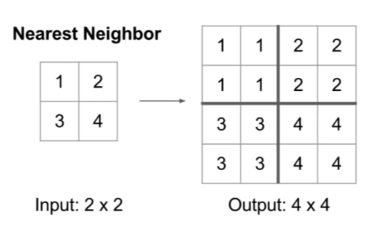
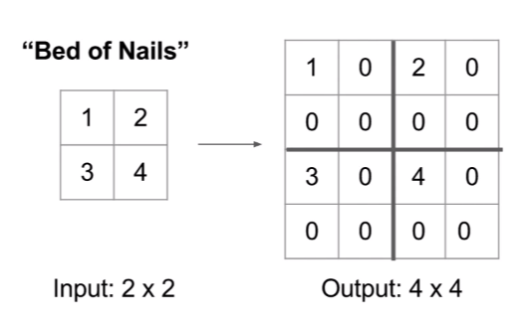
Upsampling

Slide 28
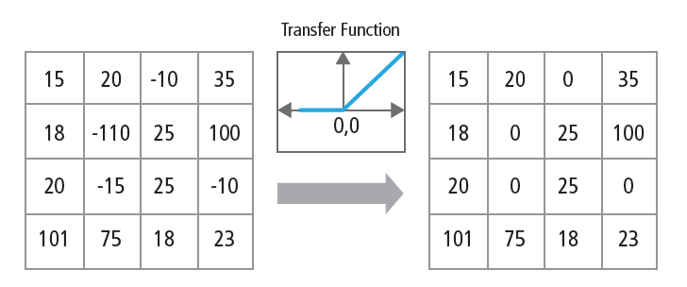
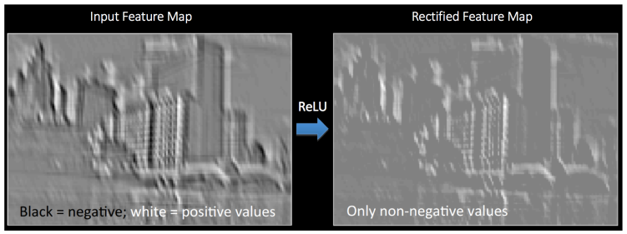
Rectified Linear Unit
There is activation functions between the convolutional layers
Layer obtained after activation function is called activation map

Slide 29
