Slide 1
Lane-Level Localization Using an AVM Camera for an Automated Driving Vehicle in Urban Environments
Dongwook Kim, Beomjun Kim, Taeyoung Chung, and Kyongsu Yi
IEEE/ASME Transactions on Mechatronics, Vol. 22, No. 1, Feb 2017
Presented by: Yang Yu {yuyang@islab.ulsan.ac.kr}
Dec. 2, 2017

Slide 2
Overview
A lane-level localization algorithm based on a map-matching method.
Digital map improves vehicle localization.
Lane detection: around view monitoring(AVM).
Features for map-match: lane marking.
Sensor fusion: AVM module and vehicle sensors.
Position correction: iterative closest point (ICP) .
Map matching: map and sensor feature data.
Covariance of the ICP is estimated using Haralick’s method.
Localization ﬁlter: extended Kalman filter (EKF).

Slide 3
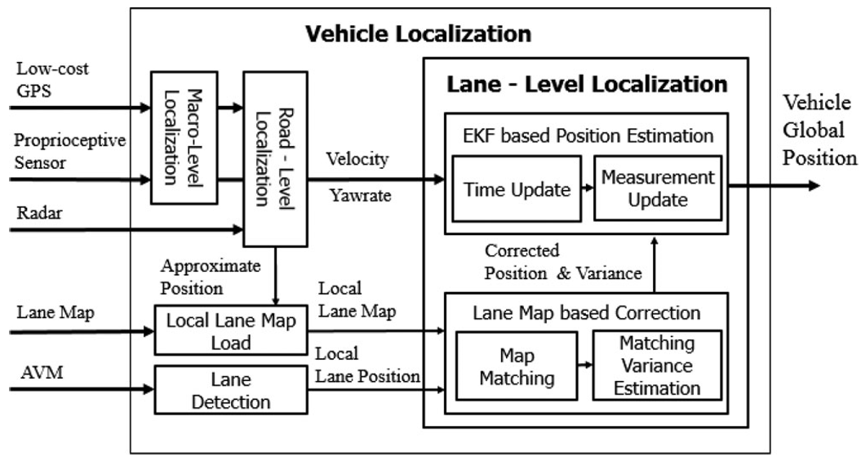
Structure of Vehicle Localization (1/2)
Structure of vehicle localization.

Slide 4
Structure of Vehicle Localization (2/2)
Macro-level: navigation system-GPS and proprioceptive sensors.
Road-level: radar and known information.
Lane-level localization:
AVM: top-view image around the vehicle
Direct calculation of the lateral offset.
Barely affected by others.
More robust to weather and illumination conditions.(side line)
ICP: localize the vehicle to digital map.
Reduce false matching: ICP covariance and validation gate.
EKF: corrected position obtained by map-matching is observation.

Slide 5
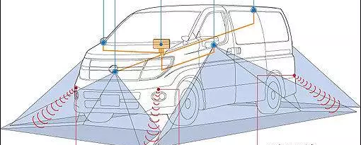
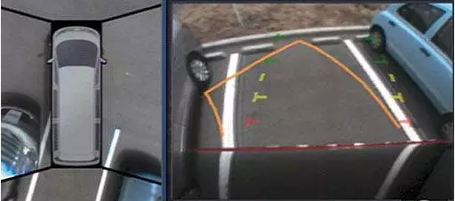
Around View Monitor
Four wide-angle cameras set up at on the front, back, left and right.
Range radar.
Composite virtual bird's-eye top view image.

Slide 6
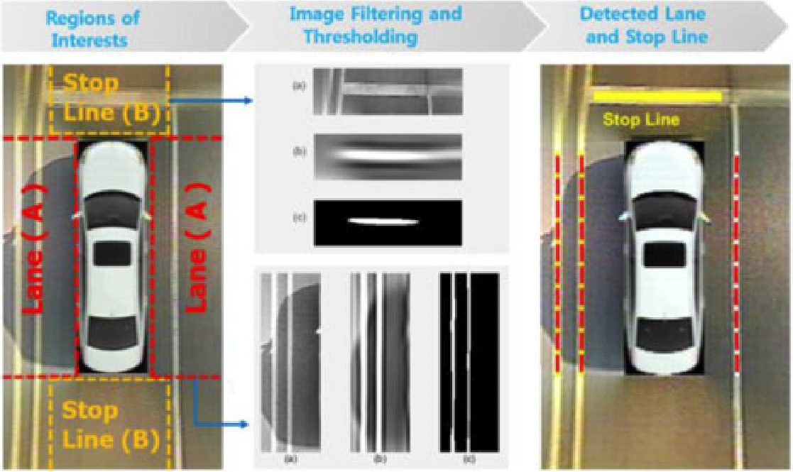
Regions of Interest
Assign line type (lane or stop line, vertical or horizontal line).
The lane and stop line detection.

Slide 7
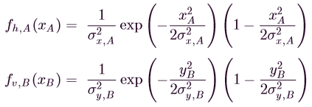
Gaussian Filter
Filtered by a two dimensional Gaussian kernel.
Vertical direction of image A and horizontal direction of image B are smoothing Gaussians.
Horizontal direction of image A and vertical direction of image B are the second derivatives of Gaussians

Slide 8
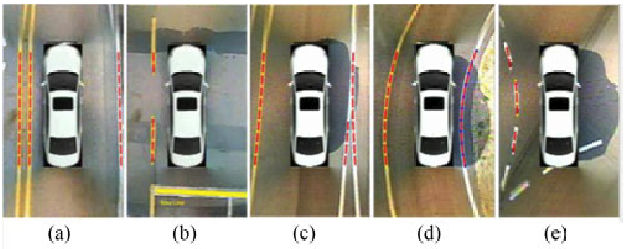
Random Sample Consensus
After thresholding, RANSAC uses a model with randomly selected edge points to determine the most likely candidate lines
Second-order polyline for expressing the line.
Result of various lines detection:

Slide 9
Map-Matching Based on ICP
A two-dimensional point-to-plane ICP algorithm matches digital map with the lane data obtained by AVM.
It compares the two clouds and finds the transformation matrix (rotation matrix and translation vector) iteratively until minimizing error metric function.
Minimize error along the surface normal. This error metric function:
are matching result .
The corrected vehicle position:

Slide 10
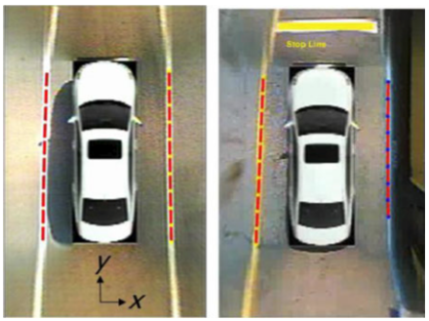
Matching Covariance Estimation (1/2)
Haralick’s method is estimate the ICP’s covariance.
The approximate value of covariance:
Different shape of matching data: corridor (left) and U-shape (right).

Slide 11
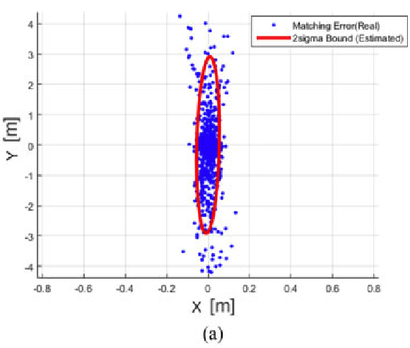
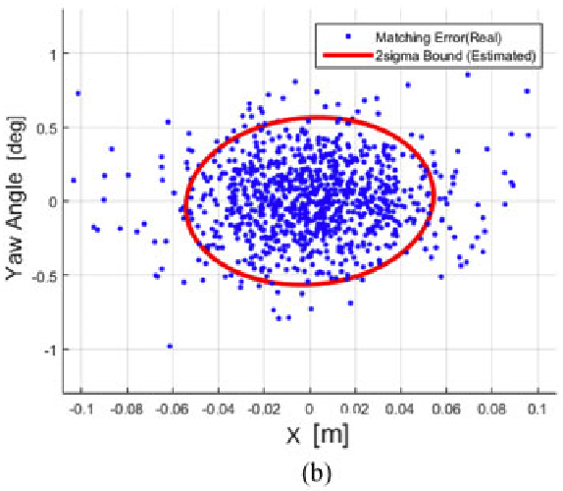
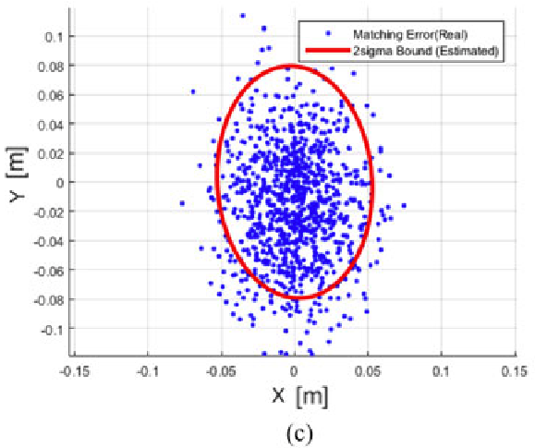
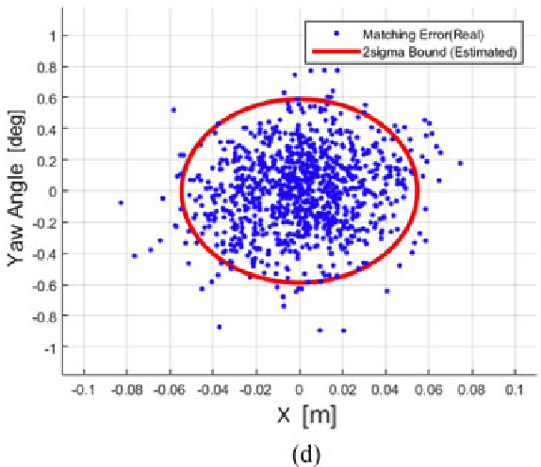
Matching Covariance Estimation (2/2)
Estimated standard deviation of matching error (red line) and true error obtained by Monte Carlo simulation (blue dot)

Slide 12
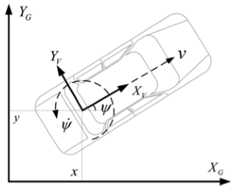
Localization Filter
Position from ICP : observation inside EKF.
Validation gate: solve false matching.
Prediction vehicle model.
Point position (x,y), orientation (Ψ)
State vector

Slide 13
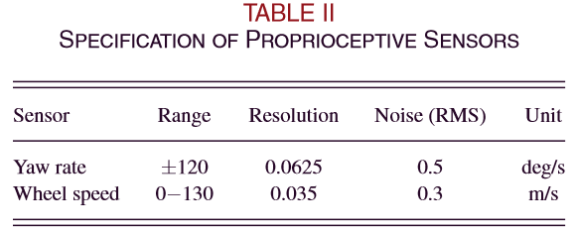
Extended Kalman Filter (1/3)
U_{k}: external input (velocity and yaw-rate)
Z_{k}: corrected vehicle position.
w_{k} and v_{k} : process noise and measurement noise.
Process noise: associated with proprioceptive sensors. Zero mean and a Gaussian distribution.

Slide 14
Extended Kalman Filter (2/3)
Nominal discrete process model equation
estimated states from previous time
Covariance of predicted state
covariance matrix related to proprioceptive sensor’s noise

Slide 15
Extended Kalman Filter (3/3)
Vehicle positions are corrected by a measurement update of the EKF
covariance matrix of the measurement
Covariance of the estimated state

Slide 16
Validation Gate
Prevent fusing the result of false matching.
Threshold about acceptability of measurements.
Only measurements inside of validation gate update ﬁlter.
a conﬁdence level
Normalized error .

Slide 17
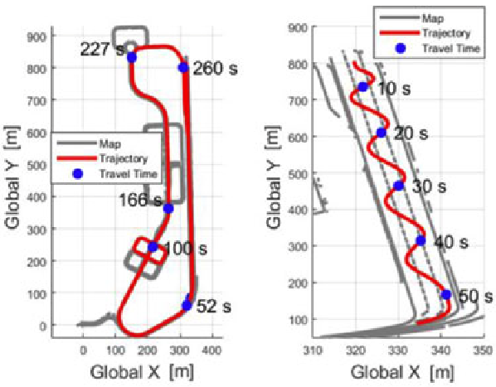
Experimental results (1/7)
Lane-level map: RTK-DGPS. accuracy centimeter.
Detailed trajectory and travel time on lane keeping and consecutive lane changing.

Slide 18
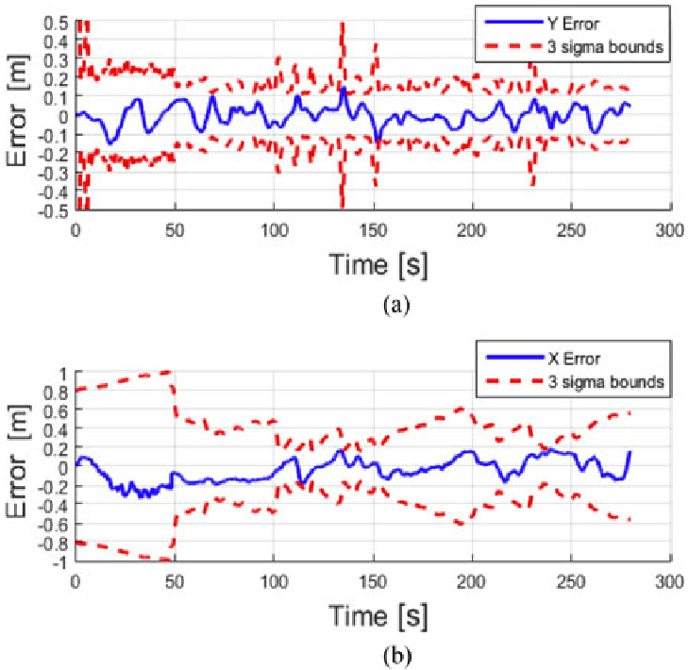
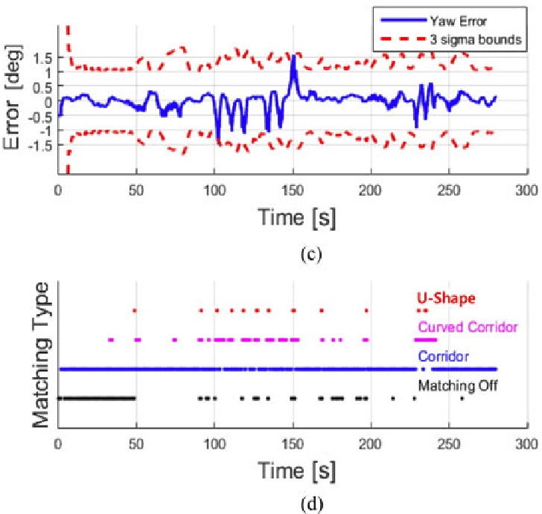
Experimental results (2/7)
Localization result of ﬁrst scenario. (a)lateral position error, (b) longitudinal position error, (c) Yaw angle error, (d) map-matching history.

Slide 19
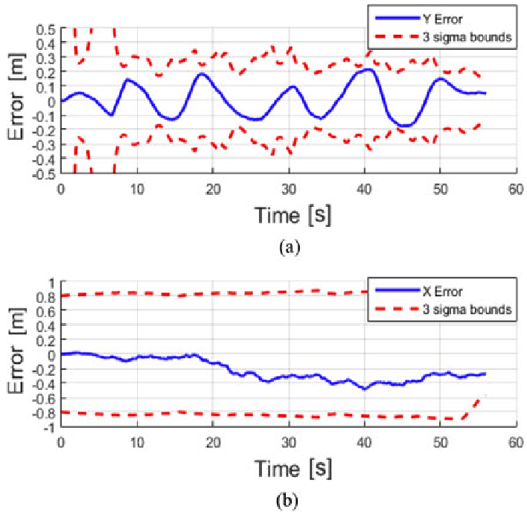
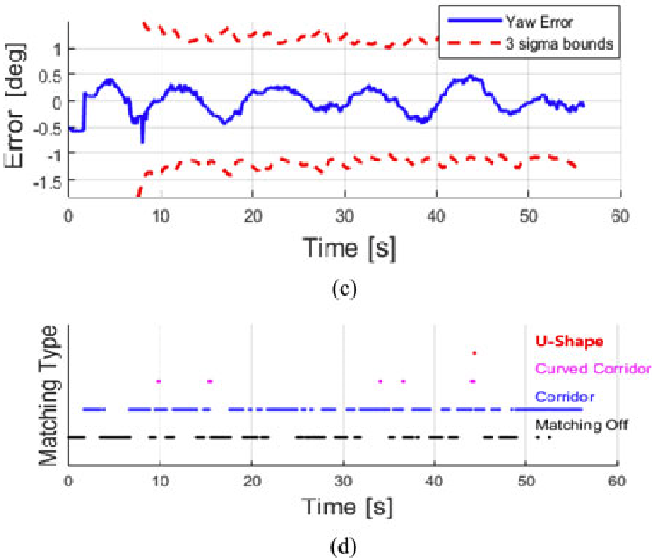
Experimental results (3/7)
Localization result of second scenario. (a)lateral position error, (b) longitudinal position error, (c) Yaw angle error, (d) map-matching history.

Slide 20
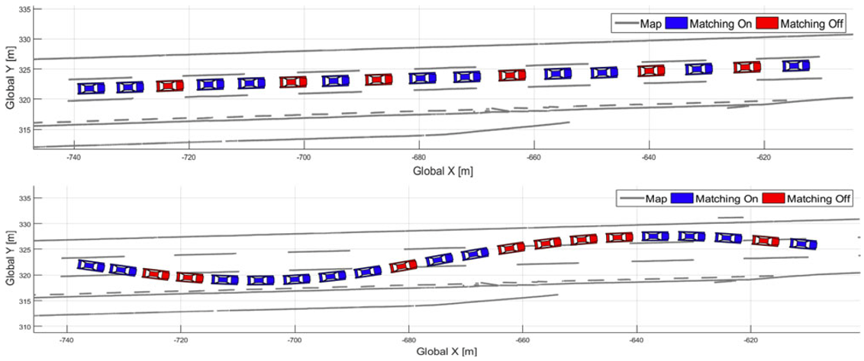
Experimental results (4/7)
Operation of map-matching according to the driving maneuvers.

Slide 21
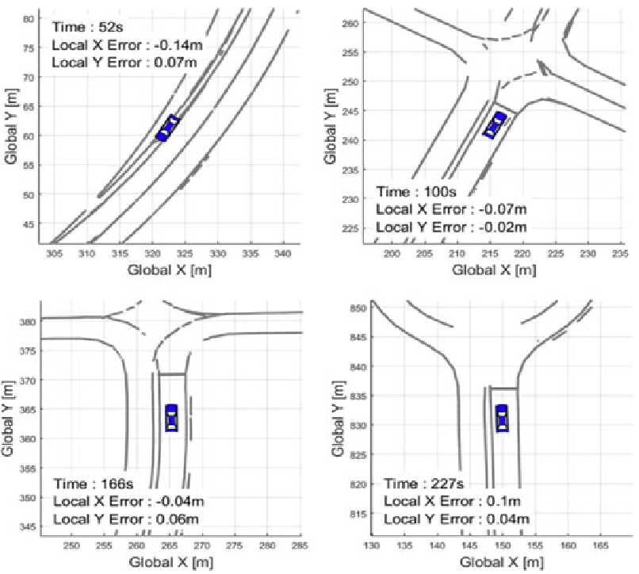
Experimental results (5/7)
Localization result of second scenario .

Slide 22
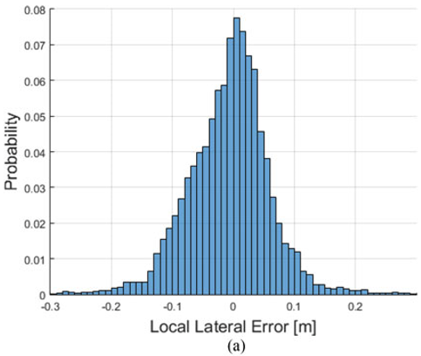
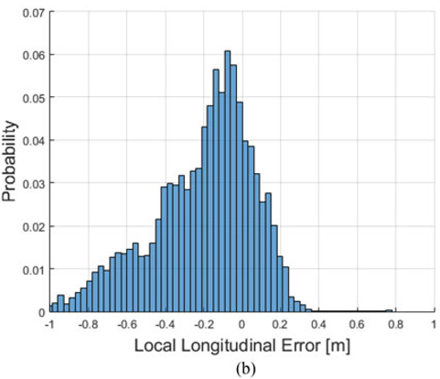
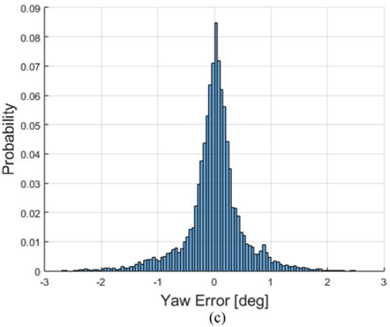
Experimental results (6/7)
Histogram of the measurement residuals over all datasets.

Slide 23
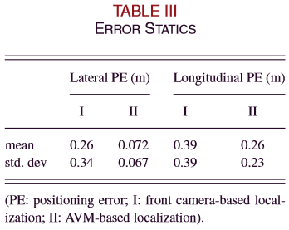
Experimental results (7/7)
Compare with method based on the front camera.
Lateral accuracy is signiﬁcantly improved.

Slide 24
Conclusion
Lane-level localization using AVM cameras with a lane map is presented.
Lane detection uses AVM module.
Position correction uses ICP on detected lane and digital map
Localization ﬁlter fuses map-matching result with vehicle sensors’ data.
A covariance estimator for ICP and a validation gate are designed in localization ﬁlter.

Slide 25
Thank you for attention!

Slide 26
Iterative closest point (ICP)
It compares the two clouds and finds the transformation matrix (the rotation matrix and the translation vector) iteratively by minimizing the sum of the square error of the distance between points.
The whole ICP algorithm is as follows.
1. X is the model cloud set. P is the object cloud set.
2. Initialize P₀=P, q₀=[1,0,0,0,0,0,0]^{T}, k=0.
3. Find the P’s closest points Y in X. Y_{k}=Closest(P_{k},X).
4. Calculate transfer parameters and error. (q_{k}, d_{k})=Q(P₀, Y_{k}).
5. Coordinate transformation. P_{k+1}=q_{k}(P₀).
6. If d_{k}-d_{k-1}<τ (τ>0), then go to 7, else go to 3.
7. The final coordinate transformation. P_{n+1}= q_{n}(P).

Slide 27
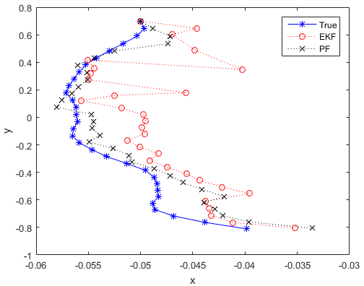
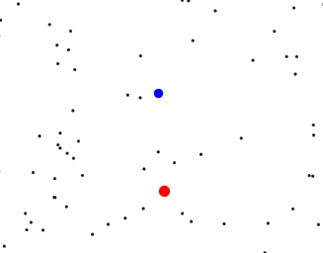
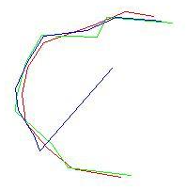
Particle Filter
Initial: plenty of particle --X (t), evenly distribute;
Prediction: state transition equation--every predictive particle;
Correction: evaluate--weight;
Resampling: filter based on weight;
Filtering: particles resampled--new state transition equations--predict particle, do some as step 2.

