Slide 1
Fast and Robust Vanishing Point Detection for Unstructured Road Following
Jinjin Shi, Jinxiang Wang, and Fangfa Fu
IEEE Transactions on Intelligent Transportation Systems, Vol. 17, No. 4, April 2016
Presented by: Yang Yu {yuyang@islab.ulsan.ac.kr}
May. 28, 2016

Slide 2
Overview
Vision-based unstructured road following --task.
Improve the vanishing point estimation with very low computational cost.
Four Gabor ﬁlters and conﬁdence measure. -- texture orientation estimation.
Tracking--Particle ﬁlter --reduce complexity.
Peakedness measure of vote accumulator space(VAS).
Displacements of moving average of observations.
Regulate the distribution of vanishing point candidates
A noise-insensitive observation model.

Slide 3
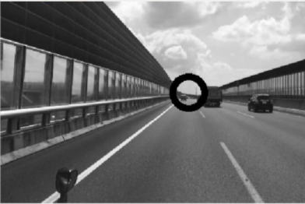
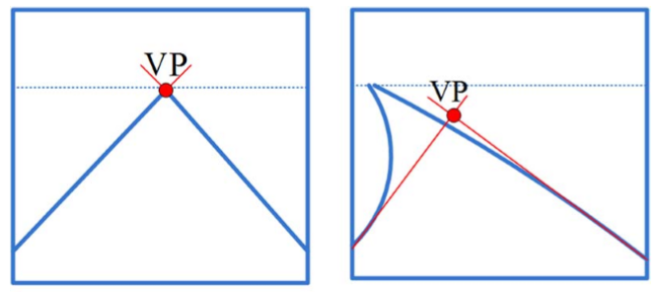
Vanishing Point
Vanishing point in straight and curved roads. Relative direction respect to path.
Steer the vehicle,
Directional constraint for drivable region segmentation,
Lane marking detection.
Transformed into limited space—hough transform.
Statistical estimation--edge feature point estimate straight parameters.

Slide 4
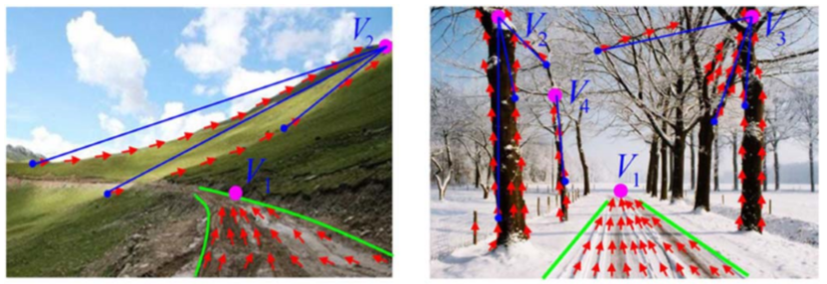
Texture and Tracking Method
Structured roads (highway or city roads)-- distinct features.
Unstructured roads (rural or desert)-- not well-paved, lack clear lane markings or boundaries.
Texture cues parallel to the road direction --edges, border lines, or ruts and tracks left by other vehicles on the road.
Use texture orientations computed with steerable ﬁlters to vote for VP.
Inﬂuence of strong edges in voting. only single image--sensitive to noise.
Peakedness and displacement information for tracking.

Slide 5
Texture Orientation Extraction
Gabor ﬁlter.
Convolution with Gabor ﬁlters bank.
Gabor energy responses.
Descending order
Conﬁdence level
Lower than Tc--Discard
Two most dominant ﬁlter activation strengths-texture orientation

Slide 6
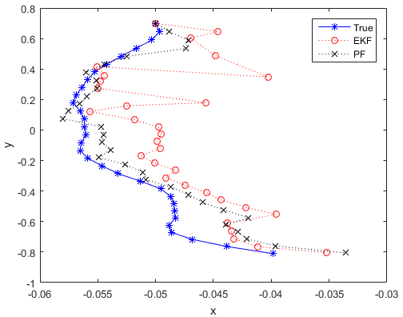
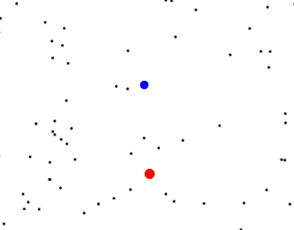
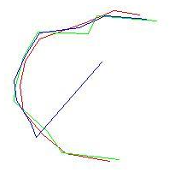
Particle Filter
Initial: plenty of particle --X (t), evenly distribute;
Prediction: state transition equation--every predictive particle;
Correction: evaluate--weight;
Resampling: filter based on weight;
Filtering: particles resampled--new state transition equations--predict particle, do some as step 2.

Slide 7
Tracking-Particle Filtering
Sensitive to strong edge interference.
So track based on peakedness measurement and particle ﬁltering.
VP track--particle ﬁltering-- posterior density estimation
VP location--stochastic process. VP state . Observation by voting
Posterior distribution by weighted samples-particles
Updates particles to approximate posterior distribution
Large weight particle is drawn multiple times.
Reduce stochastic observation noise-- moving average of vanishing point observations– base VP shift slightly.
Observation to state :
:moving average measurement noise
Bayes’ rule, the posterior density

Slide 8
Tracking-Particle Filtering
Measurement noise is zero mean Gaussian white noise with variance
Measurement density
Resample-unweighted new particle set base importance weight
VP location estimate
New sample is drawn around
Process noise ---control distribution of new sample.
pixels locations to be voted.

Slide 9
Particle Distribution Regulation
Peakedness of VAS is low or magnitude of VP displacement is large (curved road), search range increase.
Particle distribution is controlled by process and measurement noise variances. ----peakedness measure and displacement of moving average of VP observations.
0.91 1.5 44 1000 10
displacement peakedness
n: number of images with peakedness <10⁻³
Incorporate distribution information into peakedness measure
>T_{U}, reliable
Particle weight and great changes, tend to lose.

Slide 10
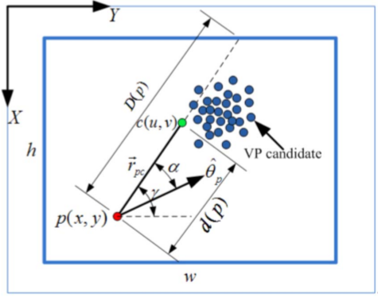
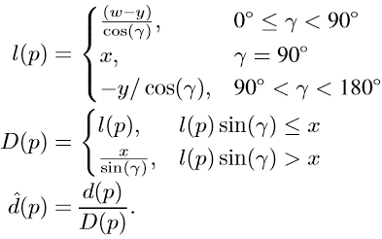
Voting Scheme
Texture dominant orientations, sample set --vote VP
Distributed uniformly, coarsely localize VP.
Round to nearest integer value.
Reliable pixels below it to vote. Several identical copies.
Resampling--multinomial selection--bias more heavily weight.
More votes to candidates that are closer to it along its ray.

Slide 11
Voting Scheme
angle(α): texture dominant orientation and ray, smaller than 15◦, vanishing point candidate gains score:
: less vote to horizontal texture orientations candidates.
more votes to closer candidates.
Largest votes– observation
Noise-insensitive observation model.
Tracking lost, vanishing point search range is automatically enlarged until it is reacquired.

Slide 12
Experimental Results-VP localization
Extracted dominant orientations-- low conﬁdence --zero
Voting accumulator space– intensity-votes of candidates received
Estimated distribution and location,
Vertical position--horizon line of road plane
Horizontal position --road direction.

Slide 13
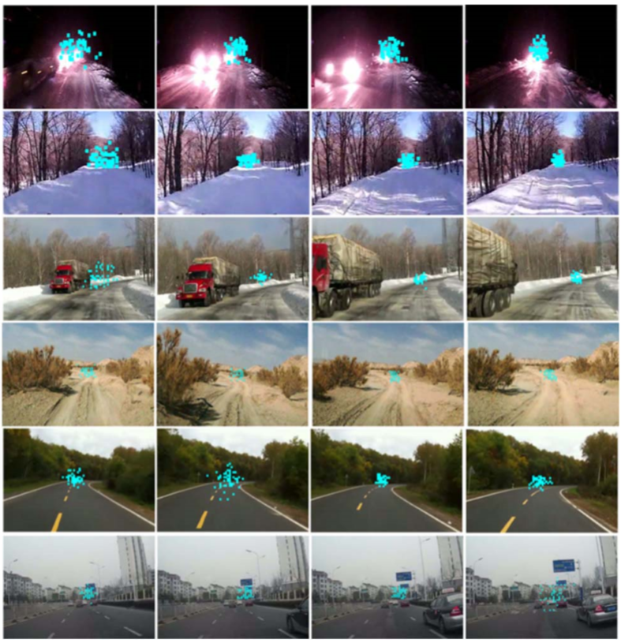
Experimental Results-Evolution
Evolution of vanishing point candidates. week, strong texture, paved roads with noticeable, sparser lane markers

Slide 14
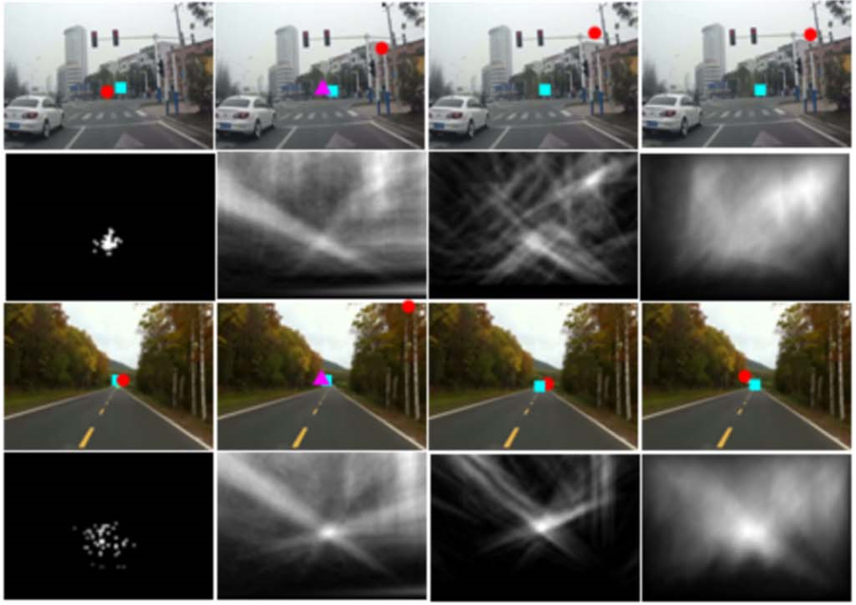
Experimental Results-Estimation
Cyan boxes --ground truths.
Red circles --estimated VP.
Pink triangles -- tracking enabled.

Slide 15
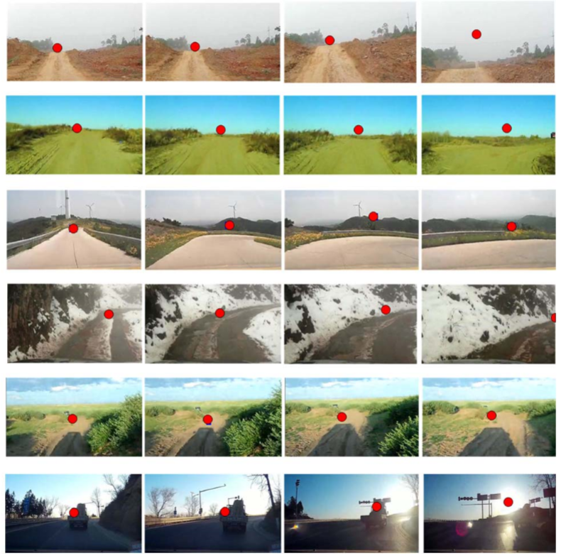
Experimental Results- VP fail
Fails: no-road situations, strong shadows, sun glare

Slide 16
Conclusion
Four Gabor ﬁlters and conﬁdence measure--dominant orientation .
Local soft voting--locate.
Trace VP--reduce complexity.
Distribution of candidates—peakedness measure and displacement of moving average of observations
Future work
Incorporate car-road geometry and odometry information into the particle ﬁltering
Use an active-pointed camera.
Shadow region prediction by sun altitude and azimuth calculation
Explicit shadow removal before the dominant orientation computation
Higher resolution for vanishing point voting

Slide 17
Thank you for attention!

