Slide 1
Automated Road Information Extraction
From Mobile Laser Scanning
Haiyan Guan, Jonathan Li, Yongtao Yu, Michael Chapman, and Cheng Wang
IEEE Transactions on Intelligent Transportation Systems, Vol. 16, No. 1, pp.194-205,
February 2015
Presented by: Yang Yu {yuyang@islab.ulsan.ac.kr}
Apr. 4, 2015

Slide 2
Overview
This paper extracts road features (road surfaces, road markings, and pavement cracks) from Mobile Laser Scanning (MLS) point cloud data.
  Detect road curbs from a set of profiles that are sliced along vehicle trajectory data.
  Create Geo-Referenced Feature (GRF) images base on segmented road surface points, .
  Develop two algorithms: 1) road markings with high retroreflectivity, 2) cracks containing low contrast with their surroundings, low signal-to-noise ratio, and poor continuity.

Slide 3
Motivation
  Compared with photogrammetry and field surveys, an MLS system captures high point density and accurate 3-D point clouds in a relatively short time period.
  This system is still in its infancy and has only been commercially available for several years. Thus, there is an urgent need to investigate MLS as a reliable and cost-effective alternative for road inspection, particularly in regard to effective road traffic safety.

Slide 4
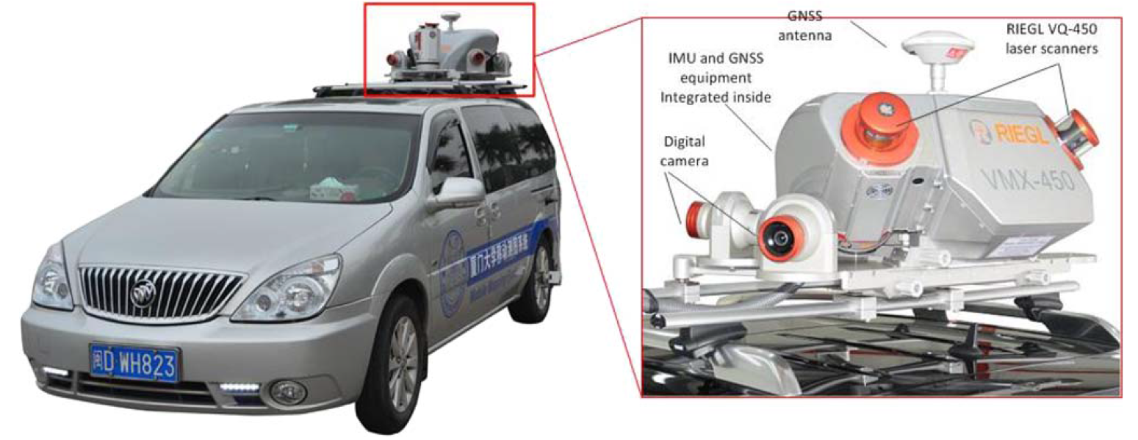
MLS System
  Two RIEGL VQ450 laser scanners;
  Four charge-coupled device cameras;
  A set of Applanix POS LV 520 processing systems containing two GNSS antennas, an IMU system, and a distance measurement indicator.
  The laser scanner is georeferenced when its position and orientation relative to the mapping coordinate system are known by a set of navigation systems.

Slide 5
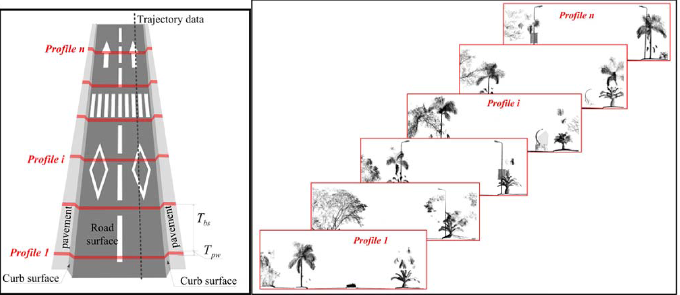
Road Surface Extraction
  Perpendicular to trajectory data, we first partition point clouds into a number of data blocks with a given length . A profile is sliced for each data block with a given width.
(a) Trajectory-based MLS data profiling. (b) A number of profile examples.

Slide 6
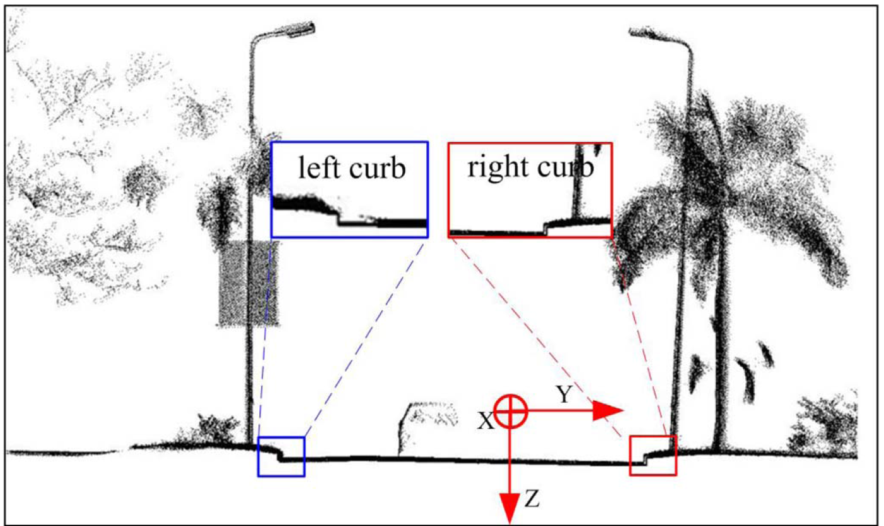
Data Profiling
  All points for each profile are projected onto the YoZ plane, we estimate curbs by slope and elevation difference criteria. This is close-up views of road curbs.

Slide 7
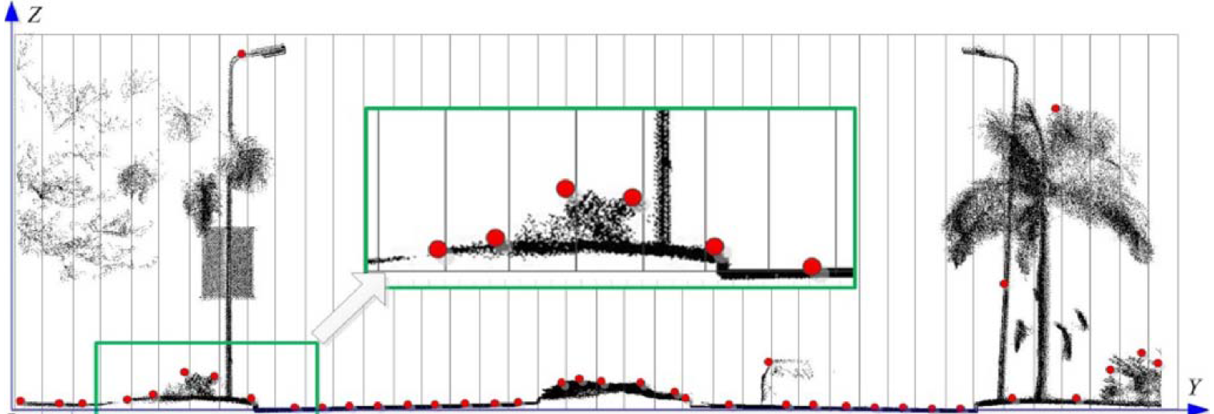
Pseudo Scan Line Generation
Each profile is vertically divided into a number of bars.
A sampling strategy is carried out for each bar to select a principal point,
  From the lowest point, we calculate the elevation difference of two consecutive points.
  The two consecutive points are labeled into the same layer if the elevation difference lies below a predefined threshold.
  This maintains road surface points and critical road features with less disruptive noise.

Slide 8
Curb Detection
Start the labeling process from the vehicle position on the road surface. The slope criterion is used to detect nonroad points.
Once a point slope greater than a predefined threshold, it means that the point reaches a possible curb.
If a curb candidate’s elevation difference is within the predefined range, the curb candidate is labeled as a curb.
Select curb candidates closest to the scanning center as curbs.
Use a cubic spline interpolation method to generate two smooth road edges from these curb points, and finally separate road points from nonroad points.

Slide 9
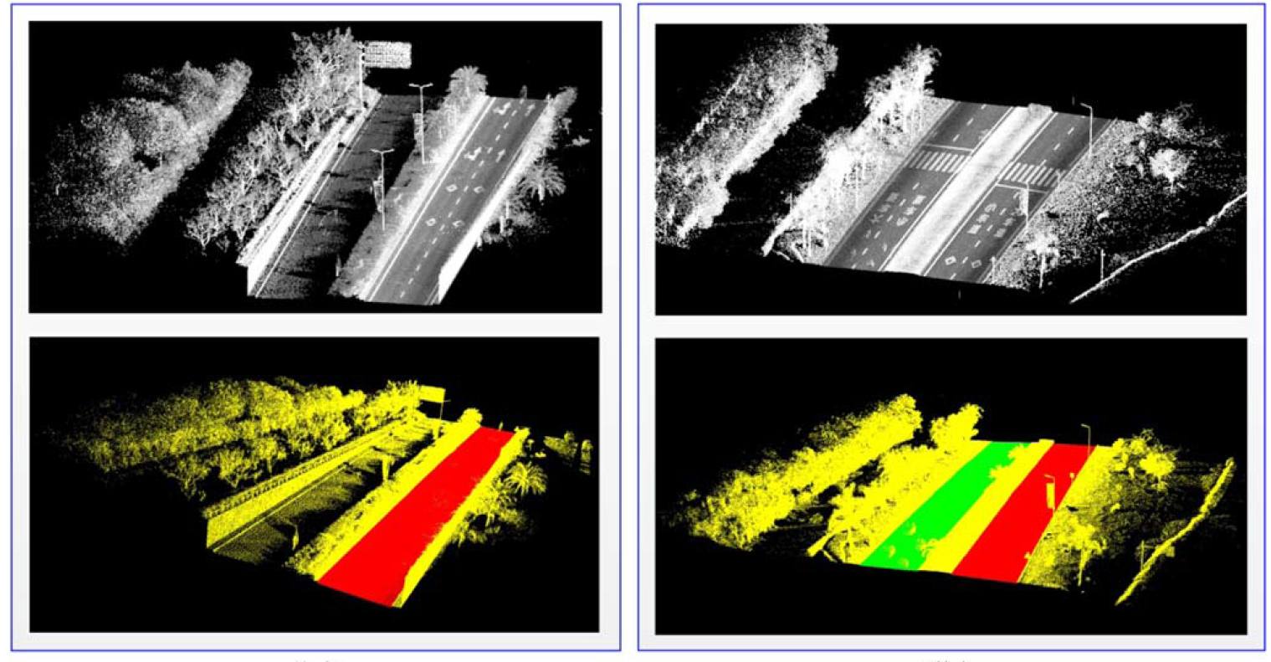
Road Surface Extraction Result
  Huandao data set containing 8.4 million points and ICEC date set containing 5.4 million points.
  (Top) Raw MLS data, (bottom) extracted road surfaces.

Slide 10
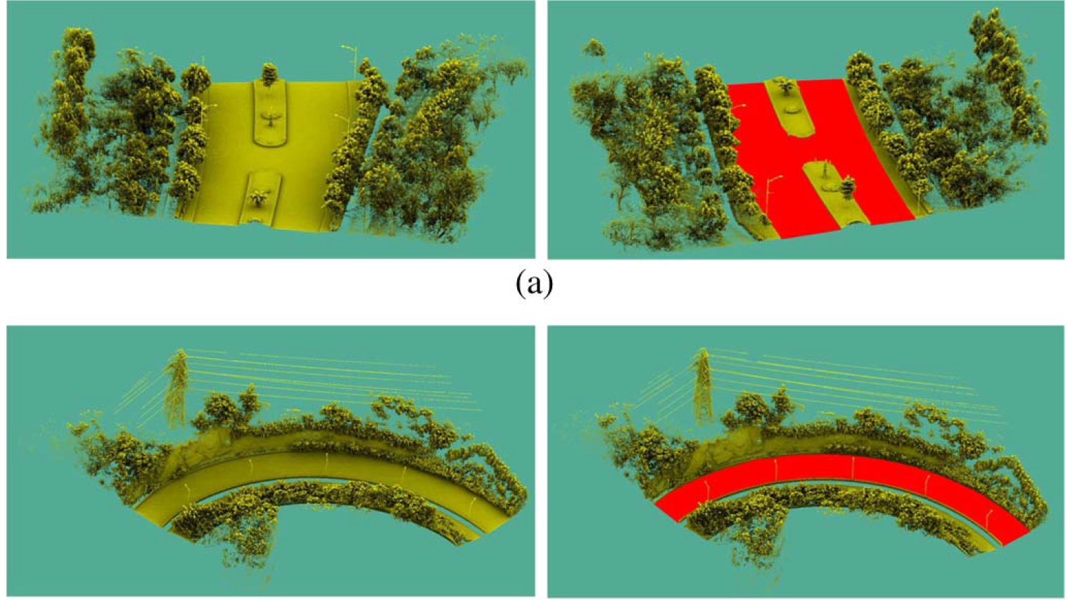
Road Surface Extraction Result
  This algorithm is able to handle roads with curvatures.
  (Left) Raw MLS data, (right)extracted road surfaces

Slide 11
Road Surface Extraction Result
  The central line represents the median value, whereas its lower and upper edges represent the 25% and 75% percentiles. The minimum and maximum values are represented by the lower and upper adjacent values.
  Box plot for the accuracy of the extracted road edges

Slide 12
GRF Image Generation
The MLS data indicate that road markings painted on road surfaces are highly retroreflective; thus, high reflectance in the form of intensity has been widely used to extract road markings.
GRF image generation, which locally and globally interpolates the extracted road surface points into a GRF image based on elevation and intensity data via an extended inverse distance weighted method.

Slide 13
Point-density-dependent Thresholding
Within different ranges of the scanning distances, local optimal segmentation thresholds are adaptively estimated.
Intensity values gradually fade from the scanning center to its two sides, it depend on:
  1) the scanning range from the laser sensor to the target;
  2) the incidence angle of the laser beam;
  3) material properties of the target.
Point density approximates Gaussian normal distribution.

Slide 14
Morphological Operations
It refines the extracted road markings by removing noise and filling out holes.
A horizontally linear shaped structuring element is used to dilate and erode the extracted road markings.
The linear structure with length l and direction θ is denoted by Kline θ(l). The direction θ is determined by trajectory data. The length l = 3 pixels is selected for convoluting road markings.

Slide 15
Quantitative Assessment
Completeness. cpt = Cp/Rf.
Correctness. crt = Cp/Ep.
Cp denotes the number of pixels belonging to the real road markings,
Rf is the number of the ground truth pixels collected by the manual interpretation method.
Ep represents the number of pixels extracted by the proposed algorithm.
F-measure is an overall score, F = 2 × ((cpt · crt)/(cpt + crt)).

Slide 16
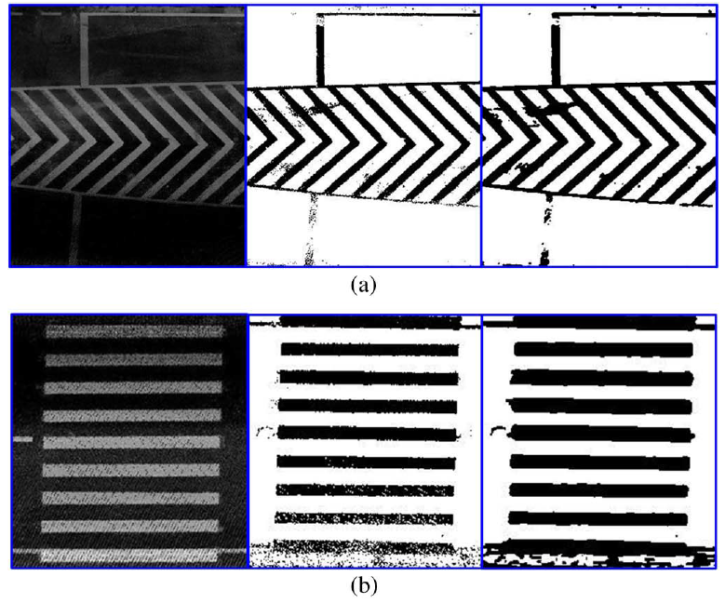
Road Markings
  (left) GRF image; (middle) point-density-dependent multithresholding segmentation results; (right) extracted road markings.

Slide 17
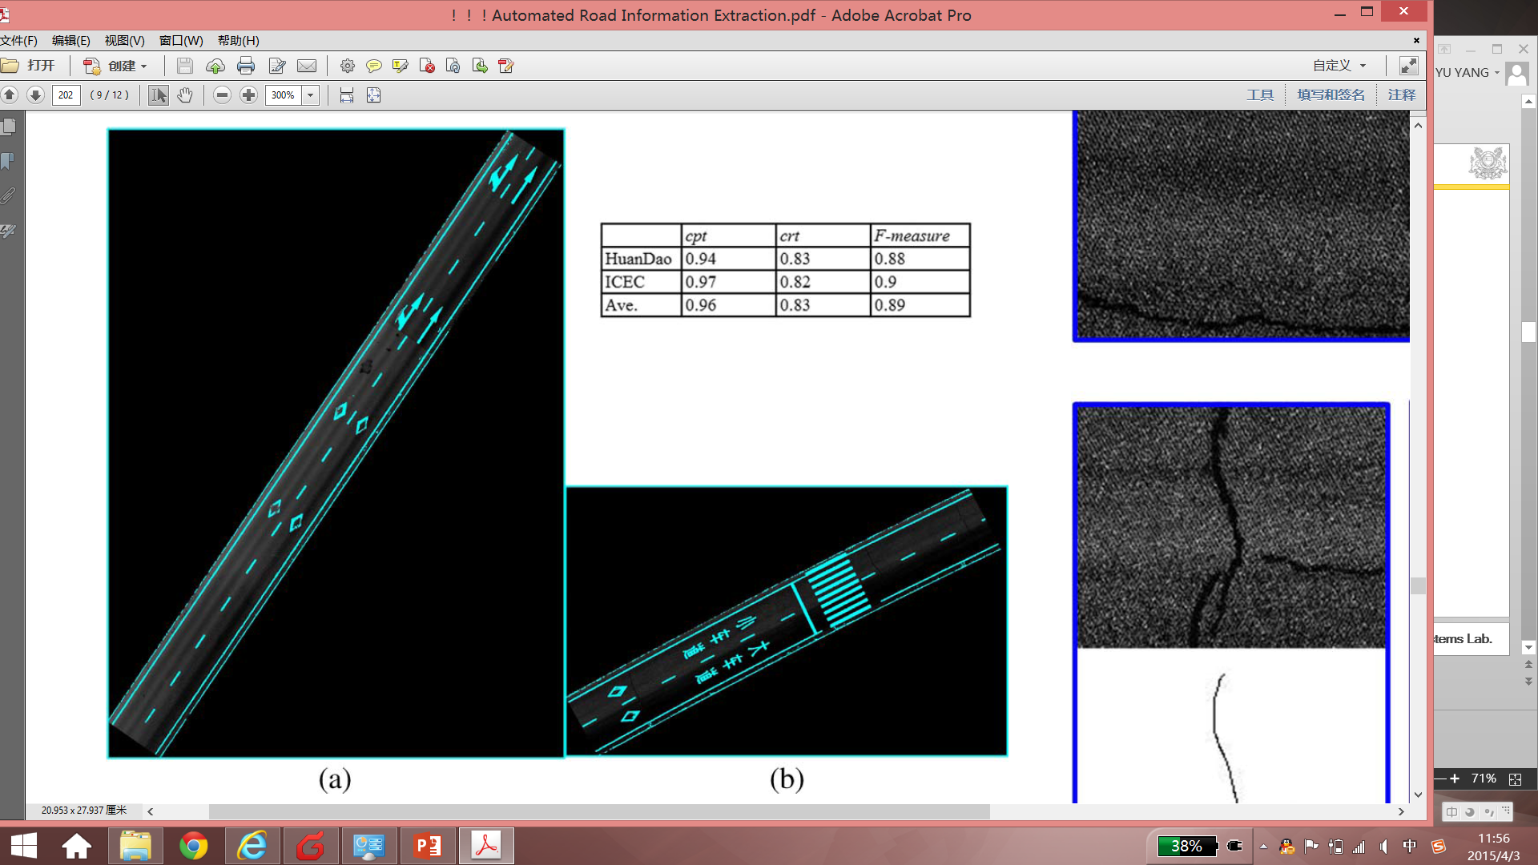
Road Markings
  Extracted road markings overlaid on the GRF images. (a) Huandao data set. (b) ICEC data set..

Slide 18
Pavement Cracks
Thresholding, which segments the generated GRF image into a number of crack candidates;
Crack enhancement, which enhances crack pixels from a noisy and corrupted background by applying iterative tensor voting to the GRF image;
Morphological thinning, which extracts the enhanced cracks from the background. It serves to thin the cracks down to their median axes, by peeling off their boundary pixels.

Slide 19
Iterative Tensor Voting
In two dimension, a second-order symmetric nonnegative definite tensor is represented by a 2 × 2 matrix, which is decomposed as
  λ1 and λ2 (λ1>λ2) are the eigenvalues. e1 and e2 are the corresponding eigenvectors.
  The first term is a stick tensor, indicating an elementary curve element with e1 as its curve normal.
  The second term is a ball tensor, indicating a perceptual structure without preferred orientation.

Slide 20
Iterative Tensor Voting
Each crack candidate is initially encoded by a ball tensor with unit saliency, in a form of a 2 × 2 identity matrix. The ball tensors only cast votes to other ball tensors in their voting fields. All the tensors corresponding to the crack candidates obtain rough orientations and magnitudes.
Each oriented crack candidate is further encoded as a stick tensor to refine the orientations and to obtain a saliency map of cracks.
Use iterative tensor voting (ITV) to obtain a good saliency map of cracks. The tensor with high λ1 − λ2 values seems to be concentrated.

Slide 21
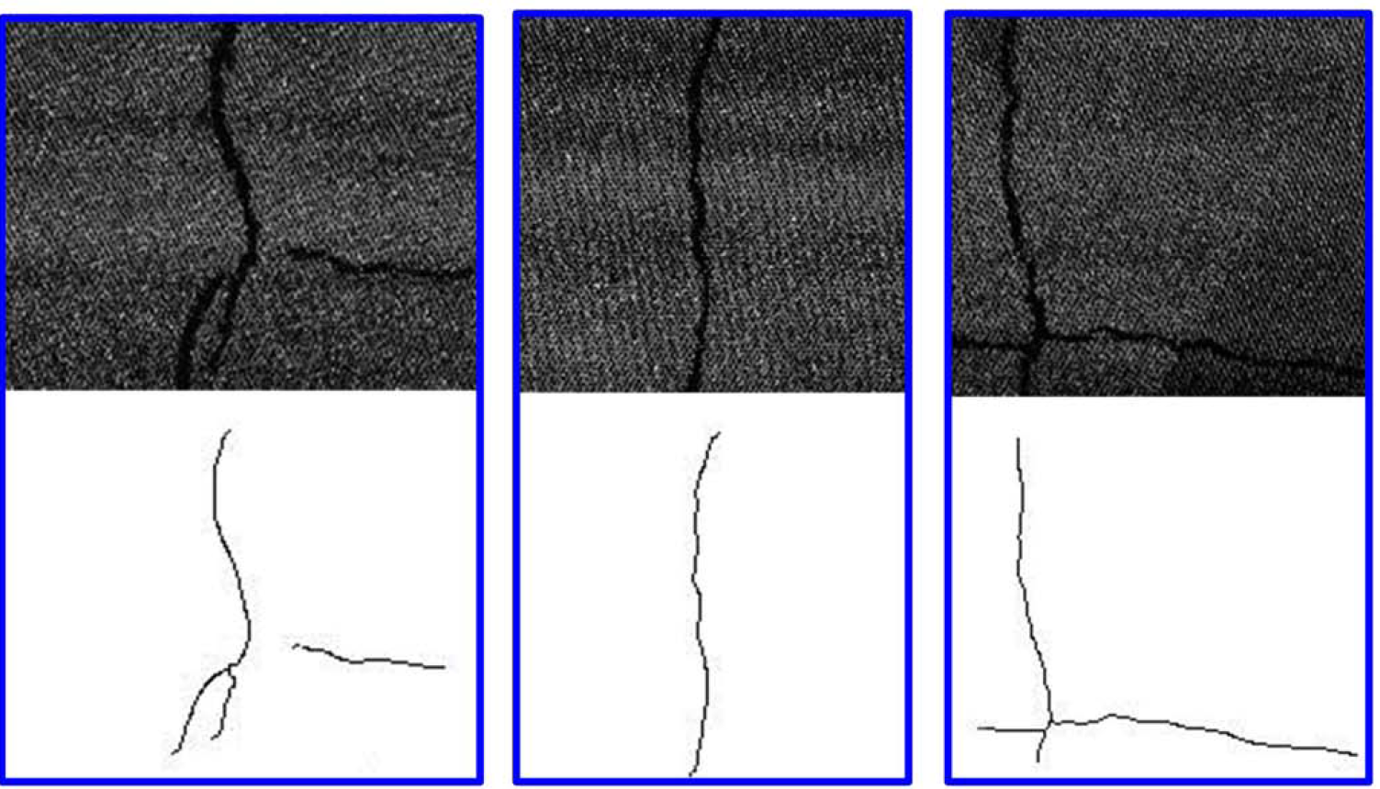
Pavement Cracks
  GRF images and extracted cracks.

Slide 22
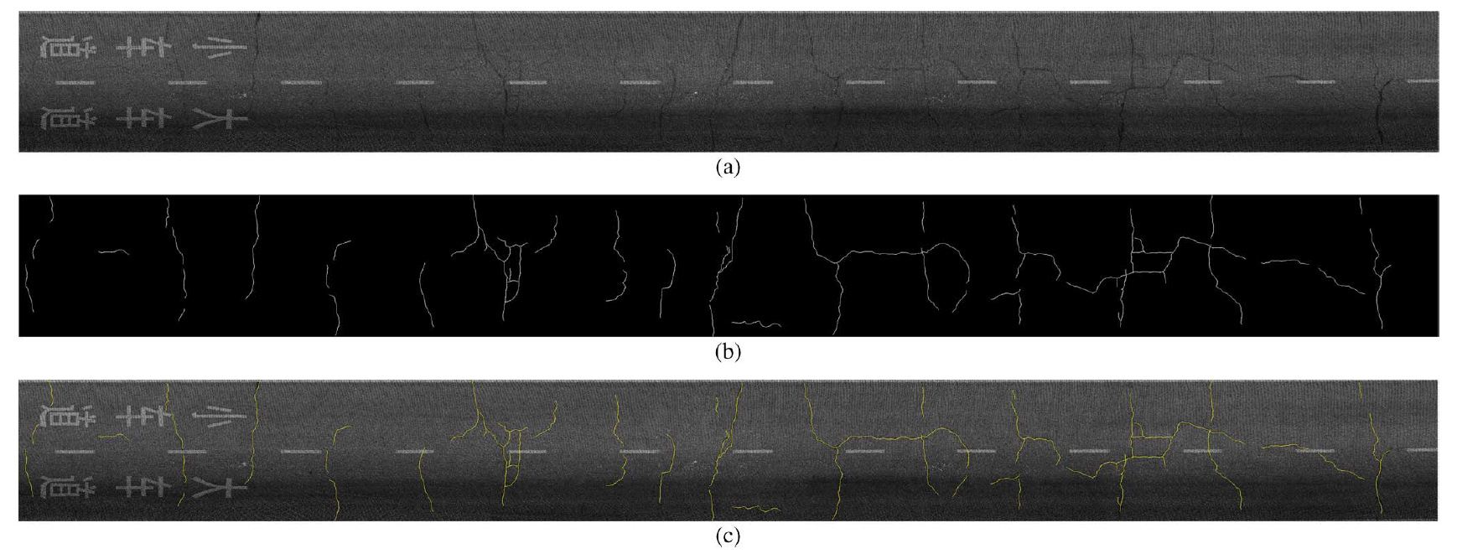
Pavement Cracks
  Crack detection results for the 75-m-long road section. (a) GRF image. (b) Detected cracks. (c) Detected cracks overlaid on the GRF image.

Slide 23
Conclusions
The accuracies of detected road surfaces meet the requirements of transportation-related road applications, such as mapping natural terrain, assessing roadway condition, conducting Geographic Information System, and modeling urban traffic.
This algorithm achieve stable performance on six road sections, and enhance curvilinear crack structures from noisy and corrupted road data.
Future work
  Apply this algorithm to the car washing system.
  Improve the road features extraction method.

