Slide 1
Tracking Multiple Occluding People by Localizing on Multiple Scene Planes
Saad M. Khan and Mubarak Shah, PAMI, VOL. 31, NO. 3, MARCH 2009,
Donguk Seo
seodonguk@islab.ulsan.ac.kr
2012.07.21
Notes:
Hi!! I will present for ‘correspondence across structured multiple cameras for human tracking’.

Slide 2
Introduction(1)
Multi view approach to detect and track multiple people in crowed and cluttered scenes
Detection and occlusion resolution
Based on geometrical constructs
The distinction of foreground from background
Using standard background modeling techniques
Planar Homographic occupancy constraint
Using SIFT feature matches and employing the RANSAC algorithm
To track multiple people
Using object scene occupancies

Slide 3
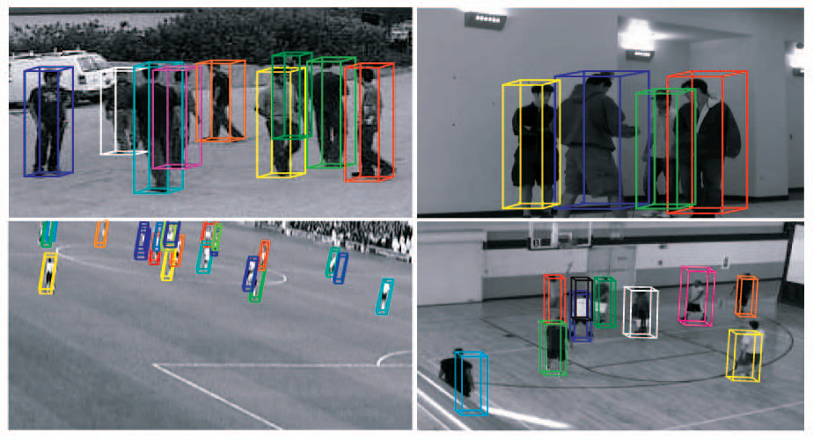
Introduction(2)
Examples of cluttered and crowded scenes to test this paper’s approach.

Slide 4
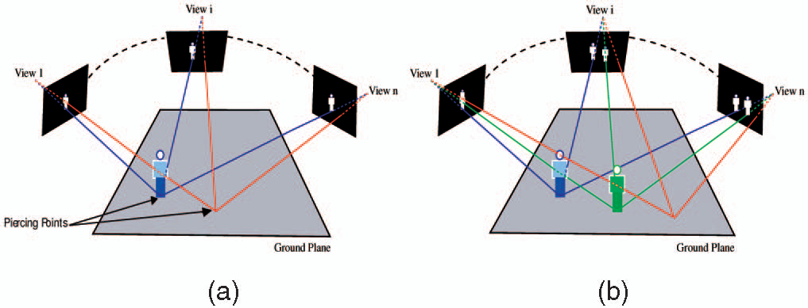
Homographic occupancy constraint(1)
(a) The blue ray shows how the pixels that satisfy the homographic occupancy constraint warp correctly to foreground in each view.
(b) Foreground pixels that belong to the blue person but are occluding the feet region of the green person satisfy the homographic occupancy constraint (the green ray). This seemingly creates a see-through effect in view 1, where the feet of the occluded person can be detected.

Slide 5
Homographic occupancy constraint(2)
Proposition 1
The image projections of the scene point $P$ given by $p_{1},p_{2},…,p_{n}$ in any $n$ views satisfy both of the following:
$p_{i}∈Ψ_{i}$ for $∀_{i}$
$Ψ_{i}$: the foreground region in view $i$
$p_{i}$: the image projection of the scene point
$p_{i}=\left[H_{i_{π}j}\right]p_{j}$ for $∀_{i,j}$
$H_{i_{π}j}$: the homography induced by plane $π$ from view $j$ to view $i$
Proposition 2 (Homographic occupancy constraint)
${p^{′}}_{i}∈Ψ_{i}$, ${p^{′}}_{i}=\left[H_{i_{π}r}\right]p$ for $∀_{i}$
$Φ$: the set of all pixels in a reference view $r$
$H_{i_{π}r}$: the homography induced by plane $π$ from the reference view to view $i$
$p$: the piercing point with respect to $π$ lies inside the volume of a foreground object in the scene

Slide 6
Localizing people(1)
$Φ_{1},Φ_{2},...,Φ_{n}$: the images of the scene obtained from $n$ uncalibrated cameras
$Φ_{r}$: a reference view
$H_{i_{π}r}$: homography of the reference plane $π$ between the reference view and any other view $i$
$p$: a pixel in the reference image
${p^{′}}_{i}$: warped to pixel in image $Φ_{i}$
$x_{1},x_{2},...,x_{n}$: the observation in images $Φ_{1},Φ_{2},...,Φ_{n}$ at location ${p^{′}}_{1},{p^{′}}_{2},...,{p^{′}}_{n}$

Slide 7
Localizing people(2)
$X$: the event that pixel $p$ has a piercing point inside a foreground object
Using Bayes law
$L\left(x_{i}\right)$: the likelihood of observation $x_{i}$ belonging to the foreground
Plugging (3) into (2) and back into (1)
(1)
(2)
(3)
(4)

Slide 8
Modeling clutter and FOV constraints(1)
Assumed the scene point under examination is inside the FOV of each camera
The concept of an RMS clutter metric of the spatial-intensity properties of the scene
$σ_{k}^{2}$: the variance of pixel values within the $k$th cell
$N$: the number of cells or blocks the picture has been divided into
$N$ is defined to be twice the length of the largest target dimension.
They compute the clutter metric for each view at each time instant on the foreground likelihood maps obtained from background modeling.
(5)

Slide 9
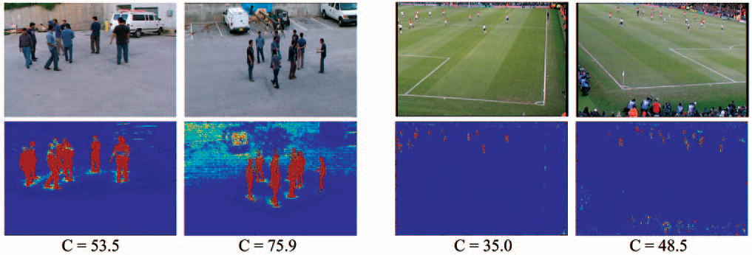
Modeling clutter and FOV constraints(2)
The first row: images from two of test sequences
The second row: foreground likelihood maps for views in the first row

Slide 10
Modeling clutter and FOV constraints(3)
To assign higher confidence to foreground detected from views with lesser clutter
$\sum_{i}{\frac{1}{C_{i}}}$: a normalizing factor
The overlapping FOV of all cameras
$δ\left(x\right)=\left\{\begin{matrix}1 & \text{if} x \text{inside} \text{image} \text{dimensions} \\ 0 & \text{otherwise}\end{matrix}\right.$
$Γ\left(x\right)=\left\{\begin{matrix}log⁡(L\left(x\right)) & \text{if} δ\left(x\right)=1 \\ 0 & \text{otherwise}\end{matrix}\right.$
$\sum_{i}{δ\left(x_{i}\right)}$: higher confidence in regions with greater view overlap
(6)
(7)

Slide 11
Localization at multiple planes
$H_{i_{π}j}$: the homography induced by a reference scene plane $π$ between views $i$ and $j$
$H_{i_{φ}j}$: the homography induced by a plane $φ$ parallel to $π$
$v_{ref}$: the vanishing point of the normal direction
$γ$: a scalar multiple controlling the distance between the parallel planes
The reference plane homographies between views
Automatically calculated with SIFT feature matches
Using the RANSAC algorithm
Vanishing points for the reference direction
Computed by detecting vertical line segments in the scene and finding their intersection in a RANSAC framework
(8)

Slide 12
Localization algorithm (1)
Obtain the foreground likelihood maps $Ψ_{1},Ψ_{2},...,Ψ_{n}$.
Model background using a Mixture of Gaussians.
Perform background subtraction to obtain foreground likelihood information
Obtain reference plane homographies and vanishing point of reference direction.
for $i=1$ to $N$
Update reference plane homographies using (8)
Warp foreground likelihood maps to a reference view using homographies of the reference plane.
Warped foreground likelihood maps: ${Ψ^{′}}_{1},{Ψ^{′}}_{2},...,{Ψ^{′}}_{n}$
Fuse ${Ψ^{′}}_{1},{Ψ^{′}}_{2},...,{Ψ^{′}}_{n}$ at each pixel location $p$ of the reference view according to (7) to obtain synergy map $θ_{i}$
end for
Arrange $θ_{i}$s as a 3D stack in the reference direction
$Θ=\left[θ_{1};θ_{2}...θ_{n}\right]$

Slide 13
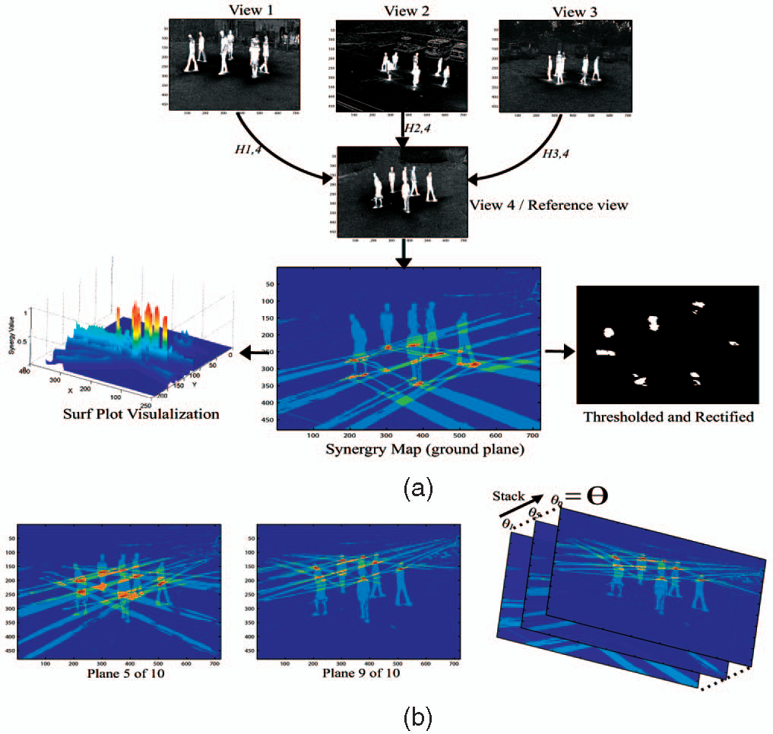
Localization algorithm (2)

Slide 14
Tracking
Tracking methodology
Based on the concept of spatio-temporal coherency of scene occupancies created by objects
To solve the tracking problem by using a sliding window over multiple frames
Look-ahead technique
$ξ^{n}=\left(ξ_{1}^{n},ξ_{2}^{n},...,ξ_{t}^{n}\right)$: the trajectory of spatio-temporal occupancies by individual $n$
$ζ_{i}^{n}$: the spatial localization of the individual $n$ in the occupancy likelihood information $Θ_{i}$ at time $i$
Localization algorithm for a sliding time window of $t$ frames $Θ_{1},Θ_{2},...,Θ_{t}$
(9)

Slide 15
Graph cuts trajectory segmentation (1)
For a time window of $t$ frames
The scene occupancy likelihood information from our localization algorithm: $Θ_{1},Θ_{2},...,Θ_{t}$
$Θ_{i}$: 3D grid of object occupancy likelihoods
Arranging $Θ_{i}$s in the dimension
Spatio-temporal occupancy likelihood grid: $\hat{Θ}=\left[Θ_{1};Θ_{2};...;Θ_{t}\right]$
To segment $\hat{Θ}$ into background (nonoccupancies) and object occupancy trajectories with the following criteria:
Grid locations with high occupancy likelihoods have a higher chance of being included in object trajectories.
Object trajectories are spatially and temporally coherent.
Energy function
(10)

Slide 16
Graph cuts trajectory segmentation (2)
$P$: the set of all grid locations/nodes in $\hat{Θ}$
$N$: the set of grid locations in a neighborhood
$B_{p,q}∝e^{−dist{\left(p,q\right)}/2τ^{2}}$
$dist\left(p,q\right)$: the 4D Euclidean distance between grid locations $p$ and $q$
$τ$: a normalizing factor
In order to minimize the energy function
Using graph cuts techniques
Undirected graph $G=\left(V,E\right)$
The set of vertices
The set of spatio-temporal grid locations augmented by the source $S$ and sink $T$ vertices: $V=P∪S,T$
The set of edges
All neighboring pairs of nodes
The edges between each node and the source and sink
$E=N∪\left\{\left(p,S\right),\left(p,T\right):p∈P\right\}$
The weights on the edges
$\left(p,q\right)∈N$ -> $w\left(p,q\right)=B_{p,q}$
The edge contains the source $S$ or sink $T$ as one of its vertices
$w\left(p,\left\{S,T\right\}\right)=−\hat{Θ}\left(p\right)$

Slide 17
Graph cuts trajectory segmentation (3)
(a) A sequence of synergy maps at the ground reference plane of nine people
(b) The XY cut of the 4D spatio-temporal occupancy tracks

Slide 18
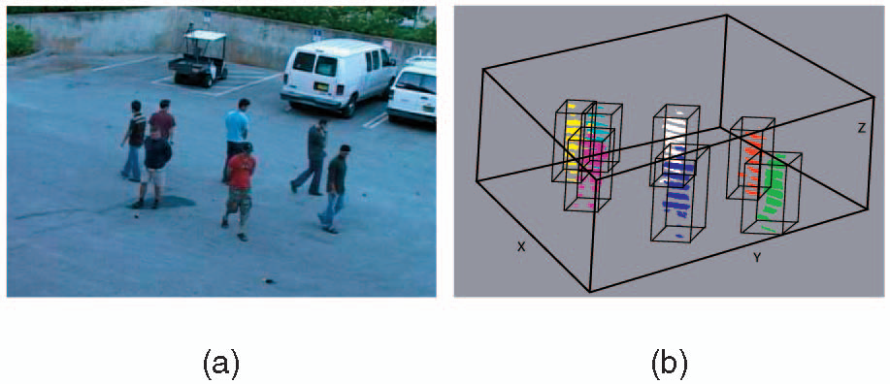
Graph cuts trajectory segmentation (4)
(a) Reference view
(b) The 3D marginal of the 4D spatiotemporal occupancy tracks at a particular time. Notice the gaps in localizations for each person’s color-coded regions. This is because only 10 planes parallel to the ground in the up (Z) direction were used.

Slide 19
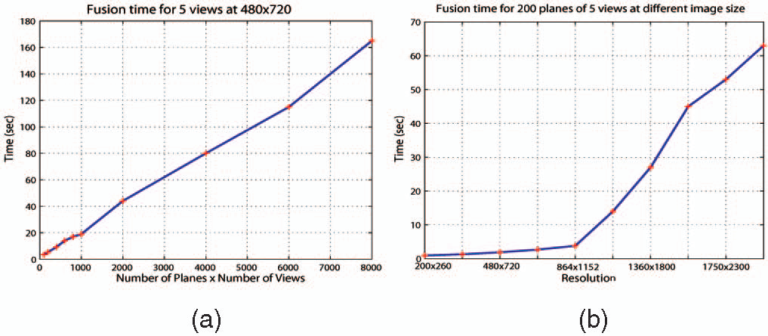
Results and discussions
(a) The execution time is linear with both the number of views and number of fusion planes
(b) Execution time with varying image resolution. As the resolution increases beyond the cache limit of the GPU, the performance drops

Slide 20
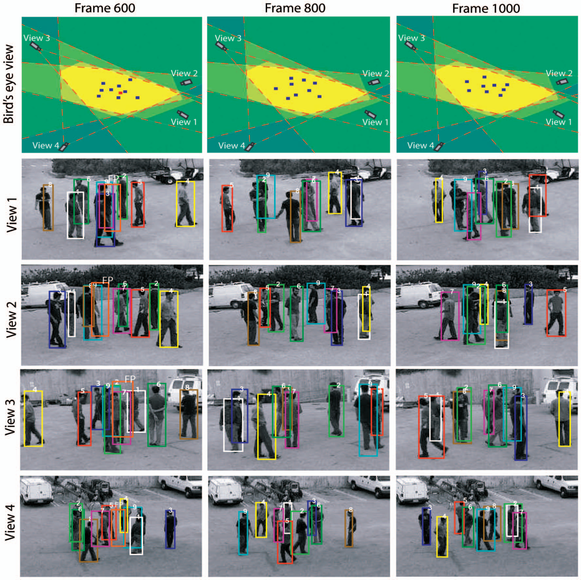
Parking lot data set(1)

Slide 21
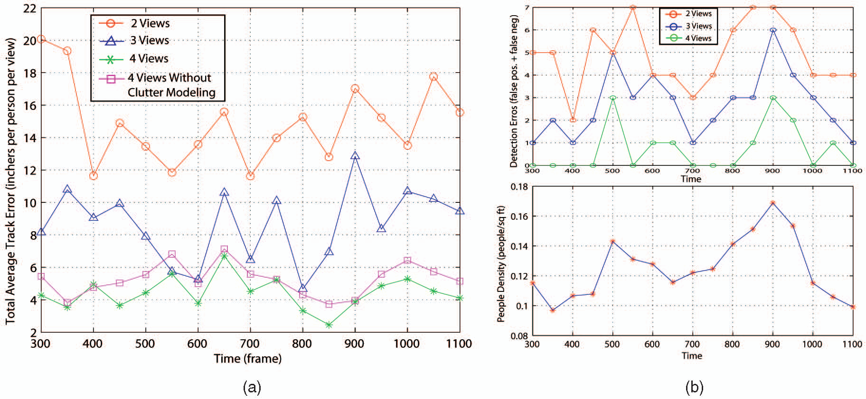
Parking lot data set(2)
(a) Total average track error of persons
(b) Plot on the top: the detection error (number of false positives + number false negative)
The bottom plot: the variation of the people density

Slide 22
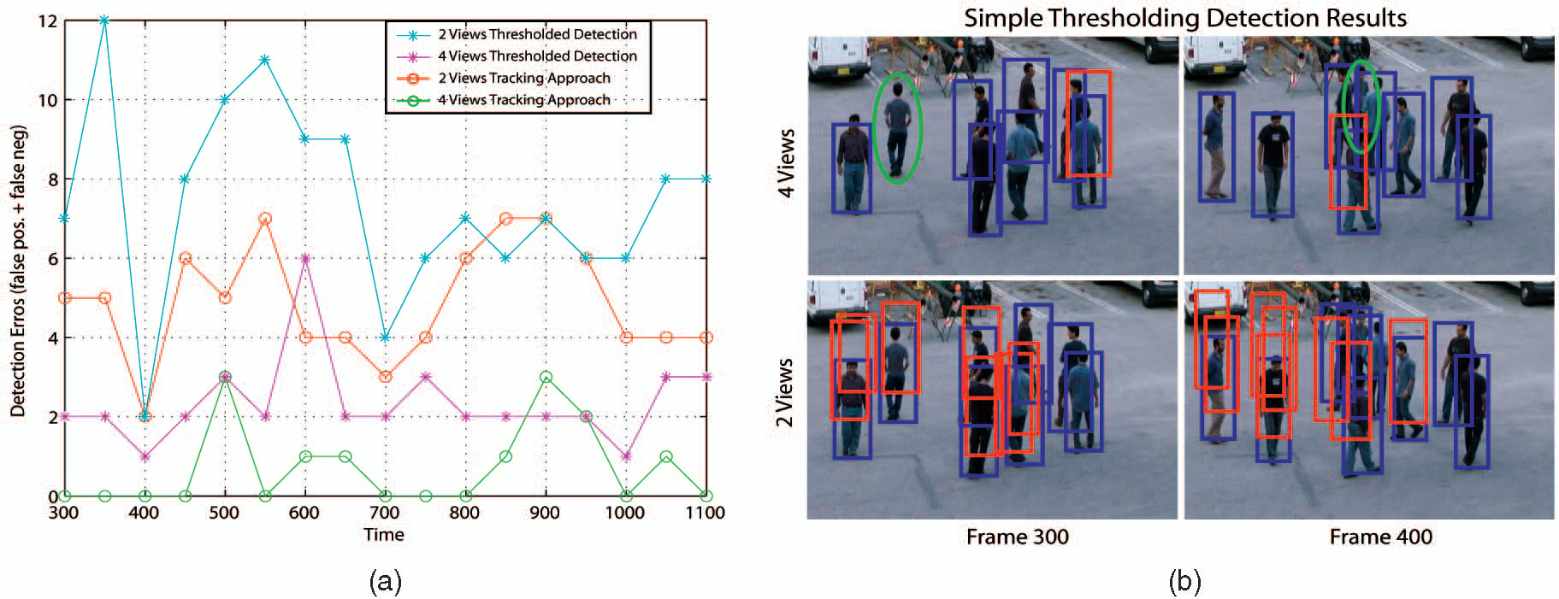
Parking lot data set(3)
(a) Detection error for utilizing a simple threshold of the occupancy likelihood data compared with trajectory segmentation-based approach.
(b) Detection results using a threshold-based approach.

Slide 23
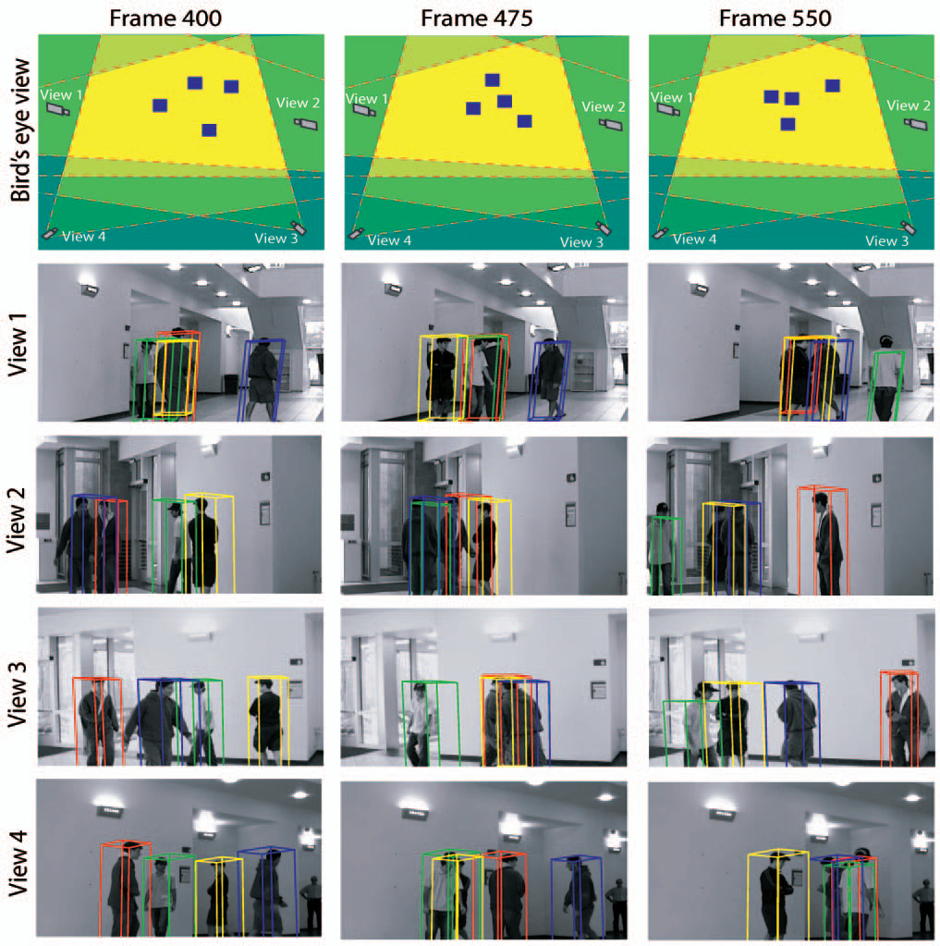
Indoor data set(1)

Slide 24
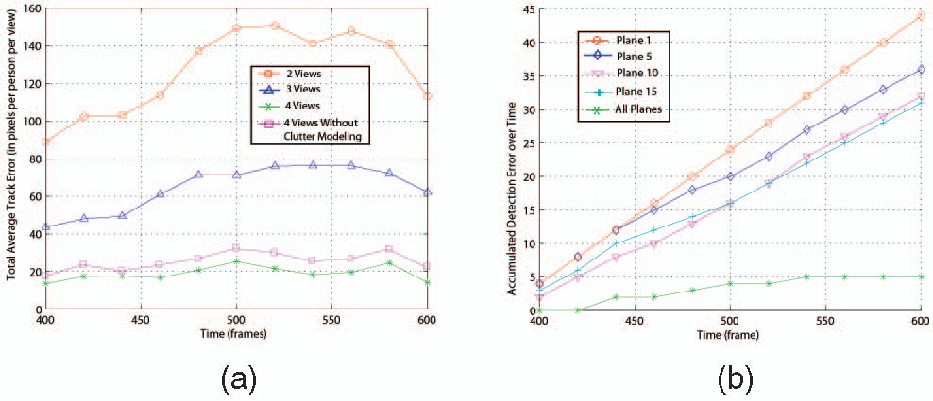
Indoor data set(2)
(a) Total average track error over time from the top center of the track bounding box to the manually marked head locations of people.
(b) The accumulated detection error (number of false positives + number of false negatives accumulated over time) for different individual planes

Slide 25
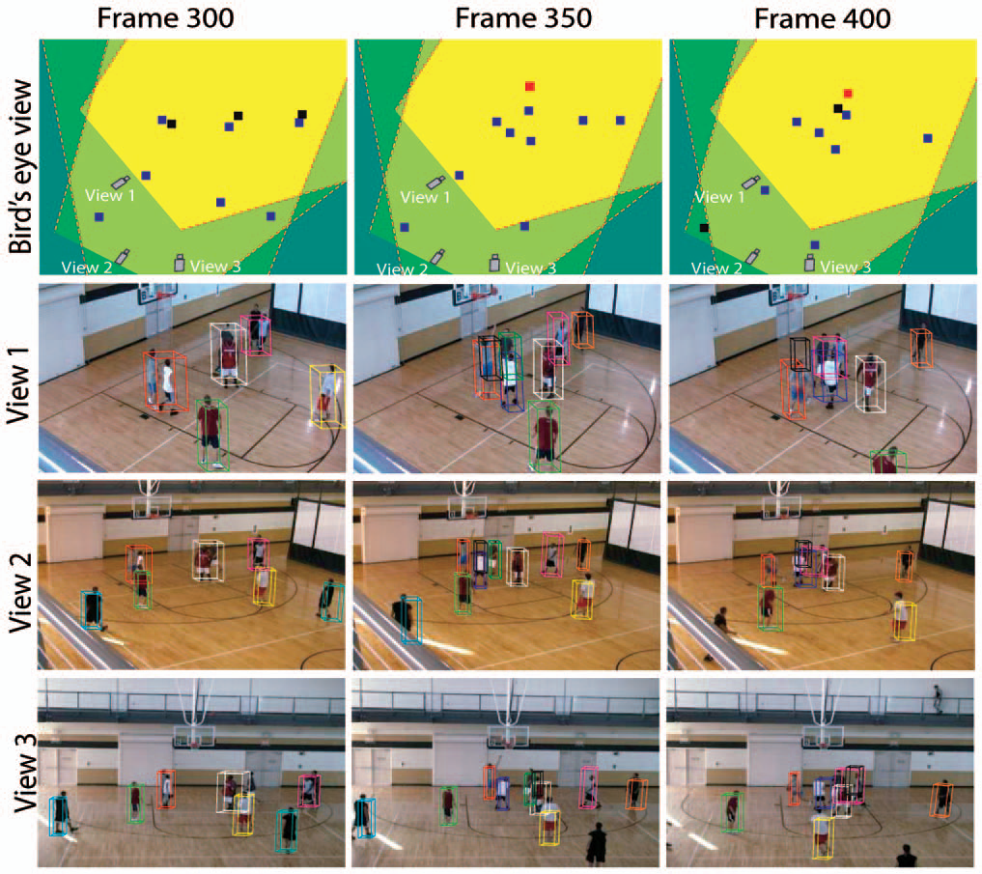
Basketball data set

Slide 26
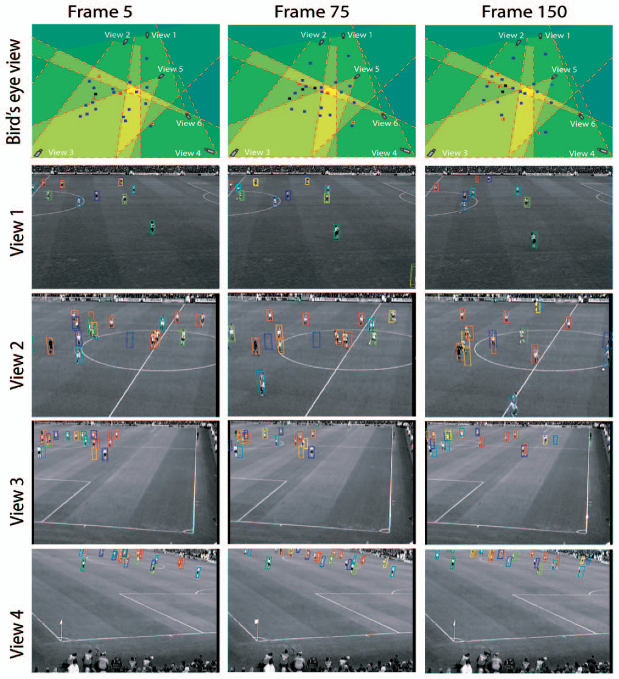
Soccer data set

Slide 27
Conclusions
To track multiple people in a complex environment
Resolving occlusions and localizing people on multiple scene planes
Using a planar homographic occupancy constraint
Segmentation of individual trajectories of the people
Combining foreground likelihood information from multiple views
Obtaining the global optimum of space-time scene occupancies over a window of frames

