Slide 1
Principal Axis-Based Correspondence between Multiple Cameras for People Tracking
Dongwook Seo
seodonguk@islab.ulsan.ac.kr
2012.04.07
Notes:
Hi!! I will present for ‘correspondence across structured multiple cameras for human tracking’.

Slide 2
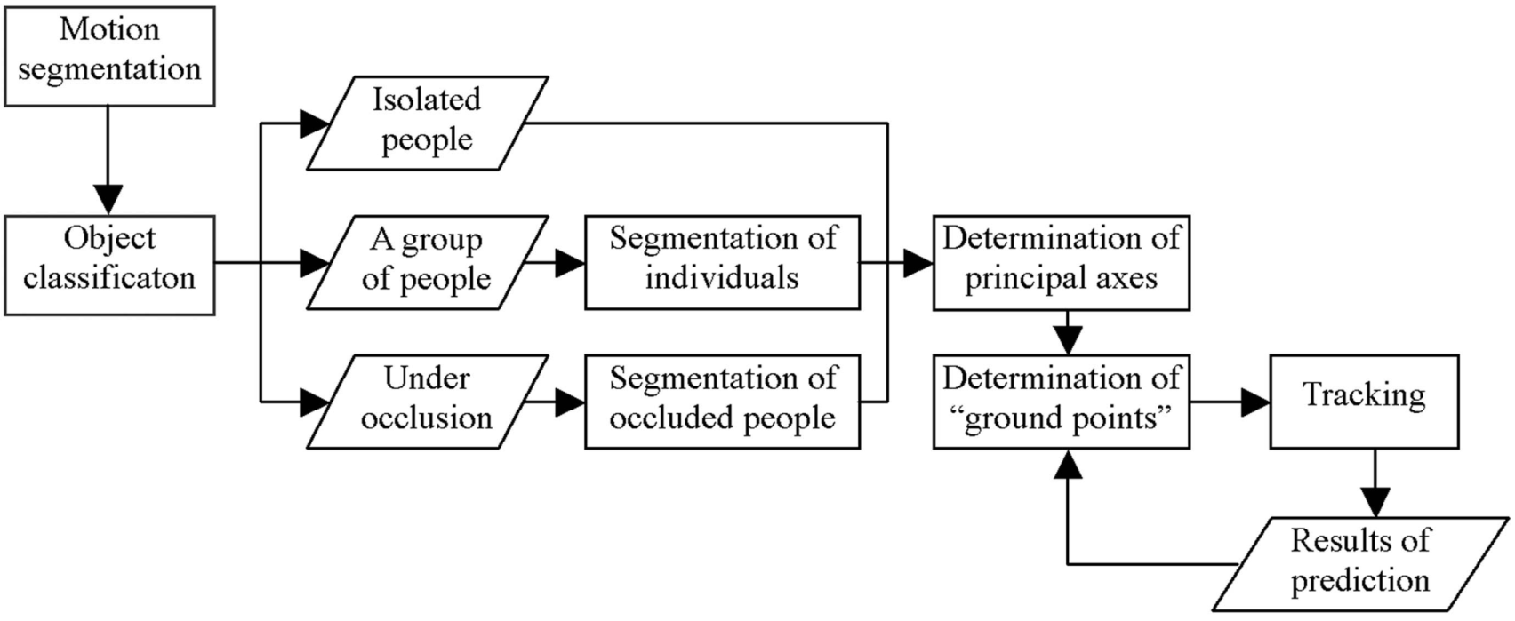
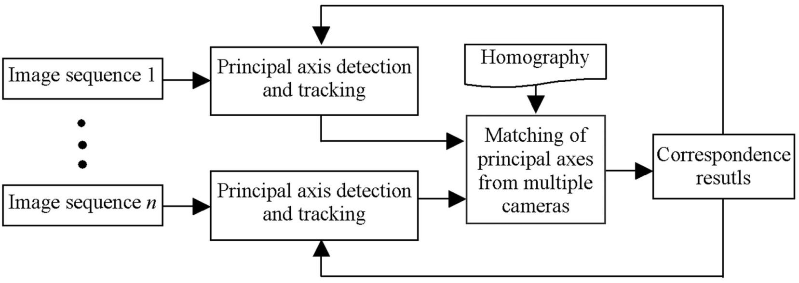
Overview

Slide 3
Detection of principal axes in a single camera
Motion segmentation and object classification
Using the vertical projection histogram to distinguish people from vehicles
- I(x,y): binary image
- height, width: the height and width of motion region
The spread of a vertical projection histogram

Slide 4
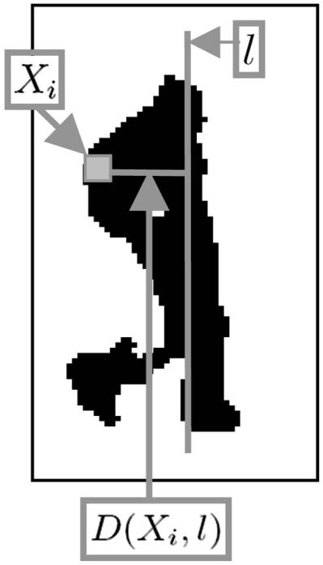
Detection of Principal Axes
Principal axis of an isolated person
Using the Least Median of Squares to determine the principal axis of an isolated person
$D\left(X_{i},l\right)$: the perpendicular distance between the ith foreground pixel $X_{i}$ and axis $l$

Slide 5
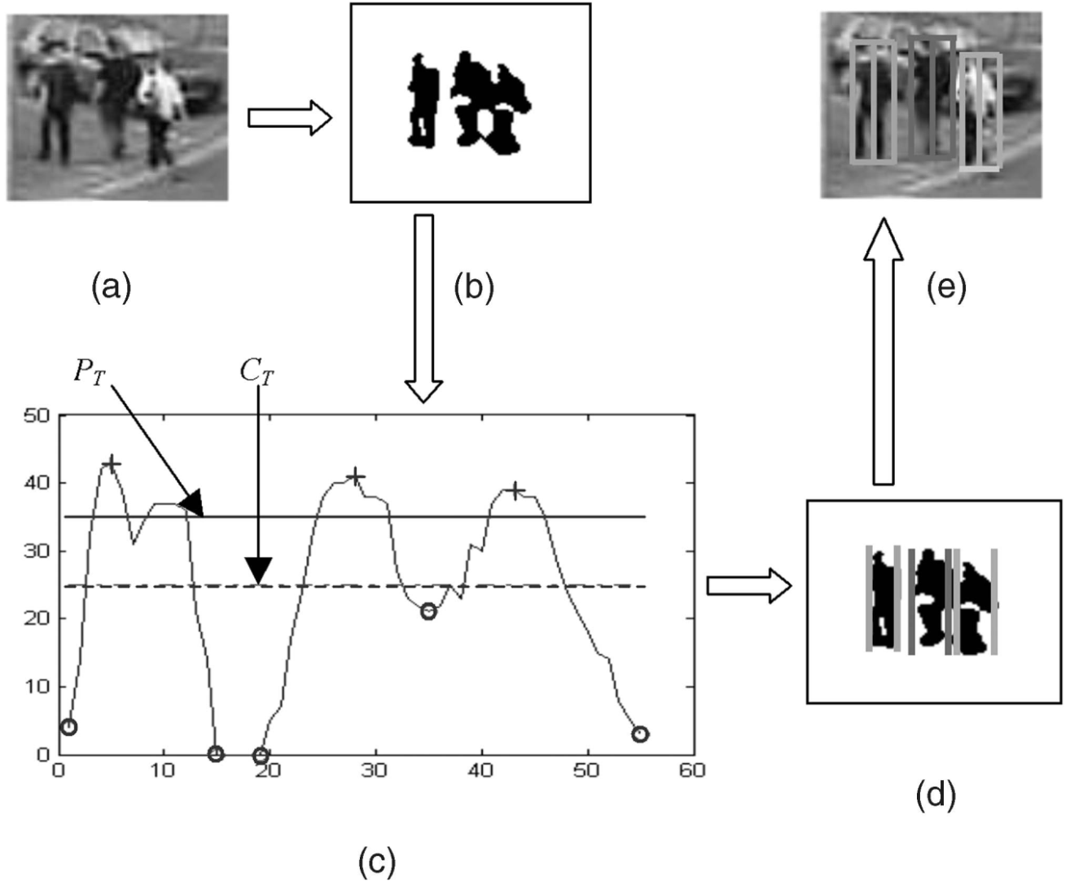
Detection of Principal Axes(Cont.)
Principal axes of people in group
input image
(b) Detected foreground region
(c) Vertical projection histogram
(d) segmented individuals
(e) Principal axes

Slide 6
Detection of Principal Axes(Cont.)
Principal axes of people under occlusion
Using the color template-based method to segment people
$M_{i}(X)$ : color model of object i consist of a color variable $C_{i}\left(X\right)$
$C_{i}(X)$ : the rgb color of each pixel X of object i
$P\left[M_{i}(X)\right]$ : the likelihood of object i being observed at pixel X

Slide 7
Tracking
The construction of correspondence relationships between “tracked objects” in previous frames and “detected objects” in the current frame
To track people using Kalman filter
$\left(x,y,v_{x},v_{y}\right)$: the state of a person
$\left(x,y\right)$: the position of a person in the image plane
$\left(v_{x},v_{y}\right)$: the velocity of a person
Using “ground-point” on the image plane for the position of individual

Slide 8
Correspondence between multiple cameras
Homography recovery
A homography is a 3 by 3 matrix H.
Consider a point $\left(x_{i},y_{i}\right)$ in one image and $\left(x_{i}^{′},y_{i}′\right)$ in another image

Slide 9
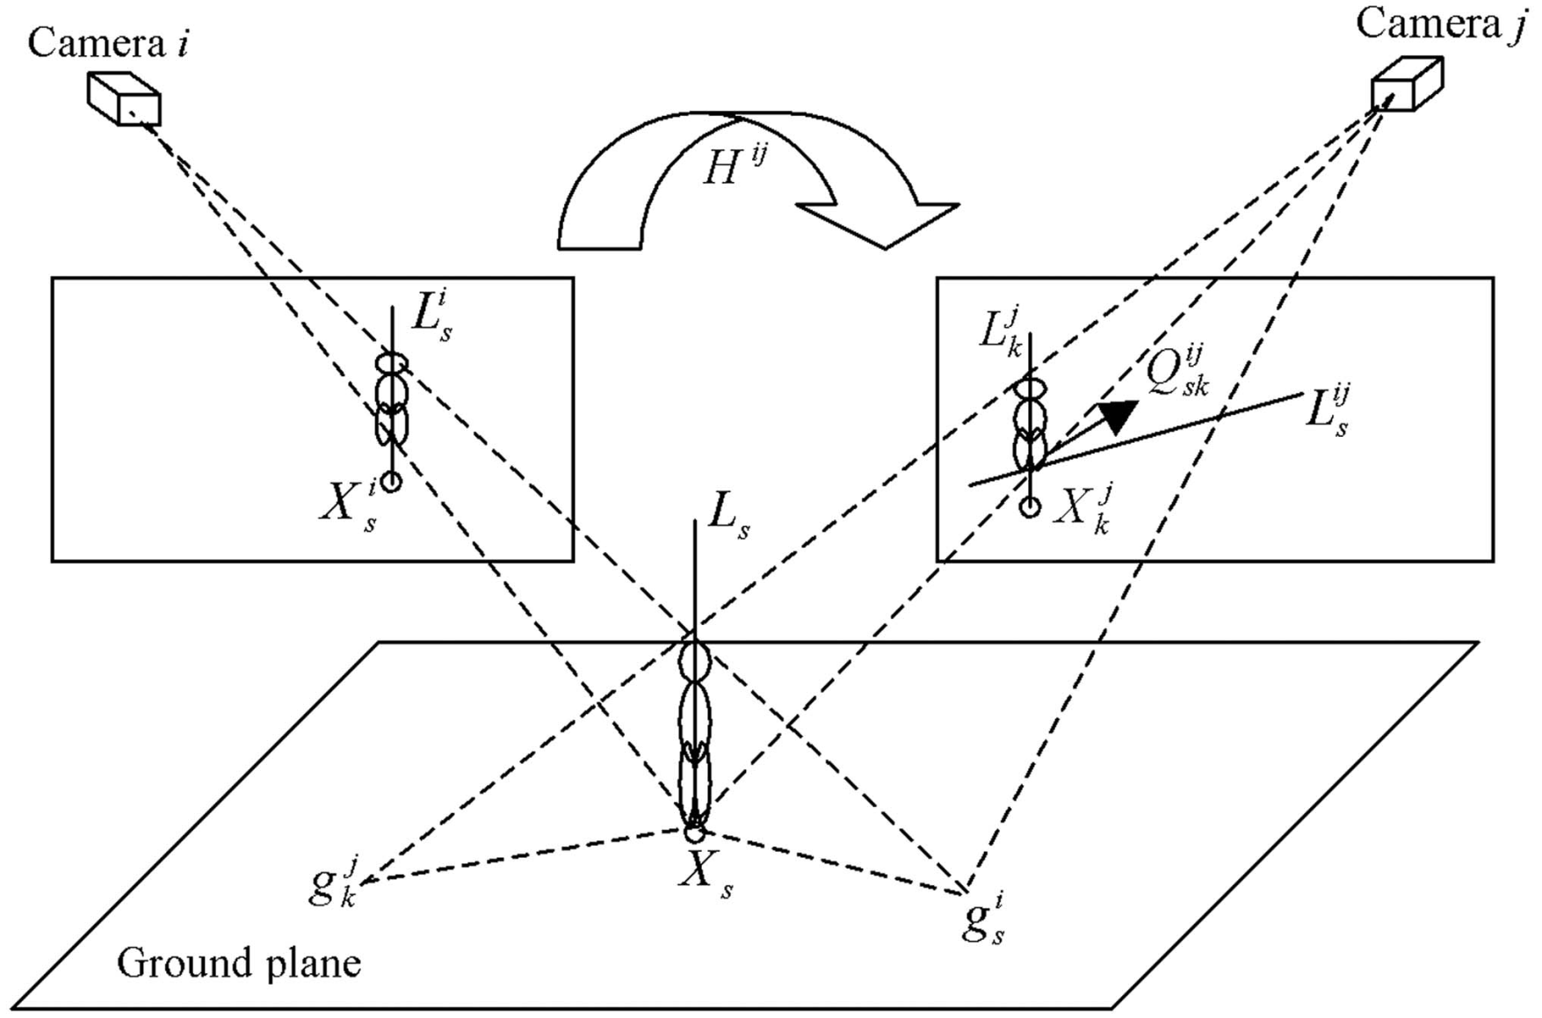
Correspondence between multiple cameras(Cont.)
Geometrical relationship and correspondence likelihood

Slide 10
Correspondence between multiple cameras(Cont.)
The function of correspondence likelihood
$Σ_{s}^{i}$: covariance matrixes (diagonal matrix-${\left(σ_{xs}^{i}\right)}^{2},{\left(σ_{ys}^{i}\right)}^{2}$)
$Σ_{k}^{j}$: covariance matrixes (diagonal matrix-${\left(σ_{xk}^{j}\right)}^{2},{\left(σ_{yk}^{i}\right)}^{2}$)
The correspondence distance ($D_{sk}^{ij}$) for principal axis pairs

Slide 11
Correspondence between multiple cameras(Cont.)
Correspondence between multiple cameras
Step1. A list($θ$) of all possible correspondence pairs of principal axes is created.
Step2. For each pair $\left\{m,n\right\}$ in the pair list $θ$, it is checked whether pair $\left\{m,n\right\}$ satisfies the constraint $D_{mn}^{ij}<D_{T}$
$D_{T}$: Threshold to classify true or false correspondence pairs
Step3. To find all possible pairing modes
$Θ=\left\{Θ_{k}=\left(L_{k_{1}}^{i},L_{k_{1}^{′}}^{j}\right),\left(L_{k_{2}}^{i},L_{k_{2}^{′}}^{j}\right),…,\left(L_{k_{l}}^{i},L_{k_{l}^{′}}^{j}\right)\right\}$, k: index of a paring mode
Step4. The minimum sum of correspondence distance
$λ=arg\min_{i}\left(\sum_{ω=1}^{l}{\left(D_{\left(k_{ω},k_{ω}^{′}\right)}^{\left(i,j\right)}\right)}\right)$
All principal axis pairs in pair mode $Θ_{λ}$ are the matched one.
Step5. The pairs in pair set $Θ_{λ}$ are labeled.

Slide 12
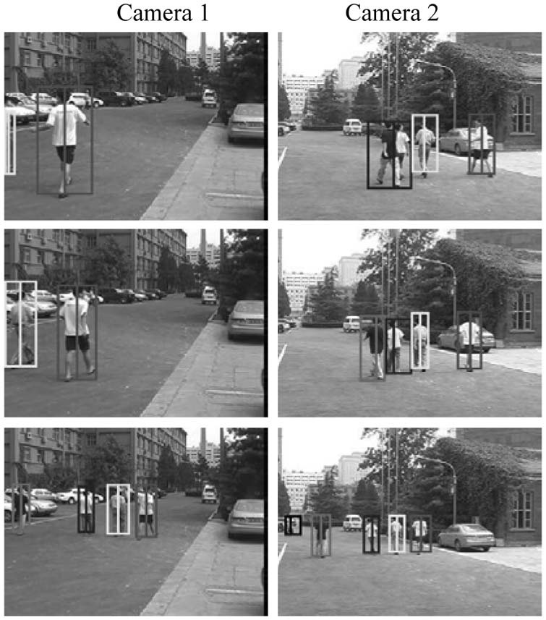
Experiments
Results on NLPR Database
Tracking and correspondence of multiple people with two cameras
# 3286
# 3297
# 3380

Slide 13
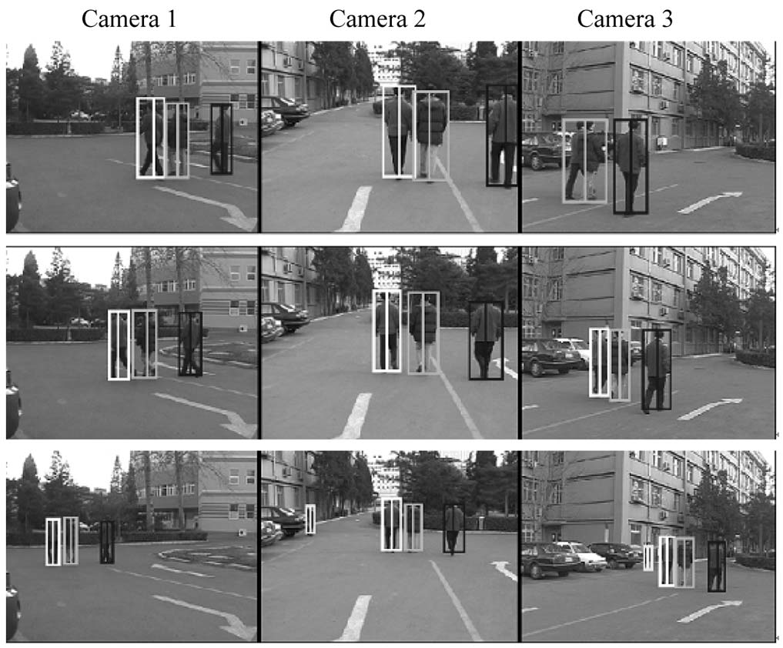
Experiments(Cont.)
Results on PETS2001 Database
Tracking and correspondence of multiple people with three cameras

Slide 14
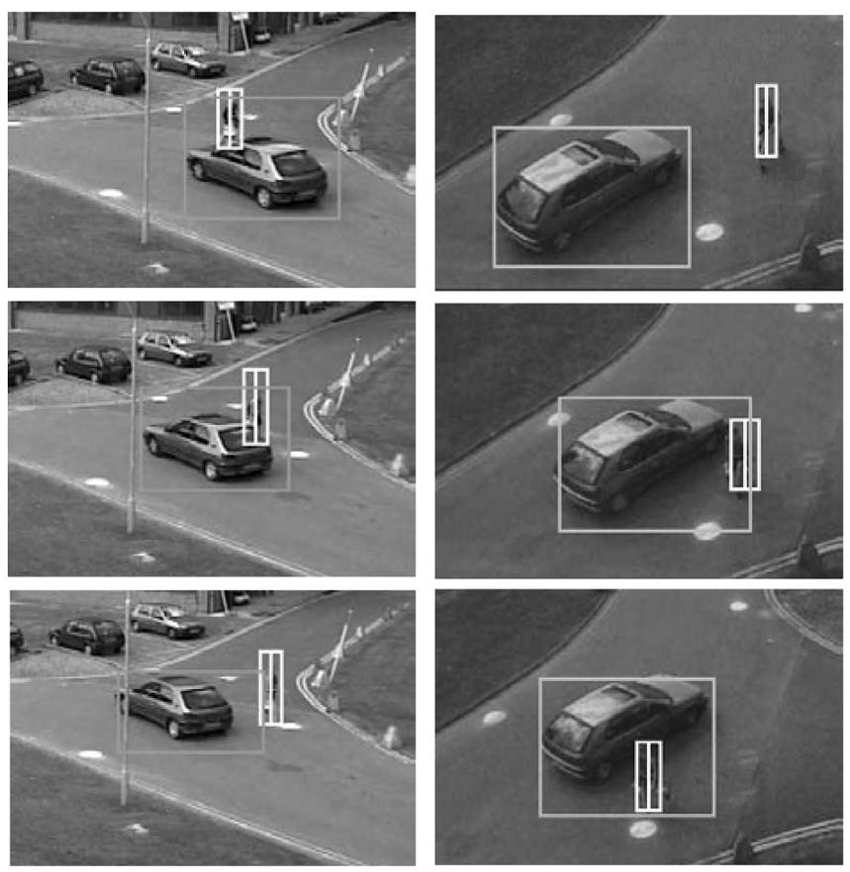
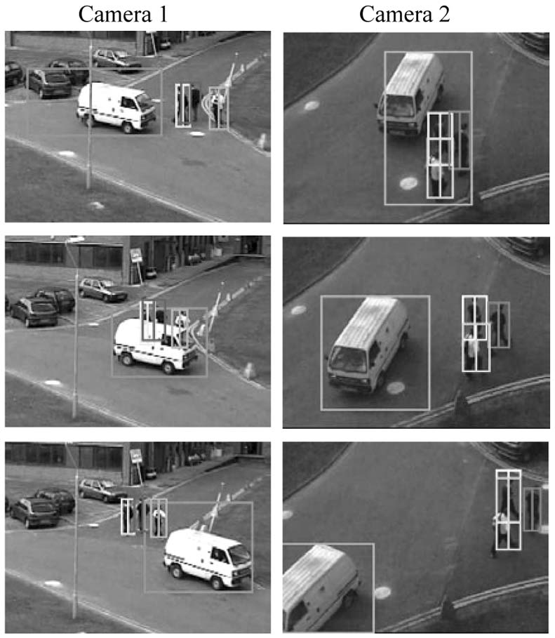
Experiments(Cont.)
Tracking and correspondence

Slide 15
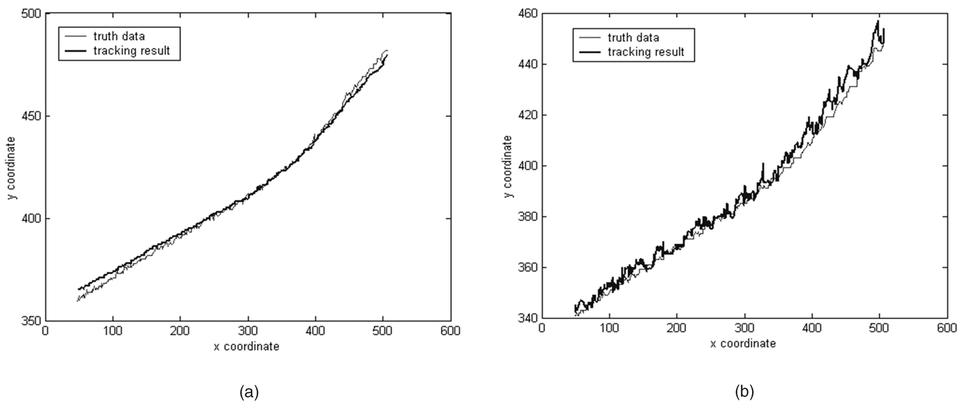
Experiments(Cont.)
Comparison
Trajectory acquired using this paper and true data. E=3.2
Centroid trajectory and true data. E=5.8

Slide 16
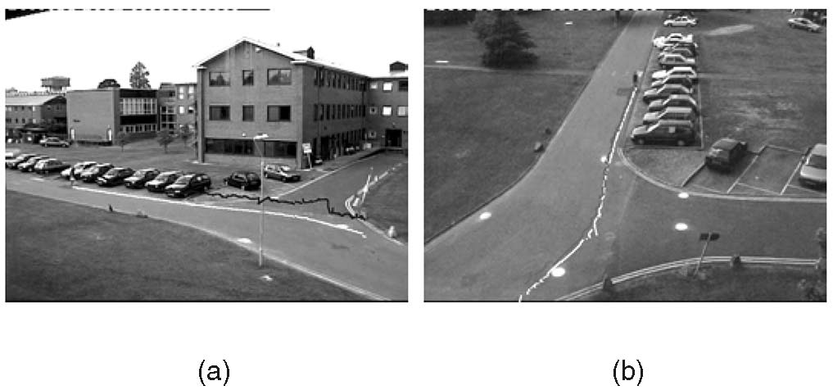
Experiments(Cont.)
Comparison
- The white ones are acquired using this paper, and the black ones are centroid trajectories.
Trajectories in view 1.
Trajectories in view 2.

Slide 17
Conclusions
For matching people across multiple cameras
Using principal axis-based method
Camera calibration is not needed and there is less sensitivity to errors in motion detection.
Future work
Applying this algorithms for non-planar ground surfaces

Slide 18
Thank you!!!

